Slide 1
Sound Chart
Meeting 2

Slide 2
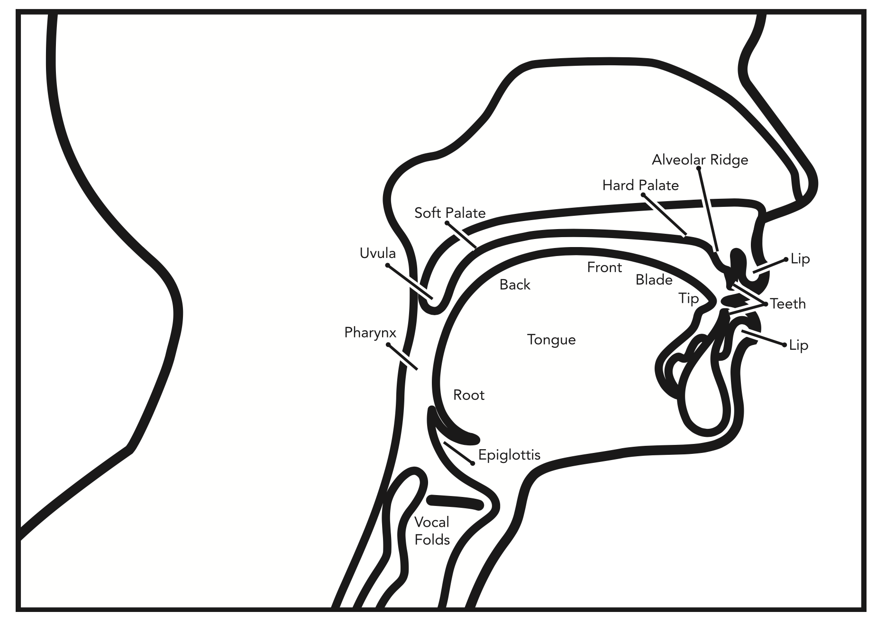
Place of articulation

Slide 3
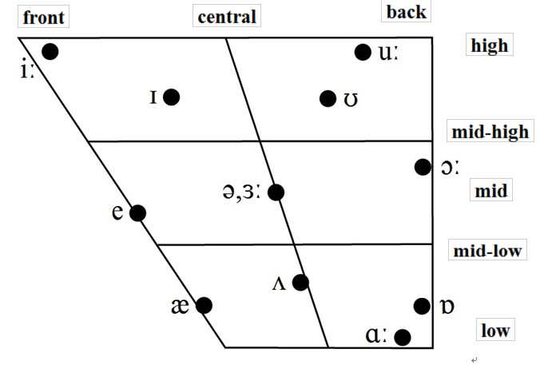
Vowels in English

Slide 4
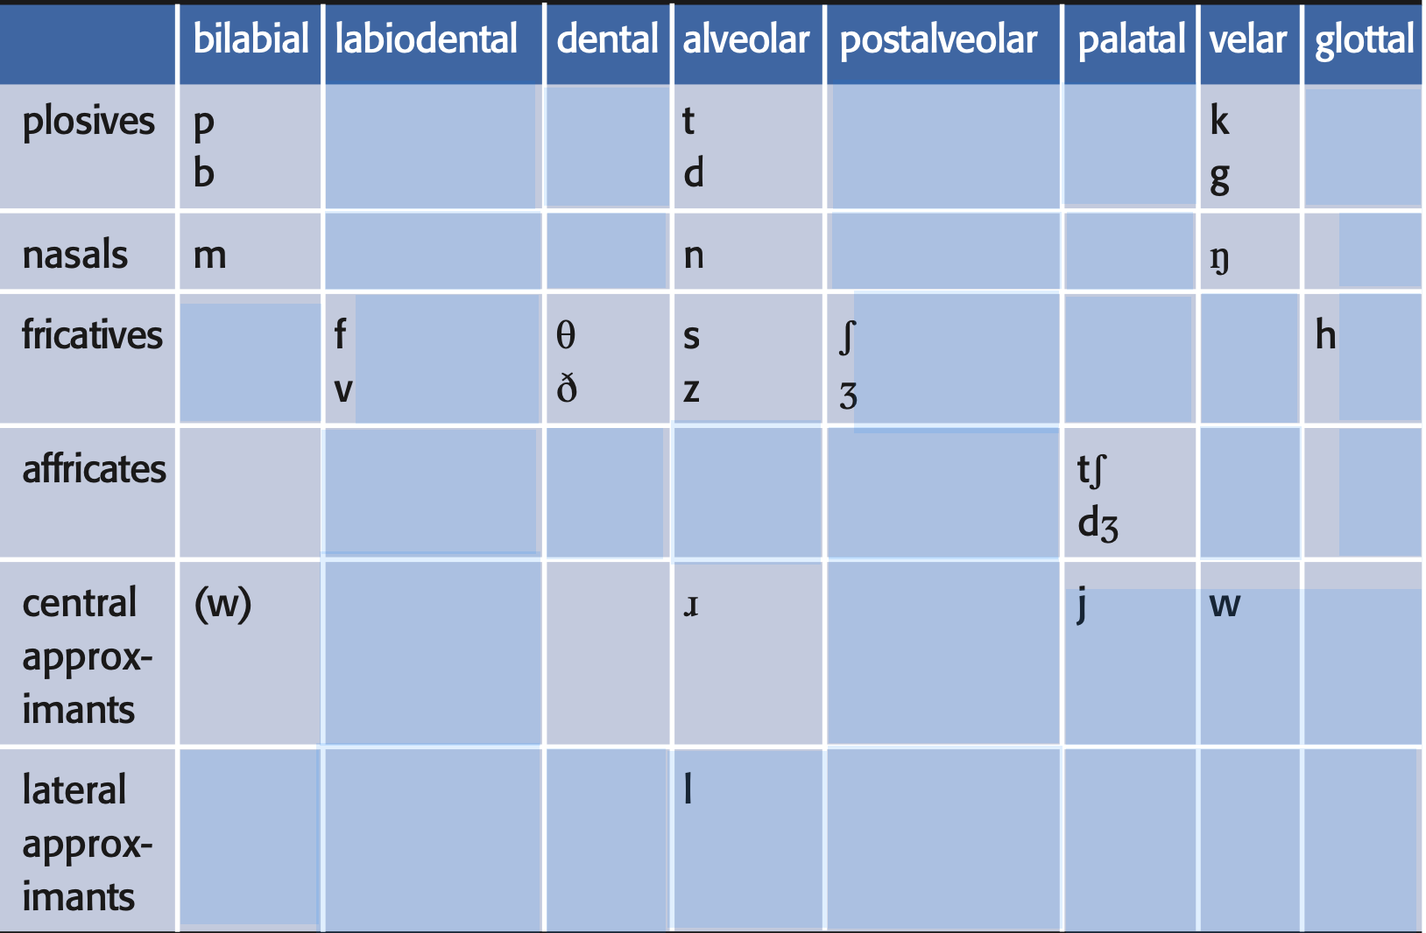
Consonants in English
Notes:
1) A fricative is a consonant produced by forcing air through a narrow channel made by placing two articulators close together.[
2) a lateral approximant (less commonly, 'lateral resonant') is a consonant whose articulation involves a central occlusion with an opening on one or both sides of the tongue that is not close enough to produce friction
3) Affricates begin as plosives and end as fricatives.

Slide 5
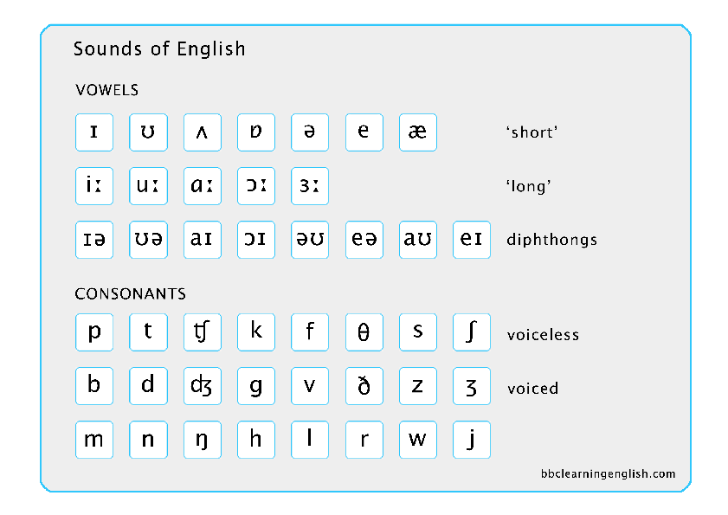

Slide 6
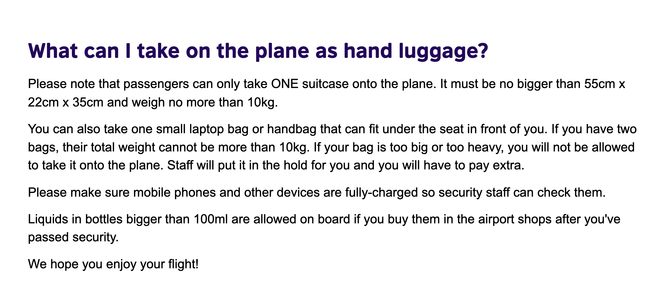
Use your dictionary to find the phonetic symbols of the text!

