Slide 1
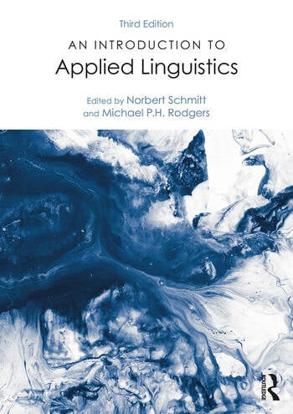
Grammar
De Carrico, J., & Larsen-Freeman, D. (2002). Grammar. In N. Schmitt (Ed.), An Introduction to Applied Linguistics (pp. 19-34). Arnold.
Meeting 3

Slide 2
Outline
The authors describe the description of the grammar from a general overview to specific pedagogical contexts
There are three main points:
Rules of grammar
Views on formal and functional grammar
Second language acquisition (SLA) grammar practical application

Slide 3
Rules of grammar: Prescriptive and Descriptive grammar
Defining grammar can be problematic. How do you define grammar?
About do’s and don’ts rules / correct on incorrect forms/ the use of auxiliaries (would/might) subject verb agreement, plural forms.
Grammar can be divided into two forms : Prescriptive and Descriptive.
Prescriptive sees distinction between correct and incorrect forms, standard varieties, or often studies relevant to standard vs correct or good English and the non-standard as incorrect or bad English.
Descriptive study studies language structure such as syntax, morphology, phonology, semantics and lexis --- concerning on vocabulary

Slide 4
Standard and non-standard Grammar
Grammar behave in a predictable and consistent way.
For example:
Would have tried or might be trying; but not
*Have would tried or *be might trying
Subject verb agreement (suffix –s)
It means that grammar falls under well established categories of acceptable form which is referred to a Standard English.
In terms of spoken and written forms, it commonly applies standard forms, but some include certain non-standard, or informal forms.

Slide 5
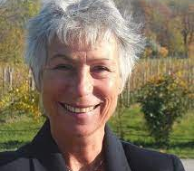
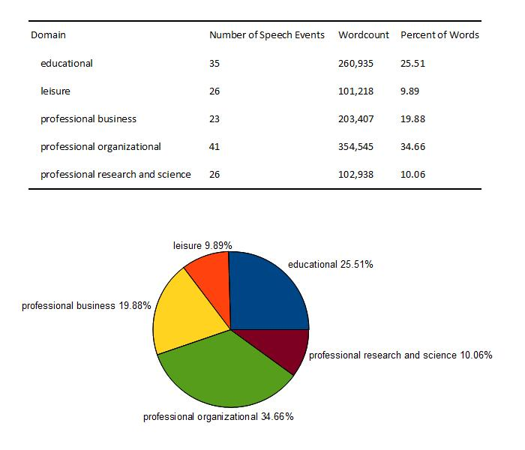
Spoken and Written Grammar
Written and spoken grammar have been the focus of Corpus studies -- involving the investigation of corpora, i.e. collections of (pieces of) texts that have been gathered according to specific criteria and are generally analyzed automatically.
For example : VOICE
Barbara Seidlhofer from the Helsinsky University

Slide 6
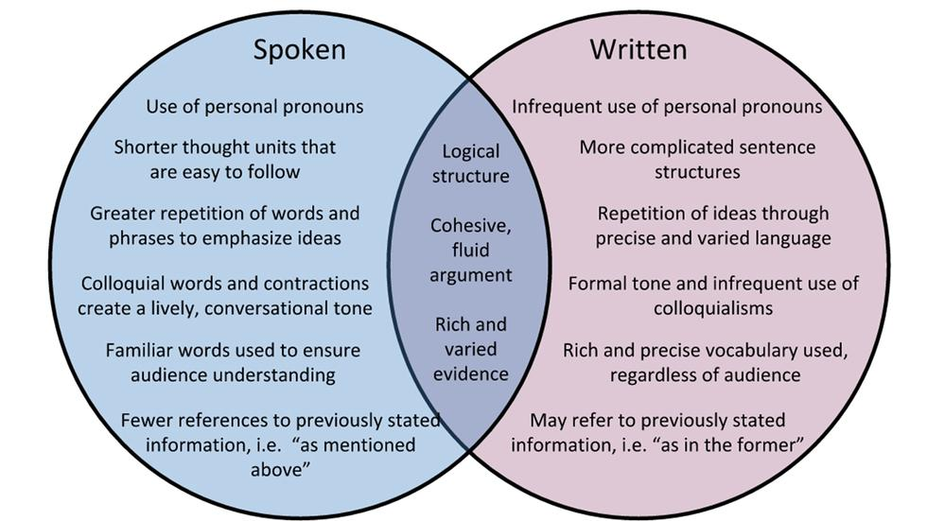
Carter and McCarthy (1995) argue that differences between spoken and written grammar are especially important for pedagogical grammars since descriptions, that rest on written modes or on restricted genres and registers of spoken language, are likely to omit common features of everyday informal grammar and usage.

Slide 7
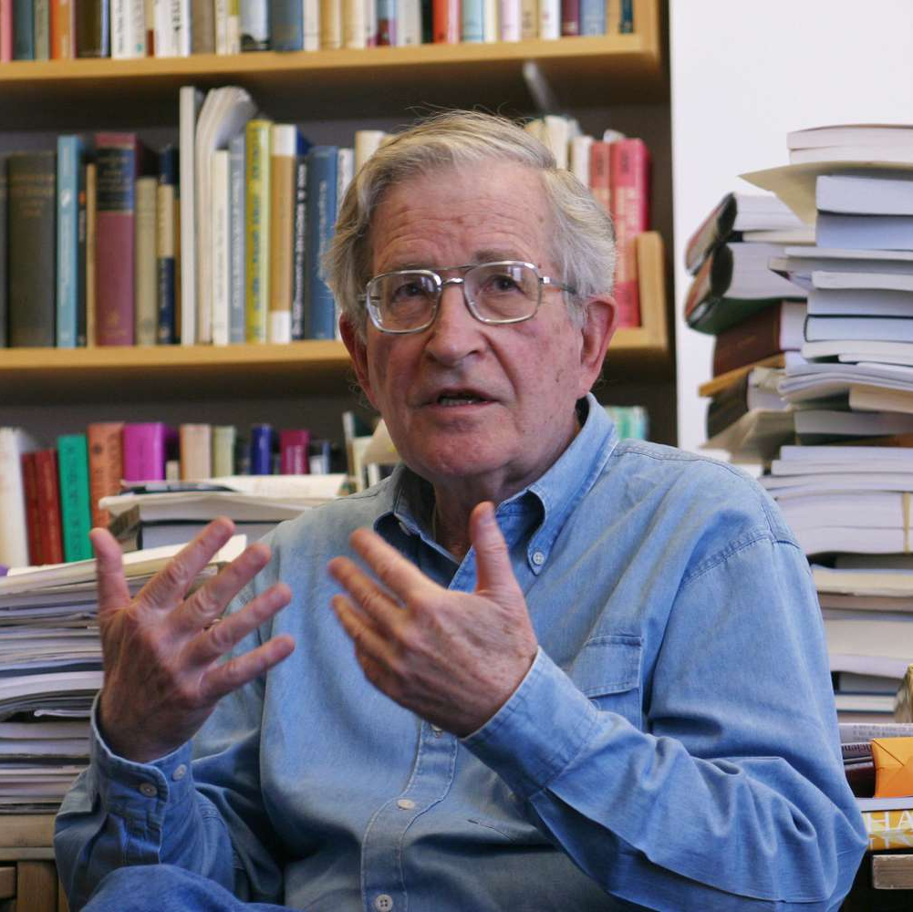
Formal Grammar
Formal grammar (best known as Traditional grammar) highlights forms and operation within structures and sentences.
One influential formal grammar is Generative-Transformational Grammar by Chomsky (1957, 1965)
The focus of attention is based on Syntax and Morphology through a speakers’ mental grammar --- a set of abstract rules for generating grammatical sentence.
Mental grammar or unconscious knowledge of systems of rules is known as “Competence” --- the ability in filling grammatical categories (e.g., nouns, verb, adjective etc) in corresponding grammatical slots in a syntactic form of a sentence.
Massachusetts Institute of Technology

Slide 8
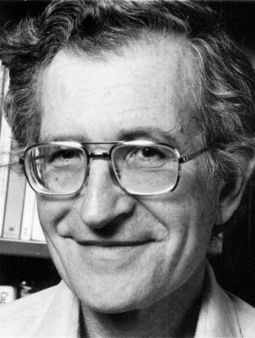
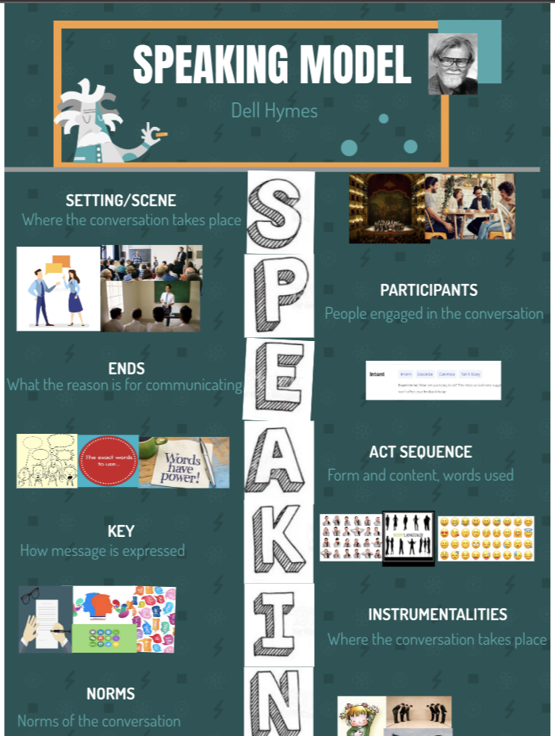
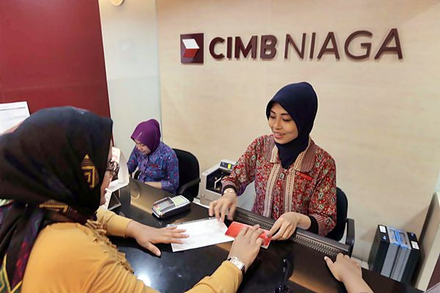
Functional grammar: Communicative competence
How to use language and functions in sociolinguistic and pragmatic discourse emphasizing on meaning communication, including the appropriate use of language in particular social context
Proposed by Dell Hymes’ (1972) communicative competence with “SPEAKING” model.
Communicative Competence as capabilities of a person, and a competence which is dependent upon both tacit knowledge and ability for use. In this sense, a Communicative Competence includes not only knowledge of the rules in Chomsy’s (1957, 1965) theory (grammatical competence) but also the ability to use language in various contexts (pragmatic competence).
examples

Slide 9
Combining studies : Constructive Theories
Various areas of applied linguistic studies based on Generative Transformational Grammar and Communicative Competence.
Differentiation between structural syllabus vs national syllabus in ESL/EFL contexts.
Structural syllabus focuses on structural categories such as adjectives, nouns and noun phrases, verbs and verb phrases, verb tenses and aspects, and clause and sentence types.
National syllabus deals with functional terms such as speech acts of requesting, offering and so on.
Newer linguistic theories emphasize a combination of forms and meanings which is known as cognitive grammar proposed by Celce-murcia & Larsen Freeman (1995) viewing formal or functional approach based on three levels : (morpho)syntax, semantics and pragmatics.
The area covered in pedagogical grammar tends to be narrowly focused on formal and functional grammars as well as corpus linguistics, discourse analysis and pragmatics. It seems to imply that applied linguists must be paid attention to students that they not only can produce grammatical structures accurately, but must be able to use them meaningfully and appropriately.

Slide 10
Strategic competence
by Celce Murcia

Slide 11
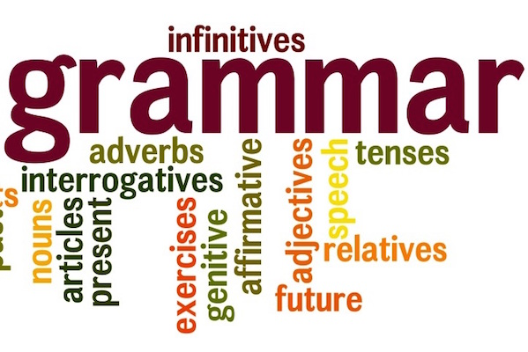
SLA Grammatical Practical Applications
Learning grammar was thought to take place through a verbal habit formation.
Later on, teachers conducted pattern practices drills of various types including repetition, questions, transformation (e.g., active to passive), and integrating between students’ L1 and the target language.
Teachers give students written grammatical practices to generate novel sentences.
Krashen’s (1983) theory mentioned that learning grammar is best when the students are subconscious through the engaging of understanding the meaning to which the language they were introduced.
SLA grammatical learning include naturalistic and classroom situations.
SLA studies suggest that isolated grammar should not be employed in learning a second language. This is because Learners will be able to complete their exercises satisfactorily when their attention is focused on the grammar, but when their attention is paid to more communicative interaction, their grammar will be forgotten.

Slide 12
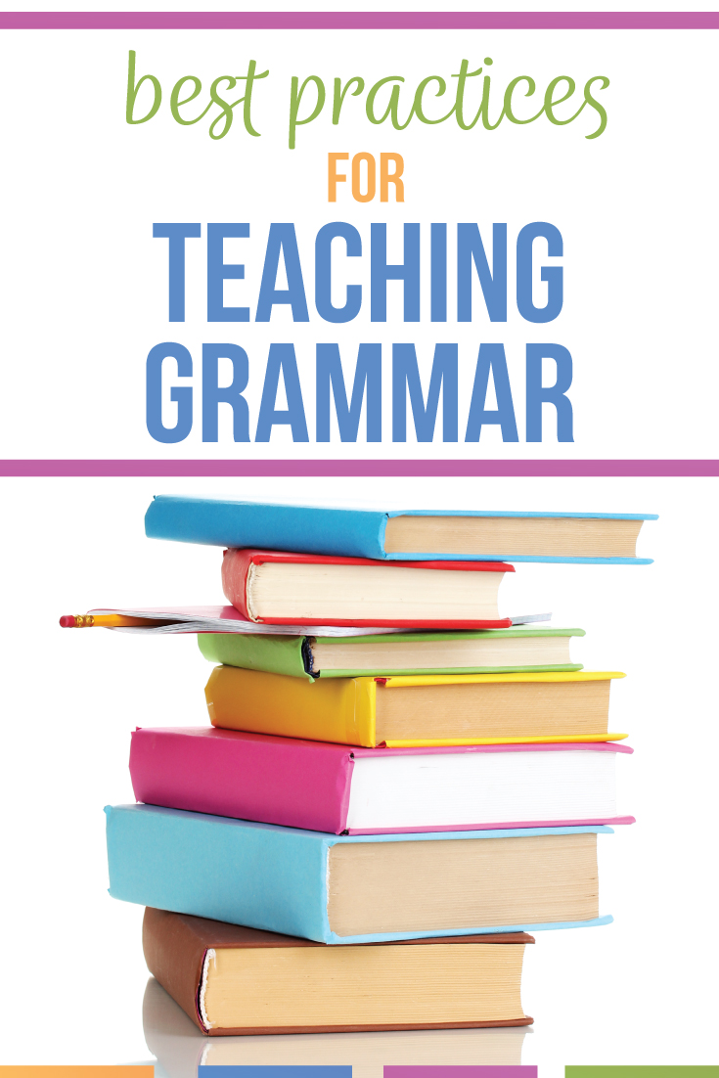
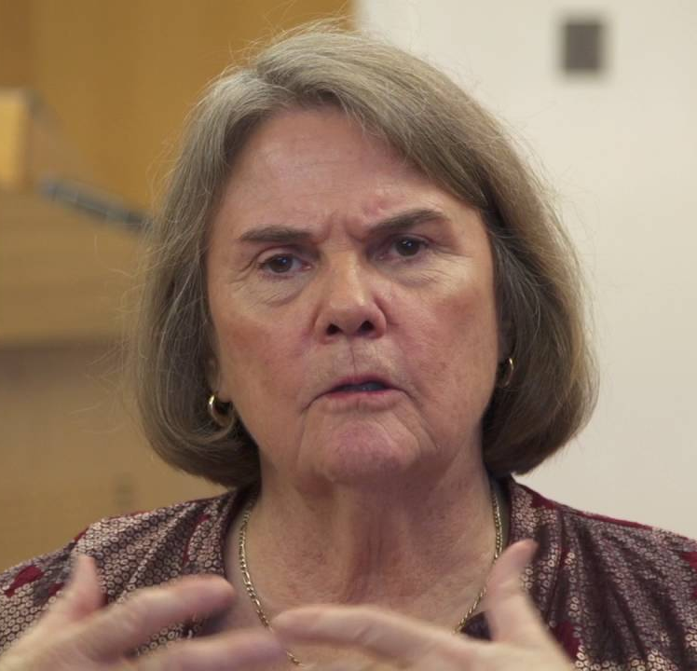
Teaching Grammar
Larsen-Freeman’s (1995) three approaches in teaching grammar :
Guided participation
Peer interaction
Grammaring

Slide 13
Guided Participation
Guided participation is when the teacher carefully leads students to become aware that they did have before neither an inductive --- students are provided with texts and examples first. --- nor a deductive process --- a more traditional style of teaching in that the grammatical structures or rules are dictated to the students first .
In this type, the teacher and students collaborate to produce a co-constructed grammar explanation.

Slide 14
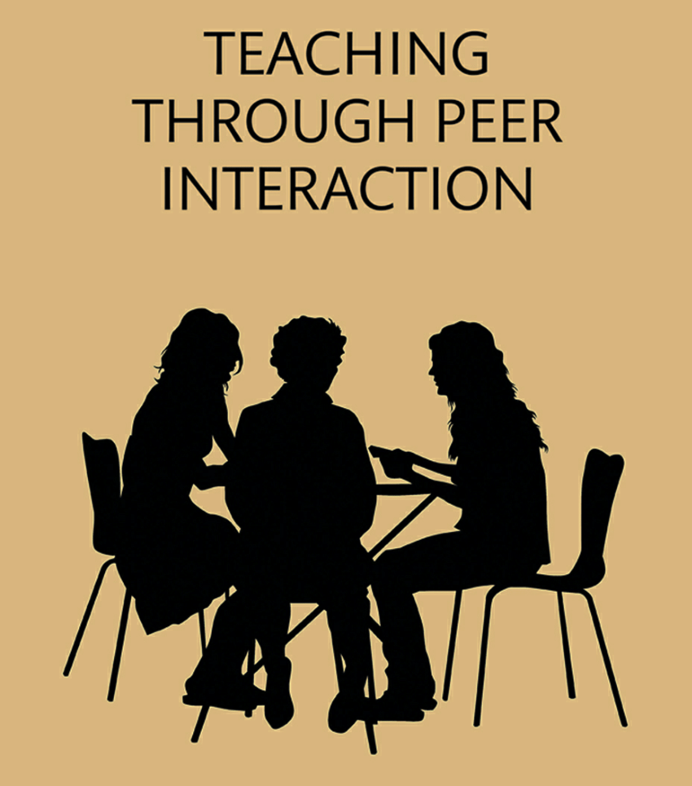
Peer Interaction
Peer interaction has been used effectively in promoting noticing through applying specific consciousness-raising tasks. In this task, the students are given data, such as a set of grammatical and ungrammatical sentences, and are encourages discovering a grammatical generalization for themselves.

Slide 15
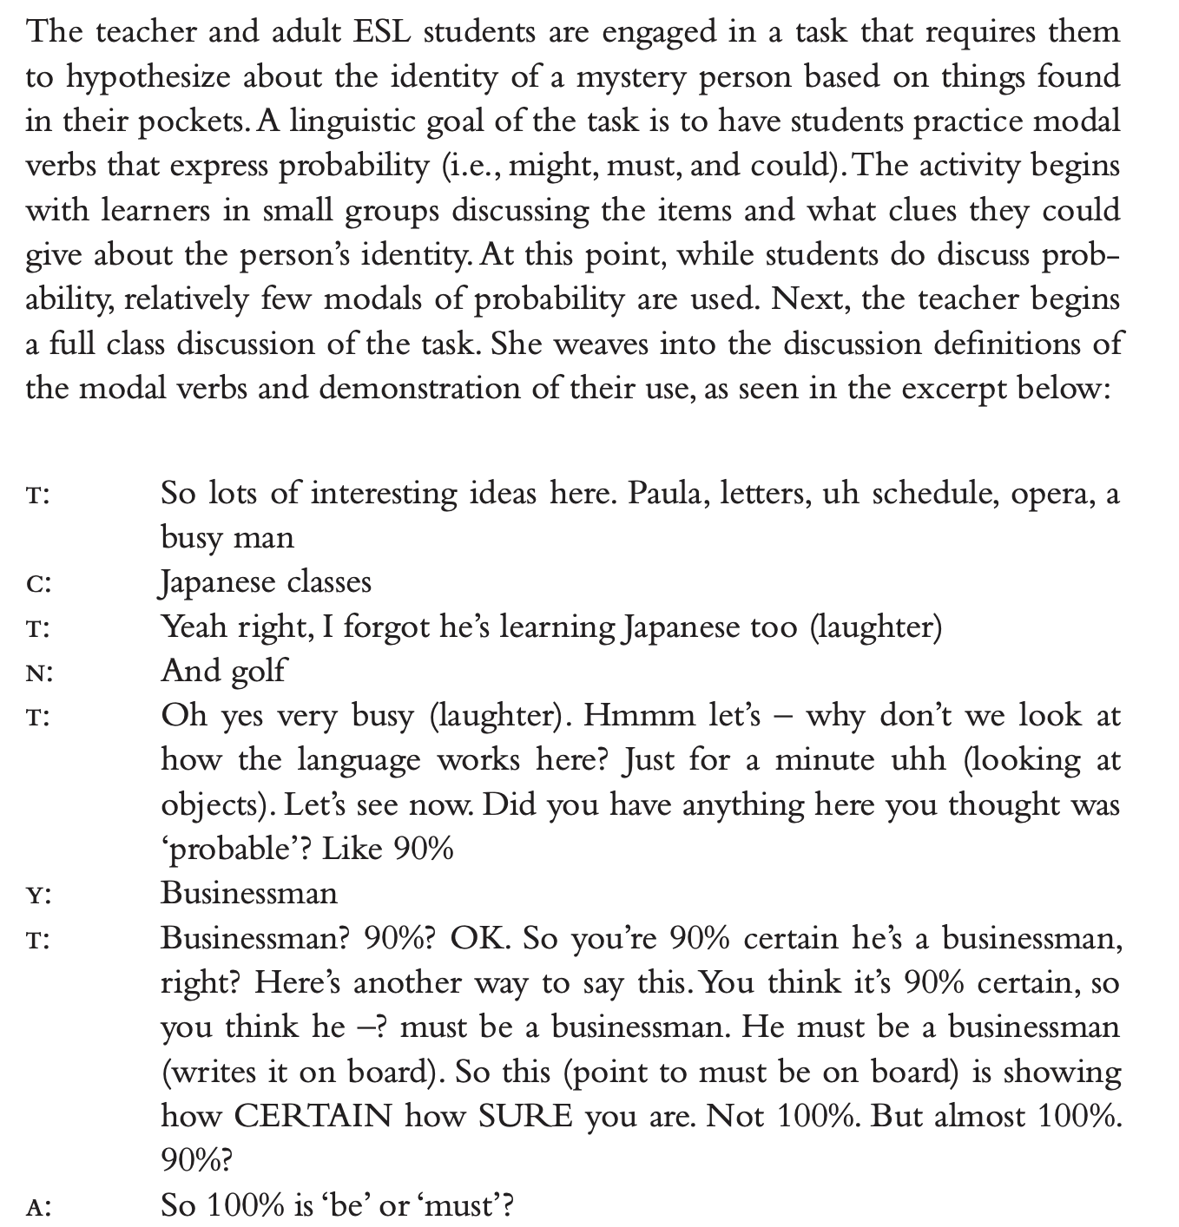
Peer interaction teaching example

Slide 16
Grammaring
This approach refers to engage students in communicative situation, so they are able to use certain structures completely.

Slide 17
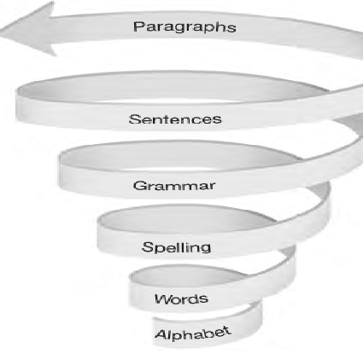
Challenges in learning grammar
Difficulties in understanding meaning : practicing associating certain phrasal verbs with physical actions (Stand up, Turn on the light, Sit down,etc.).
Difficulties in use : employing “making a choice”
For example:
asking students to role-play a situation that calls for advice to be given to a supervisor versus to a friend invites those students to select the appropriate form of modal or other structure with which to offer such advice
Feedback from the teachers is essential like a spiral syllabus

Slide 18
English teachers must be a facilitator
Teaching structure
focuses on teaching specific language structures or patterns that will be useful for ELLs. Including sentence patterns, or other linguistic elements.
Making Sense of Decontextualized Academic Language
teachers help learners make sense of this language even when it's presented without a specific context.
Contents and Linguistic Objectives Provision
Students engage with the actual material of academic content
language-related goals involving improving language skills, such as vocabulary, grammar, and communication.

Slide 19
Any questions

