Slide 1
What speakers know about sentence meaning
Truth
Entailment and Related Notions
Ambiguity
Meeting 3

Slide 2
Aims
We are going to discuss linguistic knowledge. Hence you can determine whether a sentence is true or false.
A sentence may imply the truth or falseness of another.
A sentence has multiple meanings.

Slide 3
Truth
Examining semantic rules to disclose the meaning of a sentence from the meanings of its words and the way in which they combine syntactically.
Truth-conditional semantics
It takes speakers’ knowledge of truth conditions as basic.
Compositional semantics
It calculates the truth value of a sentence by composing, or putting together, the meanings of smaller units.

Slide 4
True of false sentences
All midwife are female .
All kings are female.
All bachelors are married.
India is now the world's most populous nation with 1.486 billion people, passing China in April according to projections by the United Nations. And it's still growing.
→ True
→ False
→ False
→ True

Slide 5
Felix Viktor Presents Indonesia's First Gold at the World Swimming Championships.
He learned how to swim beautifully.
Sule
He did not learn how to swim.

Slide 6
Knowing true or false because of its meaning
Copper conducts electricity

Slide 7
Jakarta – Bandung in 40 minutes?

Slide 8
For most sentences it does not make sense to say that they are always true or always false.
Their truth is guaranteed solely by the meaning of their parts and they put together.
Tautologies or Analytic
“A person who is single is not married.”
Some sentences are always false.
Contradiction
“Circles are square.”

Slide 9
Entailment and Related Notions
The speaker is addressing someone who has mentioned his/her name. The speaker acknowledges that the person has provided some basic information about him/herself, such as being a bachelor, a solicitor (a lawyer), a Freemason (a member of a secretive fraternal organization), and having asthma (a medical condition that affects the breathing).
However, despite this information, the speaker emphasizes that he/she doesn’t have any further knowledge or recognition of the person beyond these surface-level facts.
Essentially, the speaker is saying that the person has given some details about him/herself, but these details don't reveal anything substantial or meaningful about who he/she is as a person. The speaker is highlighting the limited knowledge about the individual.
“You mentioned your name as if I should recognize it, but beyond the obvious facts that you are a bachelor, a solicitor, a freemason, and an asthmatic, I know nothing whatever about you. “
SIR ARTHUR CONAN DOYLE, “The Norwood Builder,” in The Memoirs of Sherlock Holmes, 1894

Slide 10
One sentence entails another if whenever the first sentence is true the second one is also true in all conceivable circumstances
It generally goes only in one direction
Felix Viktor Presents Indonesia's First Gold at the World Swimming Championships.
Felix Viktor swims beautifully.
entails
Negation

Slide 11
Felix Viktor does not Presents Indonesia's First Gold at the World Swimming Championships.
Felix Viktor does not swim beautifully.
entails

Slide 12
Synonyms or paraphrase
Two sentences are synonymous
if they entail each other.
Ferli put off the meeting.
Ferli postponed the meeting.

Slide 13
Contradictory sentences
Two sentences are contradictory if, whenever one is true,
The other is false, or equivalently, there is no situation in which
They are both true or both false.
Example:
Pak Eko is alive and Pak Eko is dead.
Two sentences are contradictory if, one entails the negation of the other.
Example:
Pak Eko is alive entails the negation of Pak Eko is dead.

Slide 14
Ambiguity
“Let’s pass gas”
Seen on a sign in the lunchroom of
An electric utility company
When words, phrases, or sentence have more than one meaning

Slide 15
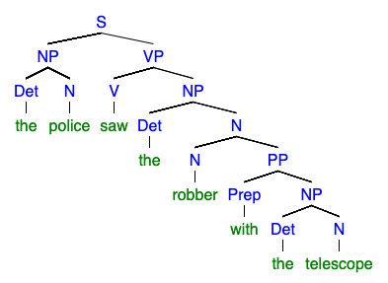
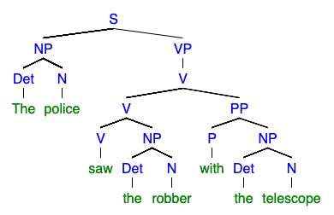
“The police saw the robber with the telescope.”
The police saw the robber with the telescope.
The police saw the robber by using a telescope.
PP modifies noun
PP modifies verb

Slide 16
Thank you

