Slide 1
When Compositional Goes Awry
Anomaly
Metaphor
Idioms
Meeting 4

Slide 2
“A loose sally of the mind; an irregular undigested piece; not a regular and orderly composition” Samuel Johnson (1709-1784)
The meaning is not always obvious even to a native speaker.
Meanings may require some imagination or special knowledge to be apprehended.
Problems of compositionality words or with the semantic rules.
We may experience difficulties to understand the meaning of the entire sentence as it contains a meaningless word.

Slide 3
“Don’t tell me of a man’s being able to talk sense; everyone can talk sense. Can he talk nonsense?” William Pitt
Anomaly
Colorless = without color
vs
“Green” means green in color or colorful.
How can it be both “without color” and “green in color”?
Think about these sentences:
1) Colorless green ideas sleep furiously.
2) Dark green leaves rustle furiously.
Sentence 1 and 2 contain same syntactic rules but not in meaning.
Anomaly means when the individual words have meaning but cannot be combined together as required by the syntactic structure and related semantic rules resulting challenges in getting a meaning.

Slide 4
a week ago
an hour ago
a month ago
a century ago
*a table ago
*a dream ago
*a mother ago
Ago is ordinarily used with words specified by some temporal semantic features

Slide 5
What do you know about metaphor?
undermine our confidence
be cautious about what you say because you never know who might be listening or eavesdropping on your conversations.
Do you know what do these following metaphor sentences mean?
1) Our doubts are traitors.
2) Walls have ears.
3) The night has a thousand eyes.
When what appears to be an anomaly is nevertheless understood in terms of a meaningful concept, the expression becomes a Metaphor.
a reminder to be cautious and aware of one's surroundings

Slide 6
Paid work based on the number of hours or days
Time is an abstract concept transforming to a concrete concept such as save time, waste time, manage time etc.
Metaphors are ambiguous : literal and metaphorical meanings.
To understand metaphor, we need to apprehend the individual words, the literal meaning of the whole expression, and facts about the world.
It has a strongly related culture component.
For example :
“There is a bug in my program.”
The sentence is hard to understand if it does not correlate with computer.

Slide 7
Many expressions now taken literally may have originated as metaphors, such as “the fall of the dollar”--- its decline in value on the world market

Slide 8
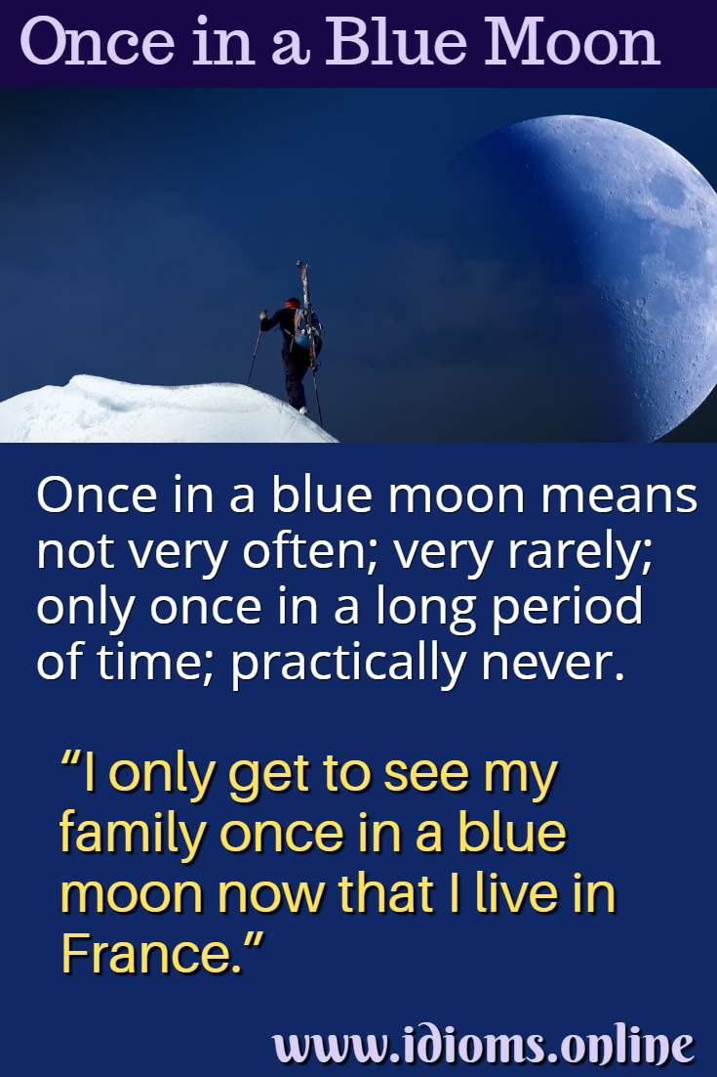
Idioms are an expression which functions as a single unit and whose meaning cannot be worked out from its separate parts.

Slide 9
feeling extremely happy or euphoric

Slide 10
make a mistake or fail to do something that was expected or required
Sell down the river
Rake over the coals
Drop the balls
Let their hair down
Put his foot in his mouth
Throw her weight around
Snap out of it
Give a piece of your mind
relax and behave more freely or informally,
often after a period of being reserved or serious.
encouraging them to stop feeling sad, upset, or lost in thought
and to become more alert and responsive.
express your strong, often critical, opinion about something or someone.
It usually implies that you are upset or dissatisfied with a situation.
betray or deceive someone, often for personal gain.
say something embarrassing, inappropriate, or tactless without intending to
criticize or reprimand someone severely for something they've done wrong. It's a way of bringing up past mistakes and making the person feel guilty.
use one's influence or authority in a forceful or aggressive way,
often to dominate or control others.

