Slide 1
Reading article abstracts and implementing ImrAd (Introduction, method, results and discussion)
Research Article Analysis

Slide 2
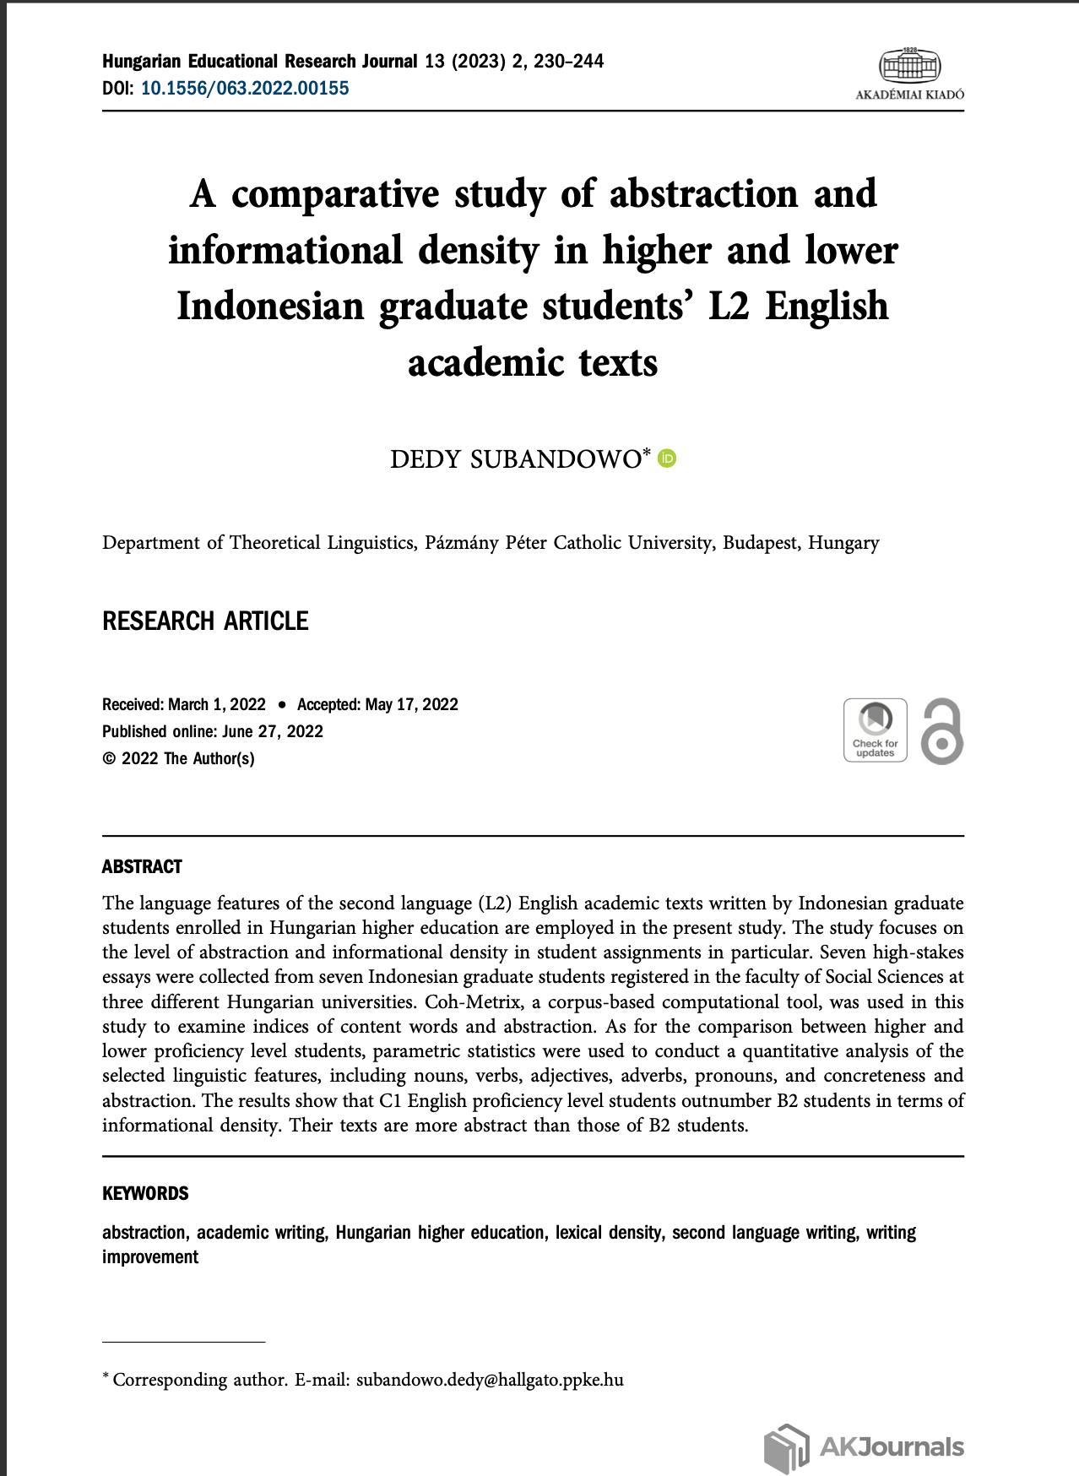
What is an abstract of an article?
A summary of the full article and explains what the article is about
It contains background/aim; research questions research method(s), results and suggestions

Slide 3
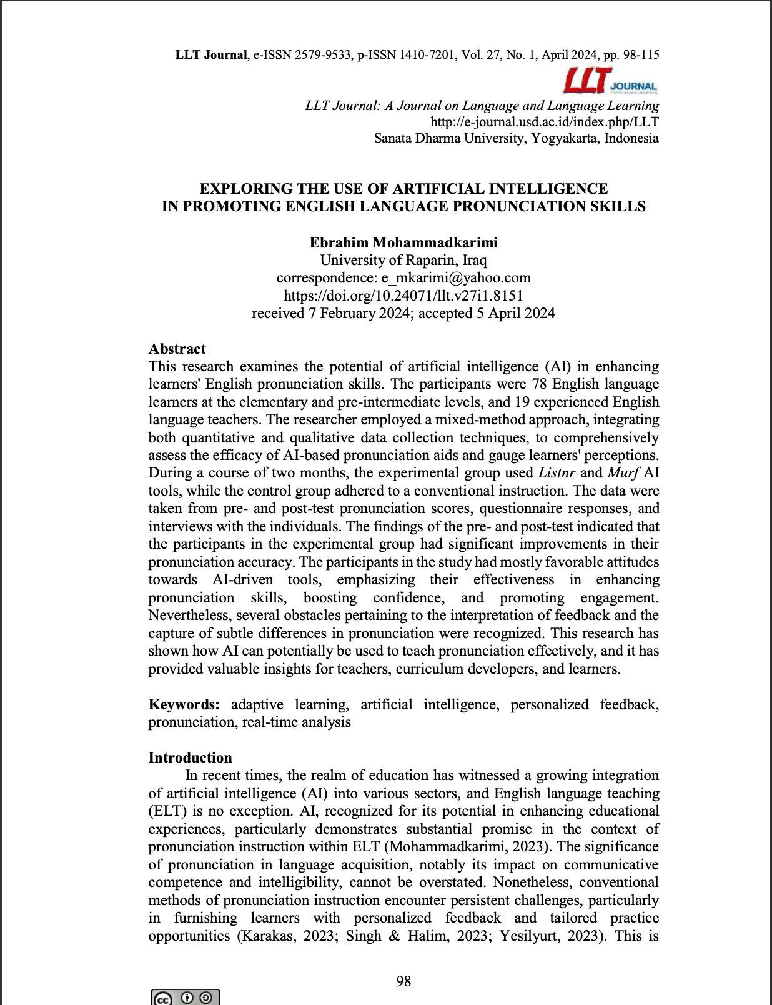
Take a look
Information
Method (research design)
Results
Expectations/
Implementations

Slide 4
What is imrad?
Notes:
IMRaD” format refers to a paper that is structured by four main sections: Introduction, Methods, Results, and Discussion.

Slide 5
Wu’s (2011) imrad model

Slide 6
Let’s do some practices
Open the g-drive link and select two articles
Identify the abstract
Examine the IMRaD sections
Write what you have found in two paragraphs and cite the articles with Mendeley by using two-style (narrative or parenthetical) citations.

