Slide 1
An overview of applied linguistics
by Norbert Schmitt and Marianne Celce-Murcia
Reflections on Linguistics Mastery
Meeting 2

Slide 2
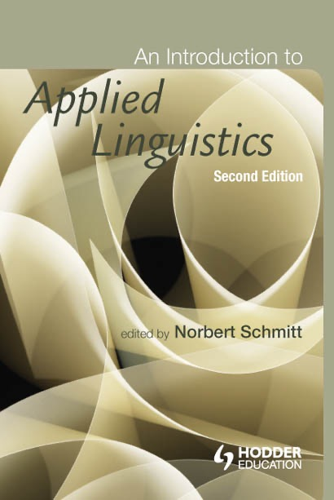
What is applied linguistics
“Applied linguistics is concerned with increasing understanding of role of language in human affairs and thereby with providing the knowledge necessary for those who are responsible for taking language-related decisions whether the need for these arises in the classroom, the workplace, the law court, or the laboratory” (Wilkins, 1999:7).
It uses :
What we know about language;
What we know about how it is learned;
What we know about how it is used;
In order to gain some purposes or solve some problems in the read world.

Slide 3
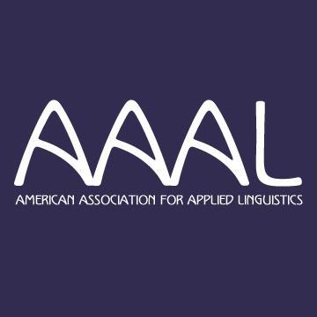
Topics in Applied Linguistics by AAAL
Analysis of discourse and interaction
Assessment and evaluation
Bilingual, immersion, heritage and language minority education
Language ideology
Language and learner characteristics
Language and technology
Language and cognition and brain speech
Language, culture, socialization, and pragmatics
Language maintenance and revitalization
Language planning and policy
Reading, writing and literacy
Second language acquisition, language acquisition and attrition
Sociolinguistics
Texts analysis (written discourse)
Translation and interpretation

Slide 4
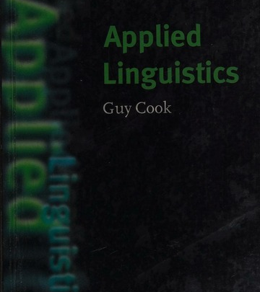
Teaching and learning of second or foreign languages (L2) is the dominant application.
A study by Cook (1987) has discovered that 83 per cent of 20-24-year olds in Europe had studied a second language.
The phenomenon of “translanguage” in the EU regions makes people speak more than one language.
In some countries, L2 is used as “lingua franca” --- when the population speaks a variety of different L1’s.
English is the main second language being studied in the world – 235 millions L2 users
Dominant topics

Slide 5
Englishes

Slide 6
Appling concerns
Traditional affair : L2 acquisition and second language pedagogy, the interface between the two
Other areas literacy, speech pathology, dead education, communication practices, lexicography and L1 acquisition are added.
Non-education sectors : authorship identification and forensic linguistics studies ---a statistical analysis of various linguistics features in anonymous or disputed texts and compares the results with a similar analysis from texts whose authors are known -- are a new study in 2001. e.g the case of a murder and the police writing transcription vs normal speech pattern.
Language goes wrong studies : Aphasis (brain damage resulting difficulties in finding and forming words), Schizophrenia (illogical thoughts and hallucinations), Autistic (social interaction problems: eye contact or gestures, using pronominal reversal by their name instead of I or me)

Slide 7
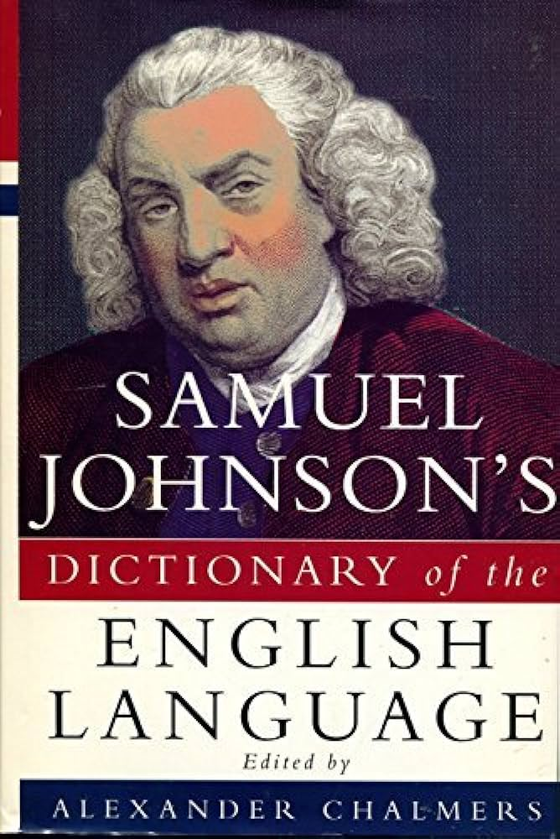
The development of appling in early history
Plato and Aristotle with the design curriculum with good writing
In 1755, Samuel Johnson produced The Dictionary of the English Language
Robert Lowth in 1762 published Short Introduction to English Grammar – how to use correct grammar

Slide 8
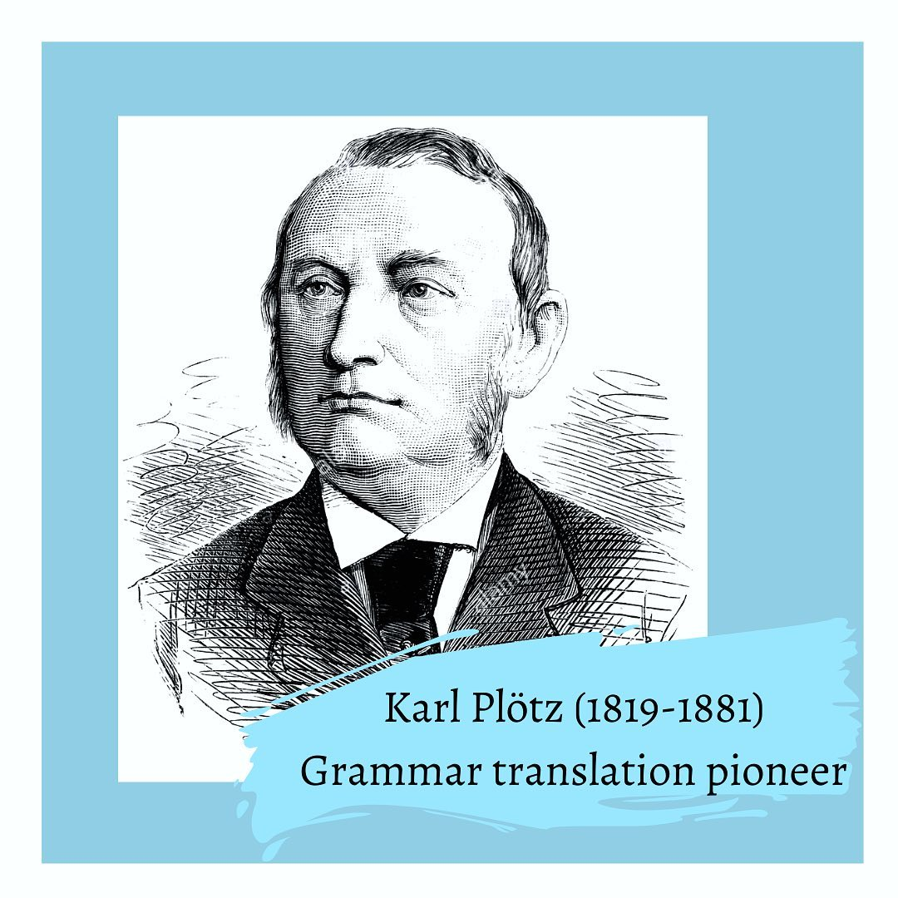
Appling in the twentieth century
The late 18th and 19th century, Grammar-translation method by Karl Plötz (1819-1881).
Translating L1 to L2 on reading and writing literacy
Problem : analysis language not ability to use it.

Slide 9
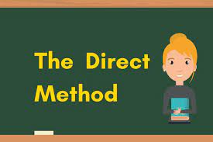
Beginning in the 20th century: exposure oral language, with listening and speaking as the primary skills.
Meaning has related directly to the target language, without step of translation
Problems: need teachers who are proficient in the target language; mimicked L1 learning but did not account the difference between L1 and L2 acquisition.

Slide 10
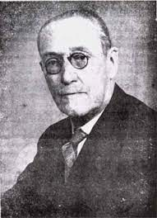
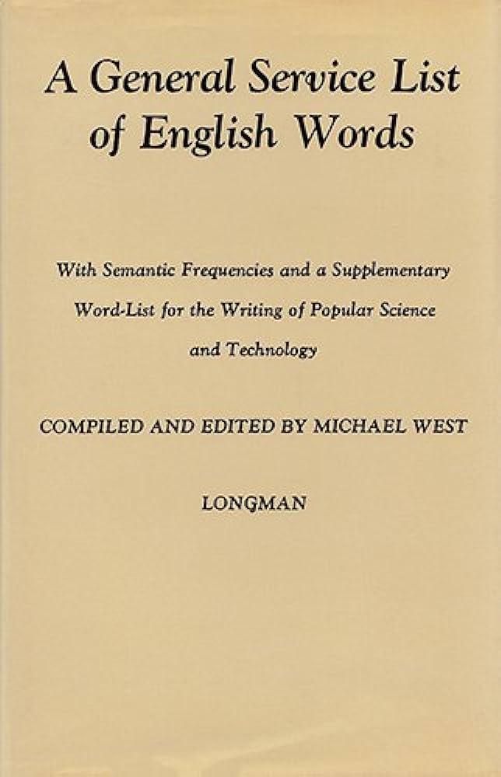
Reading method
1888 – 1973, Michael West in the UK, learners’ exposure language through reading
Managing vocabulary -- by promoting low-frequency literacy words such as isle, nought, ere with island, nothing and before to improve readability – is called “Vocabulary control movement”
A General Service List of English Words : 2000 words in English

Slide 11
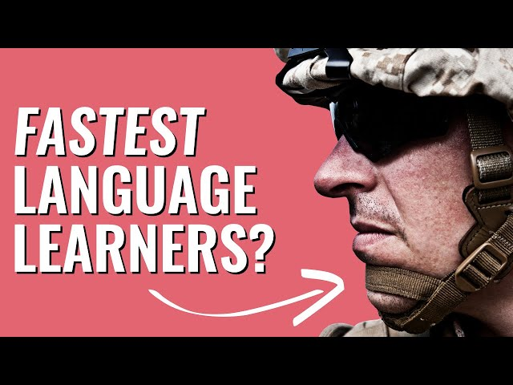
During the world war II
American military found people are fluent in foreign language
Need trained soldiers in oral and aural skills quickly
Adopted from Direct Methods focusing on listening and speaking; drew psychological theory of the time and Behaviourism saying ”language learning was a result of habit formation” – Army Method
Drilling practice focusing on pronunciation, sentence patterns and memorization.
It was successful and continued to become “Audiolingualism”

Slide 12
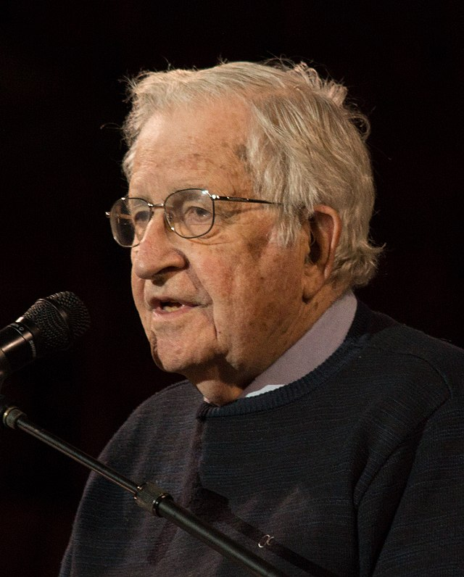
The rise of noam Chomsky (1950s-1959)
Structuralist linguistics in the association of pedagogical approach
Cognitive factors : a set of abstract rules to be innate
Chomsky’s Universal Grammar (1959) – children born with un understanding of the way language work.
They need more exposure to acquire the language (L1/L2)
The development of L2 acquisition continued to rise
Pennsylvania University

Slide 13
Hymes (1971) and halliday (1973)
Communicative competence
Systemic Functional Linguistics

Slide 14
Krashen’s (1982) Monitor theory

Slide 15
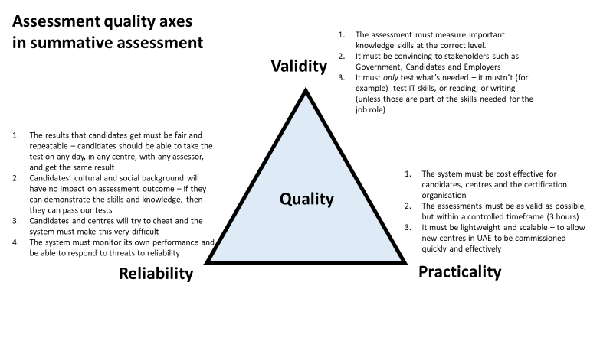
Language pedagogy assessment in 1980s-1990s

Slide 16
Computer-assisted language learning (CALL)

Slide 18
Any questions?

