Slide 1
Pronunciation Practice
Dedy Subandowo, M.A.
mrdowoportal.weebly.com dedy.subandowo@ummetro.ac.id
English Education Study Program
Faculty of Teacher Training and education
Universitas Muhammadiyah Metro
March, 2024

Slide 2
Two introductions:
About me
The course plan

Slide 3
DEDY SUBANDOWO, M.A.
A senior lecturer (2014 – now)
English Education Department
Universitas Muhammadiyah Metro
Email: dedy.subandowo@ummetro.ac.id
WhatsApp: +62 895 4253 95052
Blog: https://mrdowoportal.weebly.com
A PhD Student of Applied Linguistics (2019 – now)
Pazmany Peter Catholic University, Hungary
Research interests :L2 English academic writing, academic discourse, EFL, and language pedagogy
The 1st introduction

Slide 4
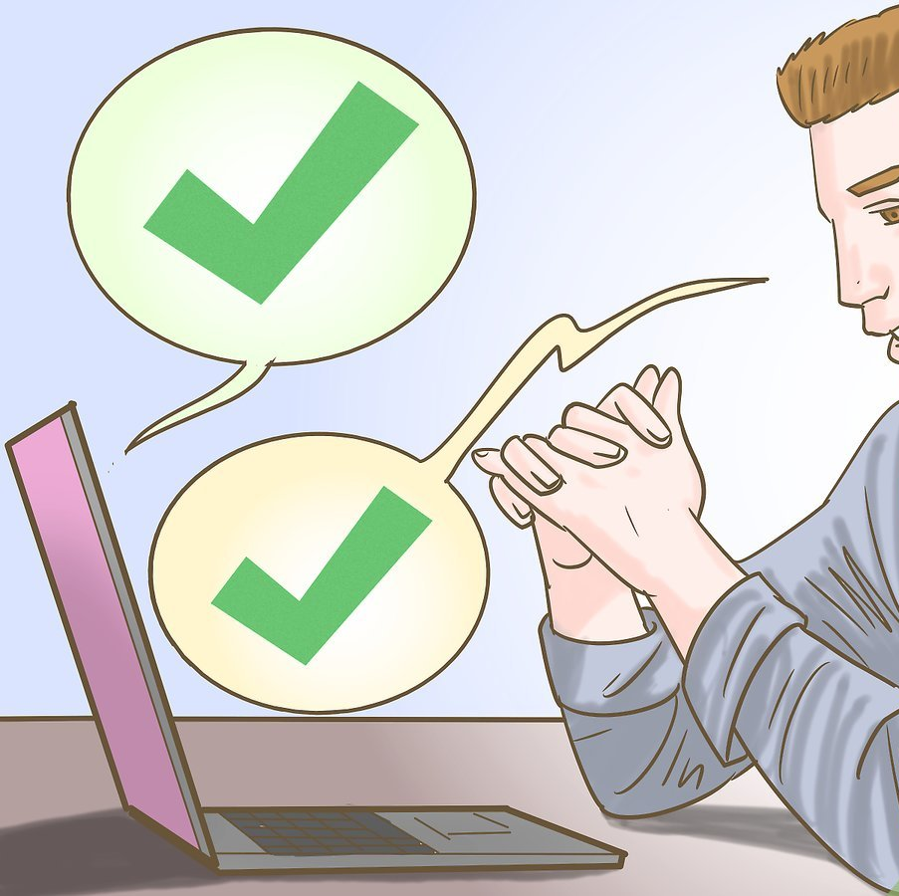
1) Class Overview
The purpose of this course is to impart English pronunciation.
The subject matter deals with learning and practicing how to pronounce words, phrases, and sentences in everyday speech with the proper stresses, sounds, and intonations.
In this course, students will engage in both theoretical and practical learning activities. All instructional methods, including practice, drilling, and lectures, are combined to create podcasts.

Slide 5
2) The course’s goals
Students are able to produce academic or non-academic works for diverse audiences and purposes.
Students can demonstrate English proficiency as evidenced by an English proficiency achievement (CEFR: B2).
Students can demonstrate pronunciation of English sounds: vowels, consonants, and diphthongs.
Students can apply correct word stress patterns and rhythm in spoken English, thereby improving their natural and influence

Slide 6
3) Learning methods
Discussion
Presentation
Workshop

Slide 7
4. Course topics
Meeting | Topics | Learning types
1 | Introduction to Pronunciation Practice – Course plan agreement
2 | Introduction to theoretical studies : the sound of English | Presentation/discussion
3 | Sound chart | Presentation/workshop
4 | Speech chunks | Presentation/discussion
5 | Stress | Presentation
6 | Intonation | Presentation
7 | Evaluation 1 | -
8 | Practical activities: introduction | Workshop
9 | Practice 1 – BBC Learning English | Workshop
10 | Practice 2 – Youtube | Workshop
11 | Practice 3 – Instagram | Workshop
12 | Practice 4 – Songs | Workshop
13 | Practice 5 – Movies | Workshop
14 | Practice 6 – Speech | Workshop
15 | Evaluation 2 | -
16 | Reflections | Discussion and questions
This Photo by Unknown Author is licensed under CC BY-NC-ND

Slide 8
5) Class Regulations
Students are allowed to skip the class three times max.
Students can get additional score for being active in the class.
Students’ opinions in any way are highly appreciated without any judgements.
Students can re-submit the task if the reasons of submission is logical
The final score will be taken from the mentioned regulations plus podcast presentations 60 %.

Slide 9
References
Baker, Ann., and Marshall, Leslie. 2006. Ship or Sheep?: An Intermediate Pronunciation Course: 3rd ed. Cambridge: Cambridge University Press.
Dauer, Rebecca M. 1992. Accurate English: A Complete Course in Pronunciation . USA: Prentice Hall Regents.
Marks, Jonathan. 2007. English Pronunciation in Use. Elementary. Cambridge: Cambridge University Press.
O’Connor, J.D. 1980. Better English Pronunciation: 2nd ed. Cambridge: Cambridge University Press.

Slide 10
This Photo by Unknown Author is licensed under CC BY-SA-NC

