Slide 1
The sounds of english
Meeting 2

Slide 2
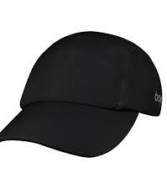
Segments or suprasegments
Segments : the individual sounds in a given word e.g., HAT ( three segments: two consonants and one vowel)
Suprasegments: syllables within a given word or intonational patterns across words, phrases, and clauses.

Slide 3
Suprasegmental

Slide 4
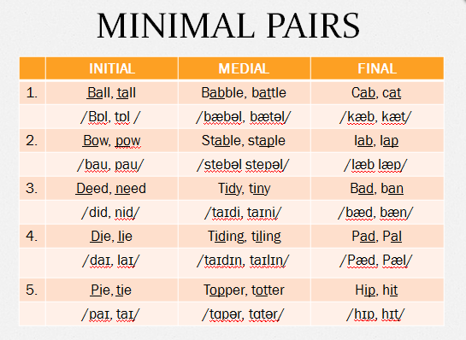
Speech segments: phonemes or allophones
Phonemes : distinctive speech sounds that can affect meanings
To test with minimal pairs : BAT and CAT : /b/ and /k/ sounds

Slide 5
Allophones: any of the different variants of a phoneme.
Words | Allophones /p/ not /b/
Pot | aspirated
Sports | unaspirated
Type | unreleased

Slide 6
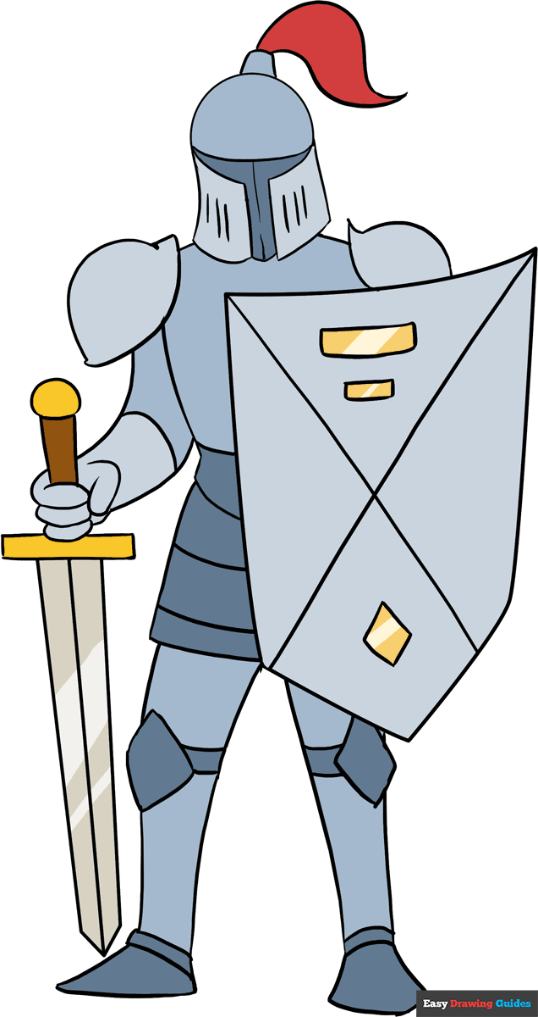
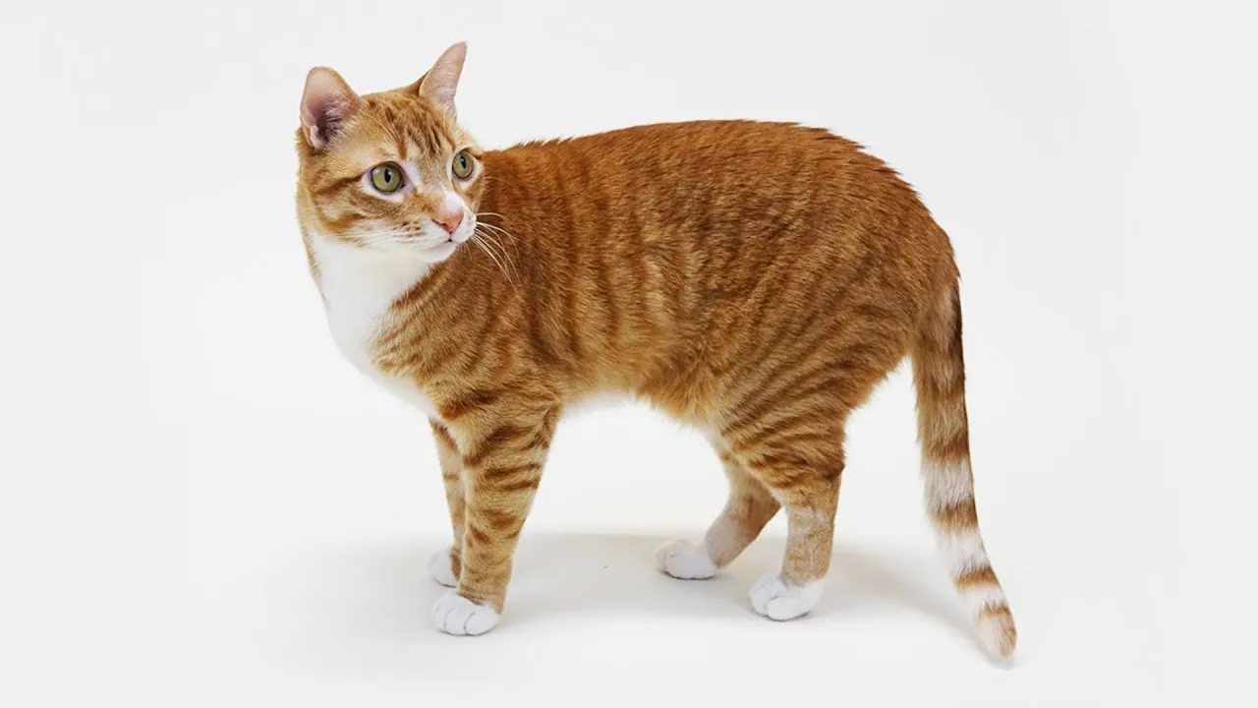
The phonetic alphabet : graphemes
CAT KNIGHT
has three graphemes. has six graphemes and three morphemes
and morphemes: /k/, /æ/, and /t/ /n/, /ai/, and /t/.

Slide 7
Consonants in English
Notes:
1) A fricative is a consonant produced by forcing air through a narrow channel made by placing two articulators close together.[
2) a lateral approximant (less commonly, 'lateral resonant') is a consonant whose articulation involves a central occlusion with an opening on one or both sides of the tongue that is not close enough to produce friction
3) Affricates begin as plosives and end as fricatives.

Slide 8
Place of articulation

Slide 9
Vowels in English

