Slide 1
Chunking and Pausing
Pronunciation Practice
Meeting 4

Slide 2
Why are chunking and pausing important?
Communication tools both listeners and speakers
“Pieces” or “chunks” to communicate a thought or idea
Highlight important information
Most effective way to share information for the listeners

Slide 3
What exactly are speech chunks?
Speech chunks can be a word, a phrase, or a whole sentence
Speech chunks can be signaled in different ways
Pauses – moments of silence, sometimes very short
Slowing down
Strong stress on the last key word in the chunk

Slide 4
Slash (/) for chunks
A single slash (/) for a short pauses
A double slash (//) for longer pauses
Many people now believe/ that in an increasingly globalised world/ we should accept variations in pronunciation/ that is/ accent. //

Slide 5
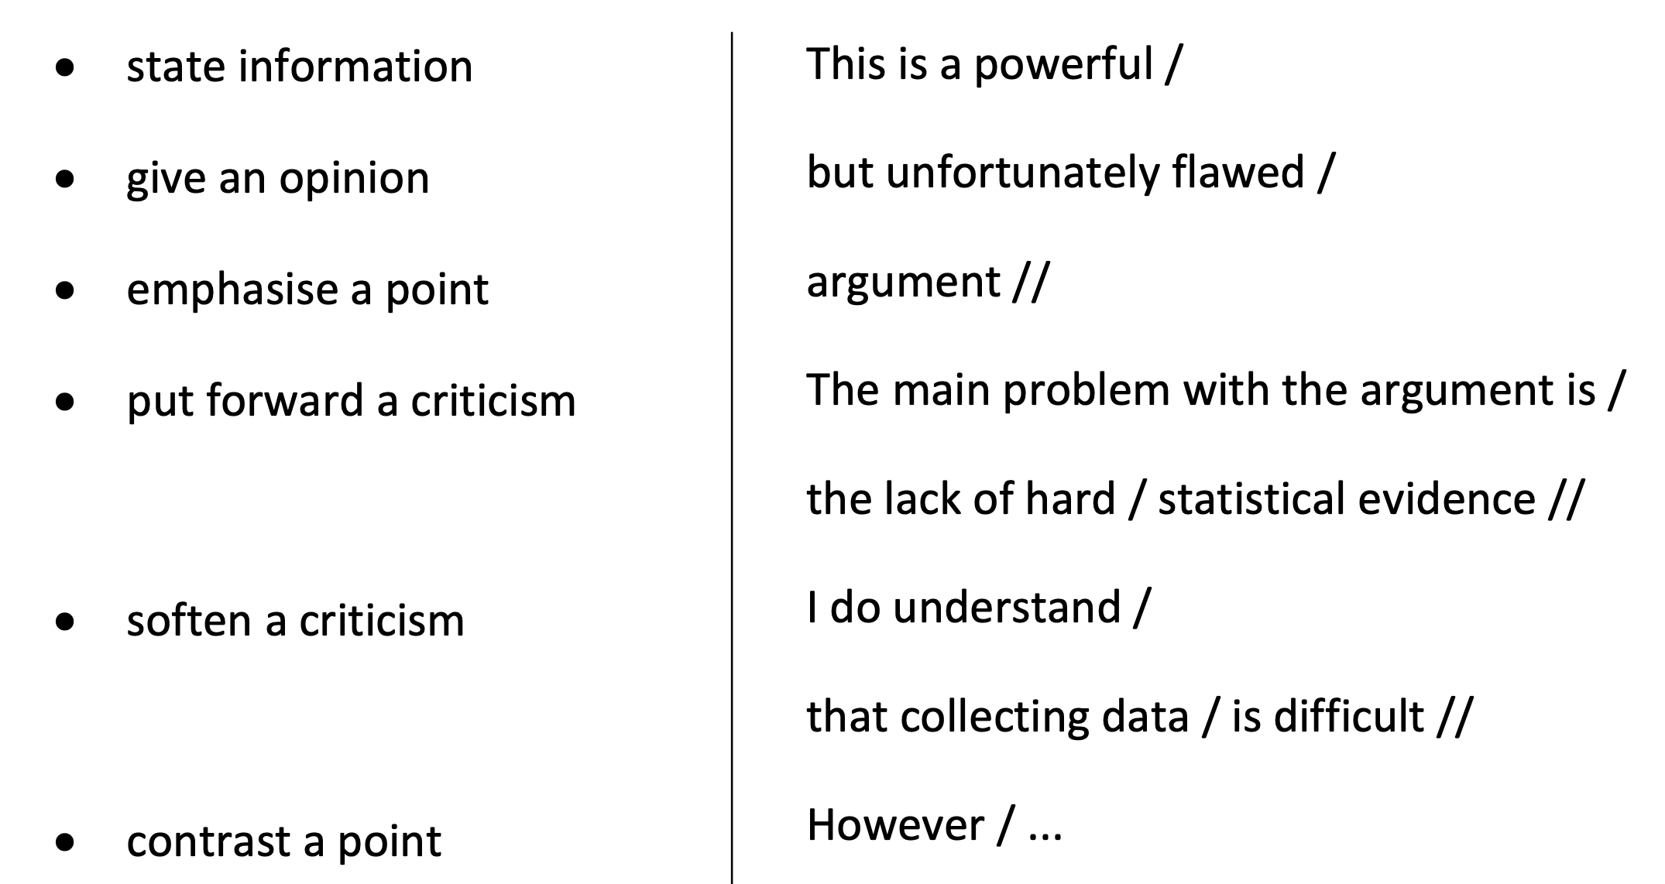
You can use pausing and chunking to :

Slide 7
Chunking and Pausing Practice: Listening Worksheet: Kofi Annan
BBC Learning English website: Talk about English, Better speaking, Episode 3 – Kofi Annan
http://downloads.bbc.co.uk/worldservice/learningenglish/webcast/mp3/betterspeaking/tae_betterspeaking_3_080221.mp3
BBC presenter, Callum Robertson, and language teacher, Richard Hallows, listen to a clip from the former Secretary-General of the United Nations, Kofi Annan. They talk about what makes Kofi Annan an effective speaker of English and ways you can practise and improve your English pronunciation.
Callum Robertson [1:28 min]: Kofi Annan is from Ghana in West Africa, and … uses English as an international language, in a highly effective way. In this excerpt from a speech on globalisation, he’s asking his listeners to make sure that the process ofeconomic globalisation helps everybody in the world, the poor as well as the rich.

Slide 8
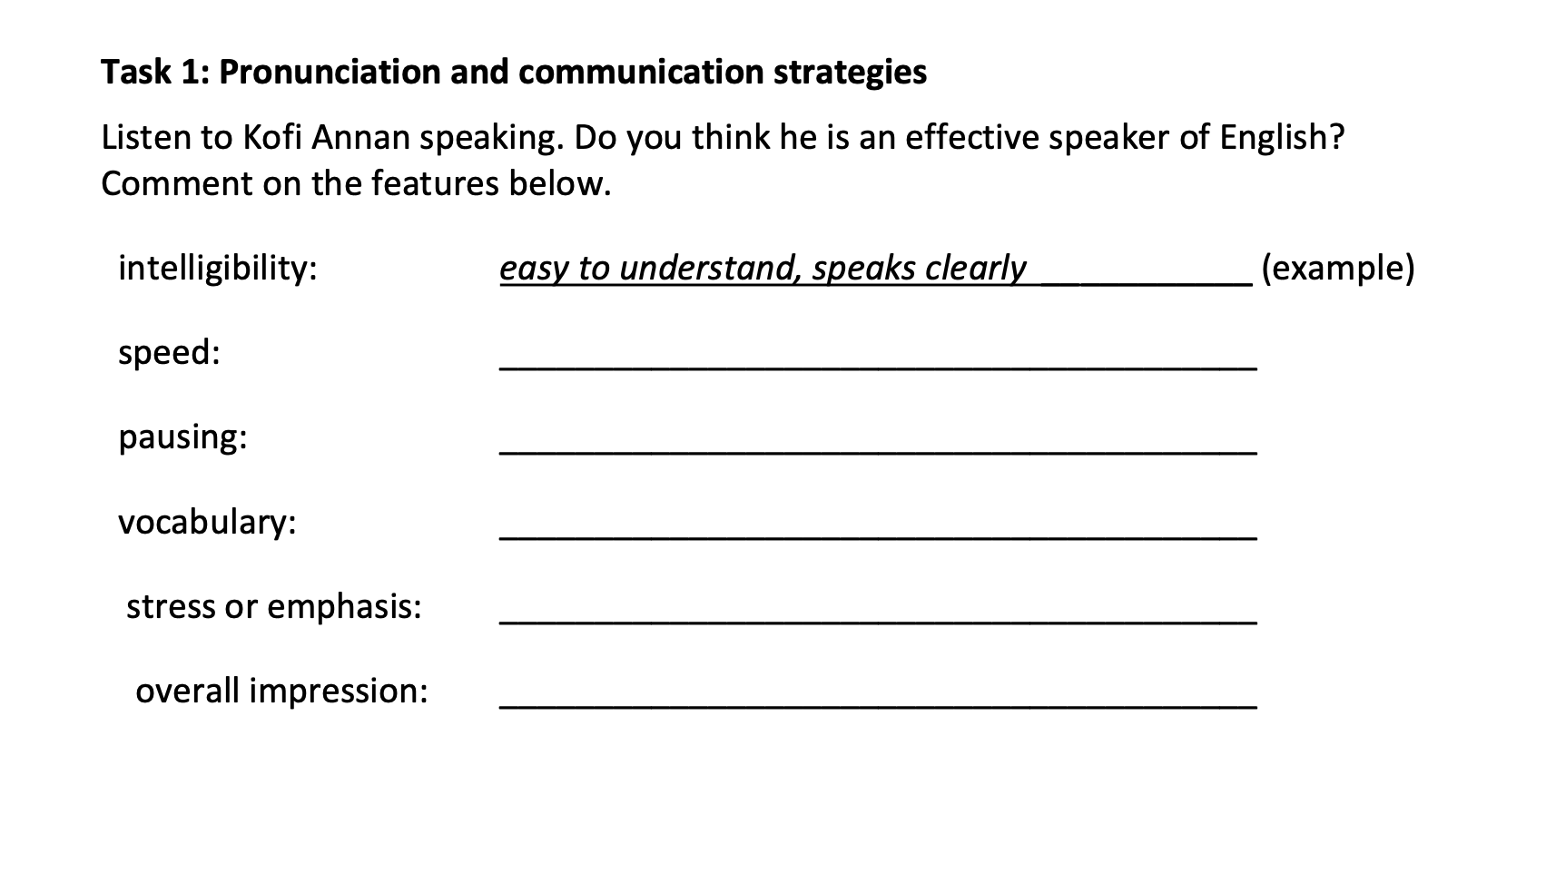

Slide 9
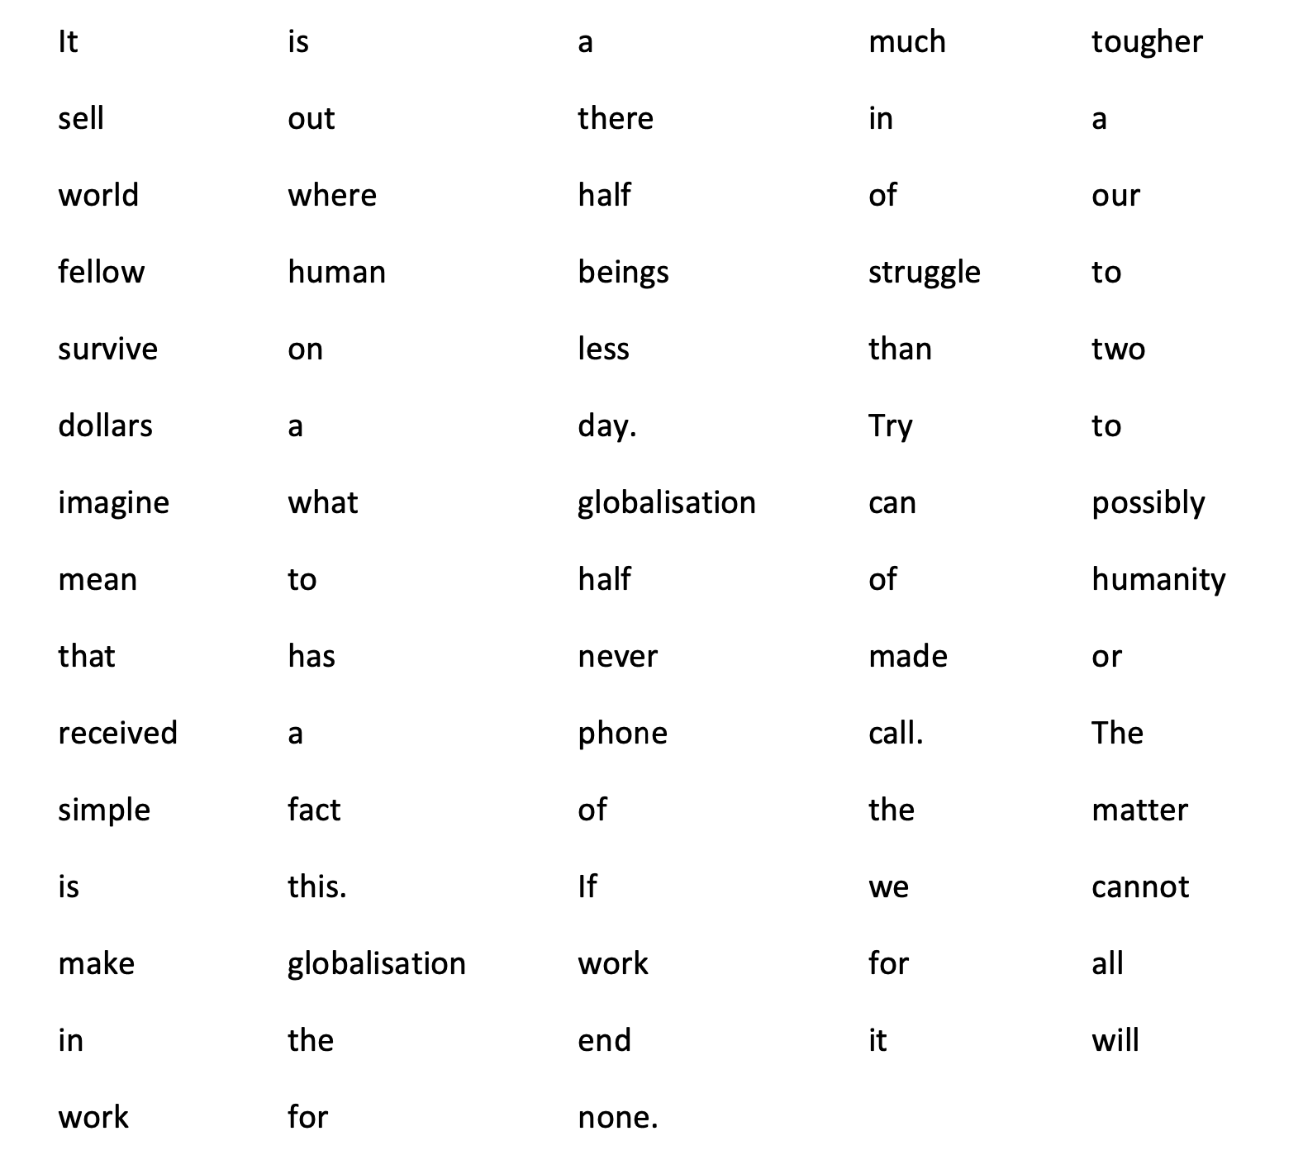
Mark the pause with a slash (/) (// for longer pauses)

