Slide 1
Generative Grammar
Lecture notes based on Carnie, Andrew. 2013. Syntax: A Generative Introduction. Wiley Blackwell
Syntax lecture course 2021 Spring
Tamás Halm, PPCU

Slide 2
0. Preliminaries
Language: a psychological or cognitive property of humans, gettting from sounds to meaning
Phonetics: how sounds are produced and perceived, articulation and acoustics
Phonology: how to organize sounds into patterns and syllables, what are the possible and impossible combinations, bluve vs. Bnuck
Morphology: organizing sounds into meaningful units: morphemes and words (dancer = dance + -er)
Syntax: organizing words into phrases and sentences
Semantics: translating phrases and sentences into thought and ideas

Slide 3
1. Syntax as a Cognitive Science
Cognitive science: describing and explaining human beings’ ability to think.
Language plays an important role in how we think and communicate ideas.
Language distinguishes us from other animals.
Linguistics is a subdiscipline of cognitive science (along with psychology, neuroscience, communication, philosophy and computer science).

Slide 4
2. Modeling Syntax
Generative Grammar:
Sentences are generated by a subconscious set of procedures (like computer programs).
The procedures are part of our cognitive abilities
The goal of syntactic theory is to model these procedures through a set of formal grammatical rules
These rules generate the sentences of language

Slide 5
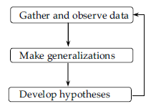
3. Syntax as Science – The Scientific Method
Hypotheses make predictions.
Hypotheses are falsifiable
Hypotheses are rules.
Descriptive rules (not prescriptive rules).

Slide 6
3.1 Scientific Method in Syntax - Example
Anaphora, reflexives:
Rule: anaphor must have an antecedent and agree with antecedent in gender.

Slide 7
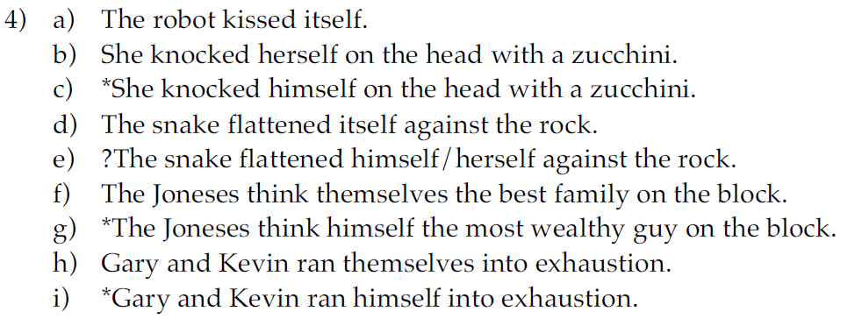
3.1 Scientific Method in Syntax - Example
Testing the hypothesis against more data:
Refined rule: an anaphor must agree in gender and number with its antecedent.

Slide 8
3.1 Scientific Method in Syntax - Example
Testing the refined hypothesis against yet more data:
Further refined rule: an anaphor must agree in gender, number and person with its antecedent.

Slide 9
3.1 Scientific Method in Syntax - Example

Slide 10
3.3 Competence vs. Performance
Garden path sentences:
14) #Cotton shirts are made from comes from India.

Slide 11
4 Where do the rules come from?
The knowledge of Language is subconscious
It is acquired, not learned
Some of this knowledge appears to be innate: Universal Grammar (UG):
The logical problem of language acquisition: productive systems are (possibly) unlearnable, because you never have enough input to be sure about the relevant facts.
Underdetermination of the data

Slide 12
4.5 Explaining language variation
If part of language is innate (Universal Grammar), how come we still have language variation? -> Parameters!
Consider word order:

Slide 13
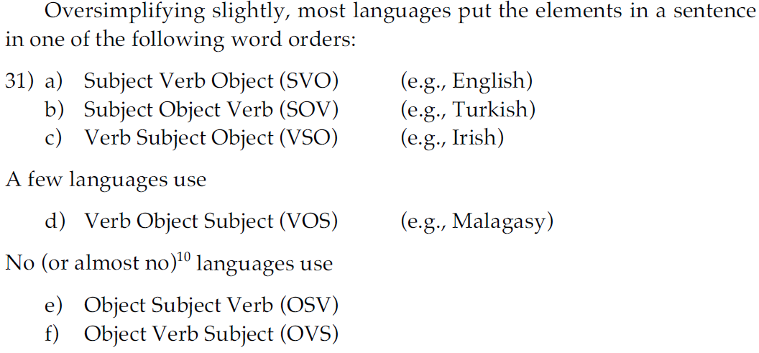
5 Explaining language variation
Consider word order:
Input: Mommy loves Kirsten.
Mommy loves Kirsten.

Slide 14
5 Choosing among theories of syntax
Levels of adequacy (Chomsky 1965)
Observationally adequate grammar: it can account for the data in a given corpus.
Descriptively adequate grammar: it can account for corpus data plus native speaker judgments about well-formedness.
Explanatorily adequate grammar: it can account for corpus data plus native speaker judgments about well-formedness plus how children acquire their language.

Slide 15
5 Homework
Homework:
GPS3 (Page 34)
GPS7 (Page 35)
Send your solutions to halm.tamas@gmail.com until next Wednesday.

