Slide 1
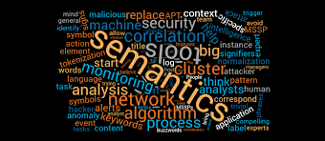

Slide 2
OVERVIEW
This course provides an introductory study on meaning in language, covering such topics as proposition, reference, universe of discourse, definiteness, ambiguity, sameness and oppositeness in meaning, hyponymy, entailment, homonymy, polysemy, derivation, participant role, and speech act. During the course, students are presented with cases pertinent to the topics and analyze them in prescribed ways. Most cases are taken from English. Their achievement in the course is assessed by means of a mid semester test and a final examination.

Slide 3
COPETENCE
1) Understand and apply the concept and scope of semantics, and the linguistic and non-linguistic context in the analysis of sentences, utterances, and propositions,
2) Define ideas in relations to lexical structure, and
3) Recognize current issues in semantic field.

Slide 4
GRADING THE SUBJECT
SCORE | CONDITION
A | FULL ATTENDANCE AND COMPLETED ASSIGNMENT, ACTIVE
A - | FULL ATTENDANCE AND COMPLETED ASSIGNMENT
B + | ADEQUATE ATTENDANCE AND COMPLETED ASSIGNMENT, ACTIVE
B | ADEQUATE ATTENDANCE AND COMPLETED ASSIGNMENT
C | POOR ATTENDANCE, SUBMITTED ASSIGNMENT
D | POOR ATTENDANCE, LESS SUBMITTED ASSIGNMENT
E | POOR ATTENDANCE, NO SUBMITTED ASSIGNEMT

Slide 5
MAIN DISCUSSION AND TOPIC
INTRODUCTION TO SEMANTICS
REFERRING EXPRESSION
SENSE
LOGIC
WORD MEANING
INTERPERSONAL MEANING

