Slide 1
ASSESSMENT ON SPEAKING ENGLISH & Scoring criteria
MEETING 2

Slide 2
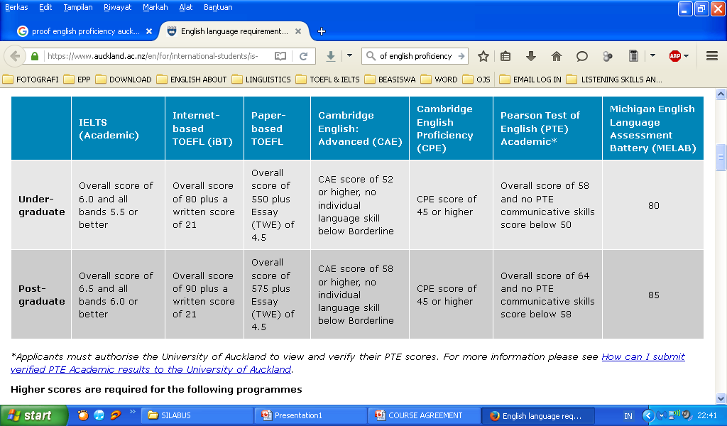
Kinds of English Assessment

Slide 3
TOEFL
Academic test purpose
Paper test mostly covered Listening, Reading, and Structure.
CBT → writing included
iBT→ Listening, reading, structure, writing and speaking.
Held by ETS
PBT (Paper Based Test)
CBT (Computer Based Test)
IBT (Internet Based Test),

Slide 4
Certified
British Council
Cambridge English
IDP Edu (International Development Program)

Slide 5
Speaking Criteria
Fluency refers to your ability to speak smoothly and at an appropriate speed, without any unnatural pauses.
Coherence literally means being logical and consistent.
Lexical resource basically means vocabulary.
There are four parts to the IELTS marks scheme:
Fluency and Coherence
Lexical Resource
Grammatical Range and Accuracy
Pronunciation

Slide 6
Grammatical range and accuracy refers to your ability to avoid making grammar mistakes. You should also have a wide enough range of grammar to be able to talk about a range of things and use complex sentences.
You don’t have to worry about having an American or British accent, the main consideration here is that your speech is clear and you are easy to understand.

