Slide 1
The meaning of language
What is semantics?
How does the study correlate with pragmatics?

Slide 2
Introduction
Welcome to the presentation on "Semantics and Its Correlation with Pragmatics."
Language is a complex system (e.g., arbitrariness), and understanding how it conveys meaning is at the core of linguistic study.
In this presentation, we will delve into the fascinating world of semantics and explore its interconnectedness with pragmatics.
By the end of this presentation, you will have a deeper understanding of how language works beyond just words and sentences.

Slide 3
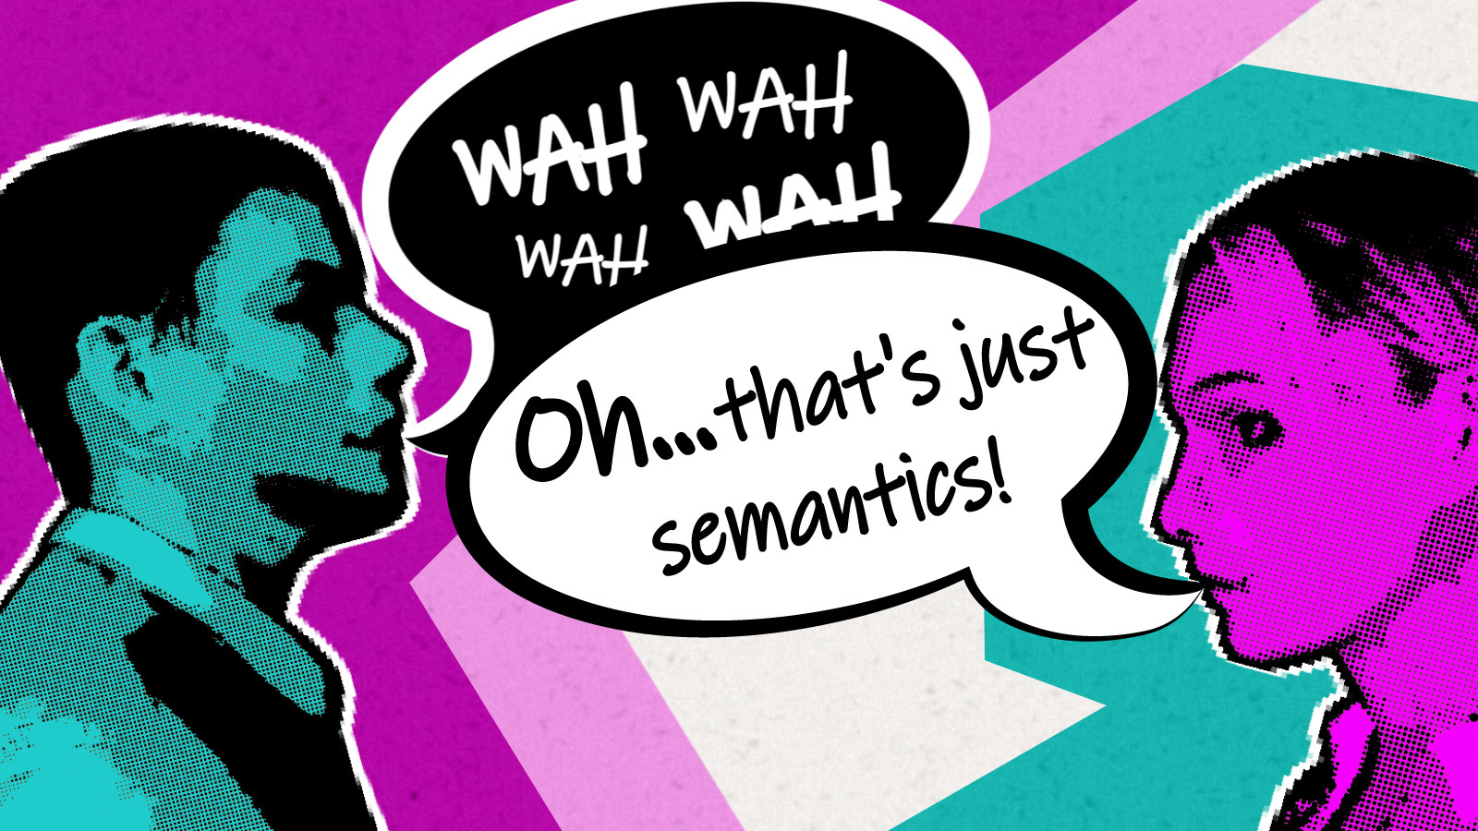
Definition
Semantics is the branch of linguistics that deals with the study of meaning in language (Kreidler, 1998. p.3).
It focuses on understanding how words, phrases, and sentences convey meaning and how that meaning is interpreted by speakers and listeners.

Slide 4
Why meanings?
New word information curiosity
Unsure messages from what we read or hear
Jokes/ humor
Double meanings or ambiguities in sentences

Slide 5
See this ads
How is the ads meaningful?

Slide 6
Ticketmaster bans Taylor Swift ticket resales
What do you think about chat GPT ?
Turn the light on!
May there be peace on earth.
→ Giving information
→ Asking a question
→ Giving a command
→ Expressing wishes

Slide 7
When you know the language you will know that the words or sentences have meanings
Words
Flick (meaningful)
Blick (meaningless)
Sentences
Jonathan swims every Sunday
Swims Jonathan Sunday every
Words has two meanings
Bank, can, sentence, book …
A sentence has two meanings
I saw [monkeys with the telescope]
I saw monkeys [with the telescope]
Two words have same meanings
Sofa and couch
Two sentences have same meanings
Anton puts off the meeting
Anton putts the meeting off
Words or sentences have opposite meanings
Alive/dead
Jonas is smart vs Jonas is not smart

Slide 8
True of false sentences
All midwife are female .
All kings are female.
All bachelors are married.
India is now the world's most populous nation with 1.486 billion people, passing China in April according to projections by the United Nations. And it's still growing.
→ True
→ False
→ False
→ True

Slide 9
Semantics is essential
Semantics plays a crucial role in language comprehension and production.
It enables us to understand the meaning of words and sentences, making communication possible.
Without semantics, language would be a collection of symbols with no inherent meaning.
It helps us convey precise and nuanced ideas, facilitating effective communication in various contexts.

Slide 10
Language in context
Pragmatics emphasizes person’s ability to derive meanings from specific kinds of speech situations; recognizing what speaker is referring to, to relate new information to what has gone before, to interpret wat is said from background knowledge about the speaker and the topics of discourse or to fill in information the speaker takes for granted and does not bother to say.

Slide 11
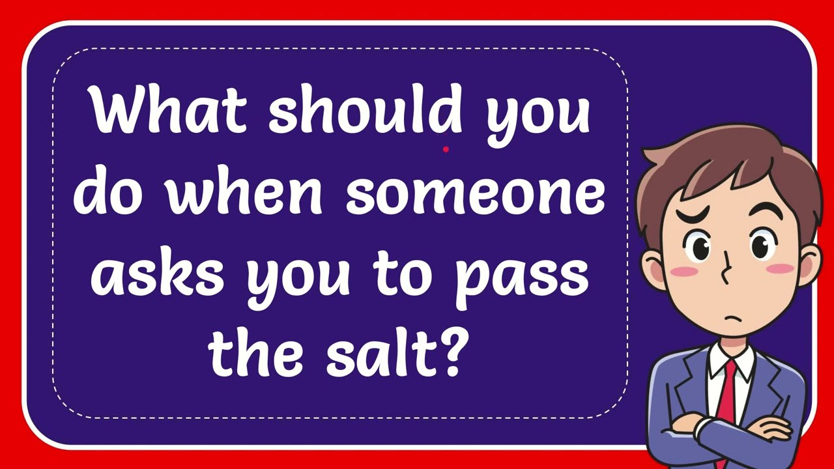
Pass the salt and the pepper together.
It is considered impolite to pass only one of them.
If the salt and pepper are not already within reach of the person who asked, you should pick them up and pass them together.
Pick up the salt and pepper shakers with your dominant hand and place them on the table in front of the person who asked.
Make eye contact and smile, indicating that you are happy to help.

Slide 12
The correlation between semantics and pragmatics
Semantics focuses on a speaker’s competence to use the language system in producing meaningful utterances and processing (comprehending) utterances produced by others.
Semantics looks at how words like "dog" mean the concept of a domesticated animal, and how phrases like "red apple" combine to create a specific meaning.
Pragmatics examines how a simple sentence like "Can you pass the salt?" can convey a request in a specific context based on social norms and shared knowledge.
Semantics and Pragmatics study people’s ability to use language meaningfully.
While semantics focuses on the core meaning of words and sentences, pragmatics takes into account the context in which language is used. Pragmatic factors can influence the interpretation of words and sentences.
Understanding the meaning of a sentence often requires considering both its semantic content (literal meaning) and its pragmatic implicatures (additional implied meaning). For example, a statement like "John ate some of the cookies" has a semantic meaning (John ate at least one cookie) and a pragmatic implicature (John didn't eat all the cookies).

Slide 13
What does x mean?
Semantics
What do you mean by saying X?
Pragmatics

