Slide 1
Types of morphemes
Bound and free morphemes
Meeting 3

Slide 2
contents
The discreteness of morphemes
Root, Stem, and Base
How to identify a single morpheme or more morphemes?
Practice
Bound and free morphemes
Affixes in English
50 examples of Prefixes and Affixes in English

Slide 3
The Discreteness of morphemes
Morpheme –er
It means ‘one who does’ ( i.e., verbs) and comparation (i.e., adjective).
What else?
Singer
Driver
Writer

Slide 4
Adjectives + -er
Adjective to adjective
Nice + -er
nicer
Tall + -er
taller
Cheap +- er
cheaper
Short + -er
shorter
Cheap + -er
cheaper

Slide 5
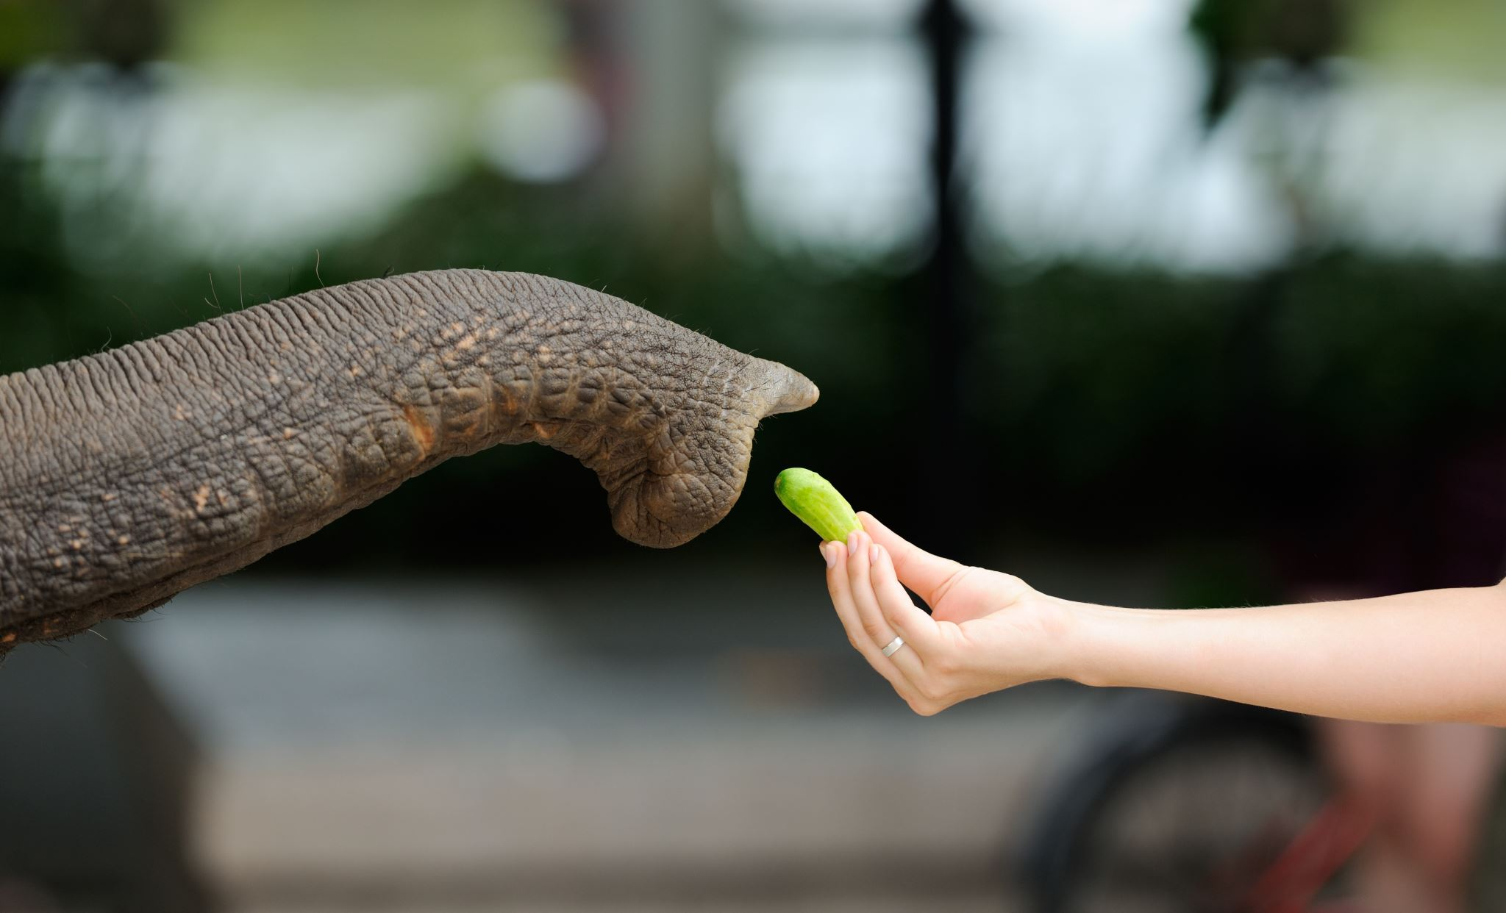
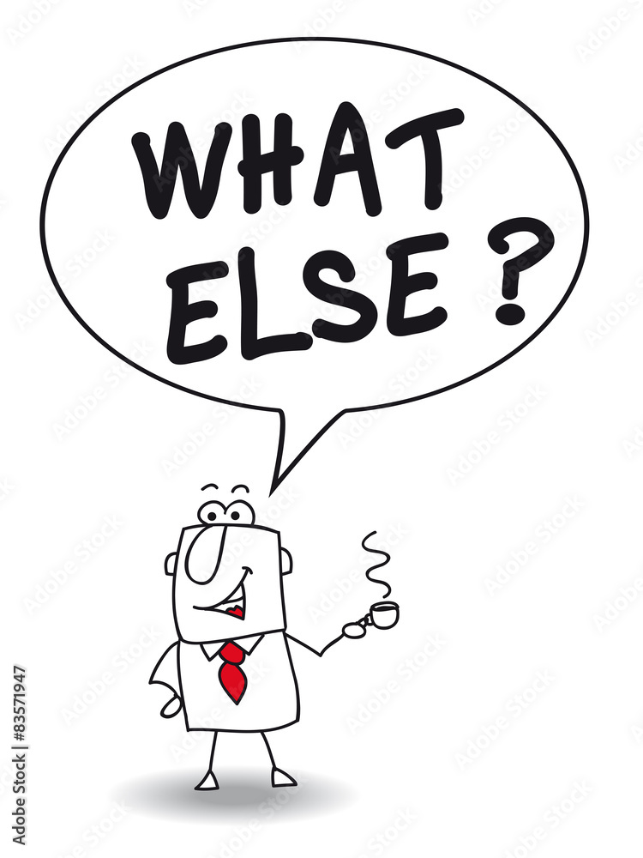
What about these words?
Someone is not *finging.
Finger
Mother
Monster
A single morpheme,
or a monomorphemic word

Slide 6
Root, stem, and base
Root can mostly stand alone; for example, paint in painter and read in reread.
Stem refers to a form when a root morpheme and an affix are combined.
For example :
comfort + - able
beauty + -ful
Base means any root or stem to which an affix is attached.

Slide 7
Root | Believe | Verb
Stem | Believe + able | Verb + suffix
Word | Un + believe + able | Prefix + verb + suffix
base
Root | system | Noun
Stem | system + atic | Noun + suffix
Stem | Un + system + atic | Prefix + noun + suffix
Stem | Un + system + atic + al | Prefix + noun + suffix + suffix
word | Un + system + atic + al + ly | Prefix + noun + suffix + suffix + suffix
base

Slide 8
How to identify a single morpheme or more morphemes?
Examine the word root.
Identify whether the root is attached by a meaningful morpheme.
Separate the root with the morpheme.
Inseparable morphemes means a single morpheme.

Slide 9
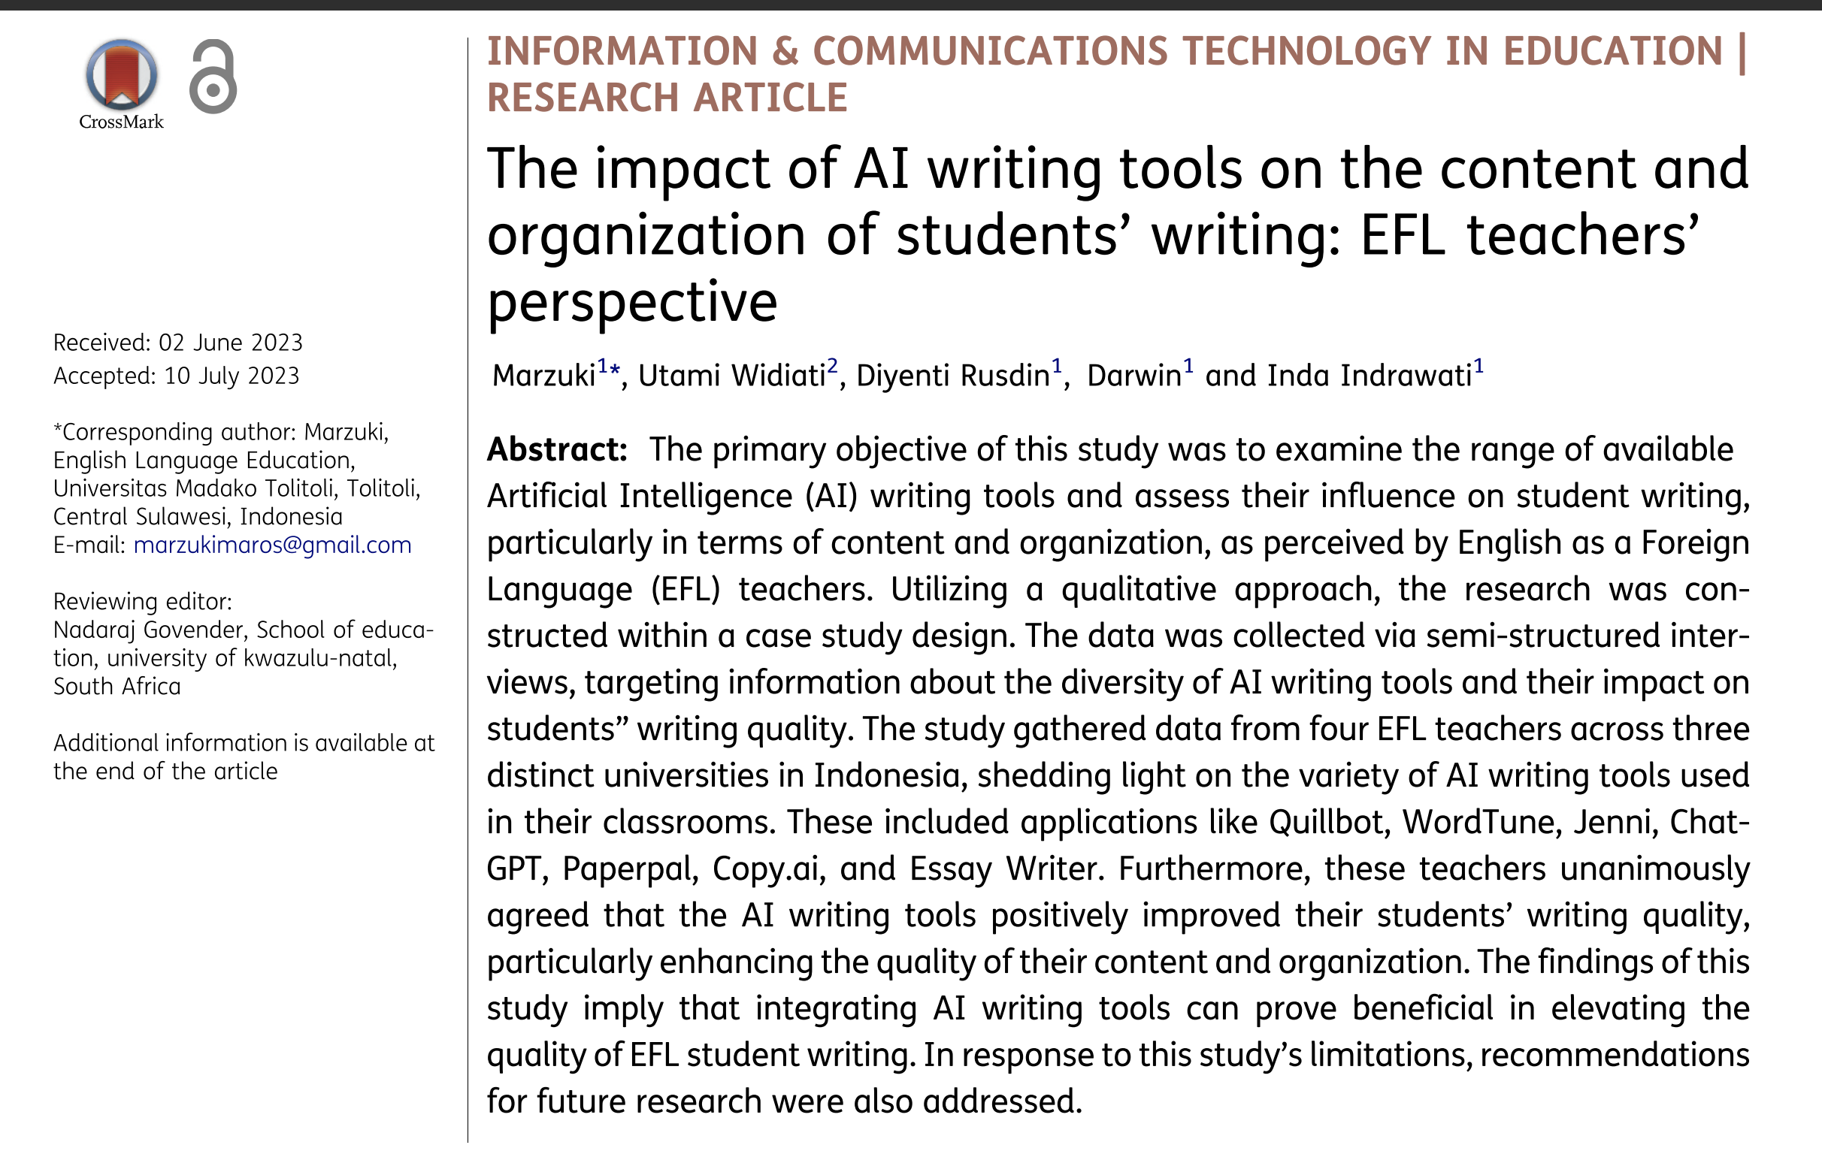
Practice

Slide 10
Free and bound morphemes
Examples:
Cat
Dog
Bike
Laptop
……
What is a free morpheme?
What is a bound morpheme?
Free morphemes are morphemes that can stand alone as words and convey meaning on their own.
Examples:
-er
-ly
Un-
Dis-
….
Bound morphemes are morphemes that cannot stand alone as words and do not convey meaning by themselves. They must be attached to free morphemes to create words with specific meanings or to inflect the meaning of a word.

Slide 11
Affixes in English

