Slide 2
Discourse Analysis
G☺☺d Aftern☺☺n
Introduction: Linguistic Forms and Functions

Slide 3
Mind Map
Introduction: Linguistic Form and Function
The Function of Language
Spoken and Written Language
Sentence and Utterance
The Transactional View
The Interactional View
Manner of Production
The Representation of Discourse: Texts
Written Text
Spoken Text
The Relationship Between Speech and Writing
Differences in Form between Written and Spoken Language
On ‘Data’
Rules Versus Regularities
Product Versus process
On ‘context’

Slide 4
The Function of Language
DISCOURSE ANALYSIS
Discourse analysis is an umbrella term for all those studies within applied linguistics which focus on units/stretches of language beyond the sentence level
Natural Language Utterance
Linguistics
Human Life
expressing social relations and personal attitudes
(Interactional)
Expression of content
(Transactional)

Slide 5
Transactional view
The Function of Language
reflects the idea that the most
important function of language
is the expression of content
aim to communicate information dominates the use of language
“
a policeman gives directions to a traveller
”
a doctor tells a nurse how to administer medicine to a patient

Slide 6
Interactional view
The Function of Language
involved in expressing social relations and personal
attitudes
emotive and affective uses of language in daily discourse and is claimed to be in spoken form in general
“
two strangers are standing at a bus-stop in an icy wind and one turns to the other and says “My goodness, it's cold”, the primary intention of the speaker are to convey information or it may be indicating friendly and to talk
”

Slide 7
Spoken and Written Language
Manner of production
production spoken and written languages
write down the utterance
choose his particular word
Writer
monitor what it is that he just said
Speaker
Reorder what has just written
change the unacceptable word
Observe interlocutor
(A person who takes part in a conversation)
Full range of voice quality effect
reinforce the meaning
gestures and facial expressions in order to support their message
Paralinguistic cues

Slide 8
Criteria of Spoken and Written Text
Spoken and Written Text
Cohesion
grammatical relationship between parts of a sentence essential for its interpretation
Coherence
the order of statements relates one another by sense
Intentionality
the message has to be conveyed deliberately and consciously
Acceptability
satisfactory in that the audience approves it
Informativeness
some new information has to be included in the discourse
Situationality
circumstances in which the remark is made are important
Intertextuality
reference to the world outside the text or the interpreters' schemata

Slide 9
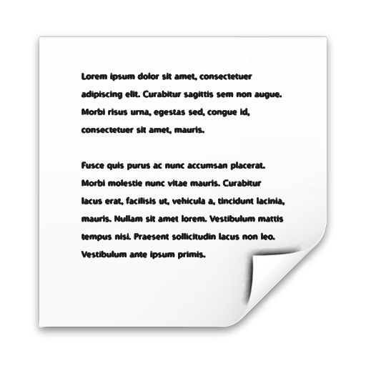
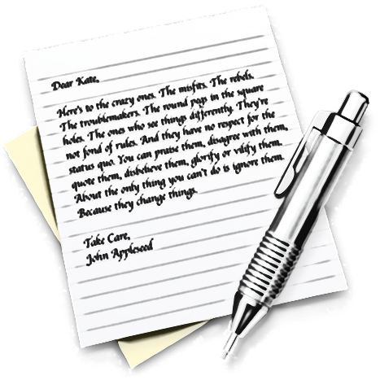
Written Text
Spoken and Written Text
Representation of a text
speeches ➔ characters/sentences ➔ paragraphs ➔ chapters
Printed version
Handwritten version
effort of interpretation
to assign a value to some
of the less legible words
once-for-all interpretation
of a text which may
never be read again
important sense of interpretation
readers can infer the message that the author intended to convey

Slide 10
Spoken Text
Spoken and Written Text
Tape-recording of a communicative act
Text
Part of the text
coughing, chairs creaking, buses going past, the scratch of a match lighting a cigarette
Analysis
Discourse analysts
Spoken Language
Transcribed and written on a paper
Orthographic
conventions
(spelling system of a language)
paralinguistic

Slide 11
The Relationship between written and spoken language
Spoken and Written Text
Written Language
Spoken Language
transference of
information
detailed transmission of
factual information
“
Not expected to write down the details
the speaker repeats sometimes several times over
”
If cannot remember all the things in spoken mode
Need to write it down to remember all the time
“
”

Slide 12
Differences in Form between Written and Spoken Language
Spoken and Written Text
Labov, 1972;
Sinclair & Coulthard, 1975;
Chafe, 1979;
Ochs, 1979;
Cicourel, 1981;
Goffman, 1981

Slide 13
Differences in Form between Written and Spoken Language
Spoken and Written Text
The syntax of spoken language is typically much less structured than written language
“
”
Good

Slide 14
Differences in Form between Written and Spoken Language
Spoken and Written Text
In written language we use “logical connector” such as: besides, moreover, however etc. In spoken language we use silence, or and, but, then, if
“
”
I’m so tired (because) I had to walk all the way home.

Slide 15
Differences in Form between Written and Spoken Language
Spoken and Written Text
In written language, sentences are generally structured in subject-predicate form, but in spoken language we usually find like: “the cats + did you let them out ?”

Slide 16
Differences in Form between Written and Spoken Language
Spoken and Written Text
In chat about the immediate environment, the speaker may rely on gaze direction to supply referent, example: (looking at the rain) frightful isn’t it.

Slide 17
Differences in Form between Written and Spoken Language
Spoken and Written Text
In spoken language, speaker may replace or refine expressions as he goes along, example: this man + this cap she was going out with

Slide 18
Differences in Form between Written and Spoken Language
Spoken and Written Text
In spoken language, the speaker typically uses a good deal of rather generalized vocabulary, such as: things like that, a lot of, got, do, thing, and stuff.

Slide 19
Differences in Form between Written and Spoken Language
Spoken and Written Text
In spoken language, the speaker frequently repeats the same syntactic form several times, example: I look at fire extinguisher + I look at fire exits + I look at what gangways are available + I look at electric cables what + are they properly earthed + are they properly covered

Slide 20
Differences in Form between Written and Spoken Language
Spoken and Written Text
In spoken language, the speaker may produce a large number of prefabricated fillers, such as: well, erm, I think, you know, if you see what I mean, of course, and so on.

Slide 21
Sentence and Utterance
Sentence and utterance
Lyon (1977)
‘the product of ordinary language behavior’

Slide 22
Sentence and Utterance
System-sentences never occur as the products of ordinary language-behavior. Representations of system-sentences may of course be used in metalinguistic discussion of the structure and functions of language: and it is such representations that are customarily cited in grammatical descriptions of particular languages. (Lyon, 1977: 31)

Slide 23
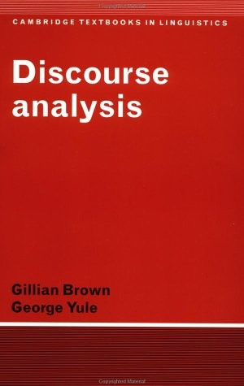
Sentence and Utterance
'sentence' :
'text-sentence',
'system-sentence' sense

Slide 24
Sentence and Utterance
System sentence linguist
produce accurate descriptions of the particular language studied
Text sentence linguist

Slide 25
Sentence and Utterance
Grammarian / System sentence linguist
*a set of rules
*mental process
Discourse analyst / Text sentence linguist
data, rules, process and context

Slide 26
Sentence and Utterance
A. On Data
Grammarian
* constructed the sentence or sentences he uses as examples
Discourse Analyst
* based on the linguistic output of someone other than the analyst

Slide 27
Sentence and Utterance
B. Rules versus Regularities
Grammarian
*The rules are 100% fixed and true
Discourse Analyst
*Regularities
*Discover regularities in his data and to describe them

Slide 28
Sentence and Utterance
C. Product versus Process
Grammarian
*his data is not connected to behavior
*'the well-formed sentences of a language'
Discourse Analyst
*Connected to behavior
*results of psycholinguistic processing experiments

Slide 29
Sentence and Utterance
D. On Context
Grammarian
Dealing with context
Discourse analyst

Slide 30
Conclusion
Discourse analysis is an umbrella term for all those studies within applied linguistics which focus on units/stretches of language beyond the sentence level (Judit, 2012). We as the human is use a natural language utterance which language serves in the expression of 'content' described as transactional and that function involved in expressing social relations and personal attitudes we describe as interactional. Spoken and written language has relation each other. But written language and spoken language have different form. The book concerns with sentence which is 'text-sentence‘, so it will connected to behavior and involves contextual considerations. The data which is used in this book is based on the linguistic output of someone other than the analyst. Besides, discourse analyst discovers regularities in his data.

Slide 31
Discussions

Slide 32
Thank Y☺u !

