Slide 1
Rules of word formation
Morphological Process Productivity
Exceptions and Suppletions
Compounding
Meeting 5

Slide 2
English Inflectional Morphemes

Slide 3
The Differences between Derivation and Inflection

Slide 4
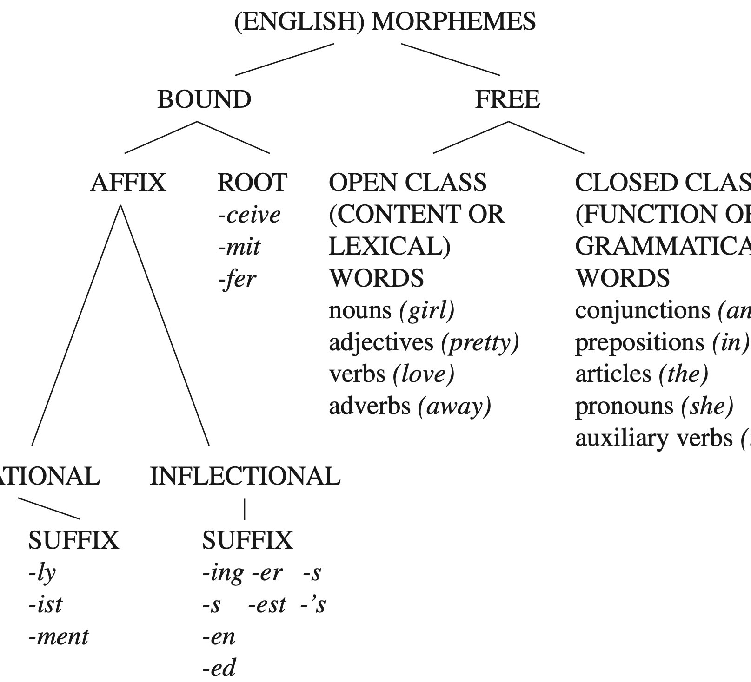
The English Morpheme Tree Diagram

Slide 5
Morphological Processes - Rules
Rule : 1
These morphological process are sometimes productive:
verb + -able to form adjective (able to be) → e.g., accept + able; adapt+ able, etc.
The formation of verb + able affixed to a new word : e.g., download + able, fax + able
Suffix - able

Slide 6
Prefix un- derives same class words, for instance: unafraid, unfit, unrealistic and so on.
It also applies to derived adjective words :
such as :
un + believe + able un + like + able
un + pick + up +able un + download + able
We know the words : happy → unhappy; coward → cowardly
But not for these words :
sad → *unsad; brave → *unbrave; obvious → unobvious
It seems to note that un- is productive mostly with the derived adjective words from verbs.
un+enlightened; un+simplified; uncharacterized --- give us more examples!!!!
Unacceptable un- forms are generally monosyllabic like *ungood, *unsad, *ungreat …
Rule 2:
prefix un-

Slide 7
Add to verbs to produce a noun meaning “one who does” giving us nearly productive morphological rules.
For instance:
examine + -er →examiner
what else…?
Not with ”nouns” such as a chairer, meaning “one who chairs”
The other rules means “more”.
for instance:
greedy + -er → greedier
clever + er → clever
what else …?
But not for these words :
beautiful + er → *beautifuler
curious + er → *curiouser
Why?
The more syllables a word has, the less likely –er will work and the word “more” is required.
Rule 3:
Affix -er

Slide 8
In terms of morphological complex words, we can in most cases predict the meaning based on the meaning of the morpheme.
What do these morpheme: -er, -able, un- mean?
What about these words, can you guess the meaning based on the morpheme?
for instance:
unloosen means
undo means `
unearth means
untread
“let loose, loosen”
“reverse doing”
“dig up”
“go back through in the same steps”
Rule 4:

Slide 9
Exceptions and Suppletions
Rule 5:
Plural morphological rules –s do not apply to these words:
examples:
child, man, foot, mouse; what else ..
And to these producing past-tense words :
example :
go, sing, bring, run, think; what else…
The irregular words (plural and past forms) are called “suppletion” which are treated separately in the grammar and cannot be the same with –ed suffixes.
* goed; *singed, *bringed, etc.

Slide 10
When a new word enters the language, the regular inflection rules for the most part apply.
For example :
geek → geeks not geeken
ox → oxen
fax → faxes not faxen
Datum vs data not datums as it is a borrowed foreign language.
When a verb is derived from a noun, the regular rule applies to it.
for example:
ring (encircled) from ring (noun) in ”the police ringed the bank with armed men” not ”the police rang the bank with armed men”.
”the hitter flied out (hit a lofty ball that was caught), rather than ”flew out” as the jargon of baseball is taken from the compound noun fly ball.
Rule 6

Slide 11
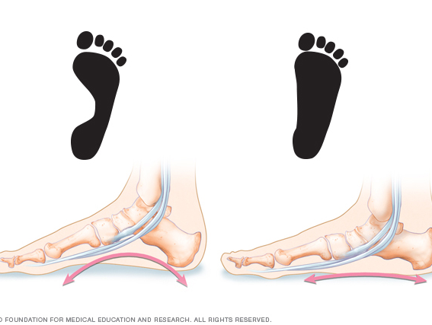
Rule 7
When a noun is used in a compound in which its meaning is lost, the plural forms follow the general morphological rules.
for instance:
flatfoot → flatfoots not *flatfeet
means a cop (singular) and a pair of cops (plural).

Slide 12
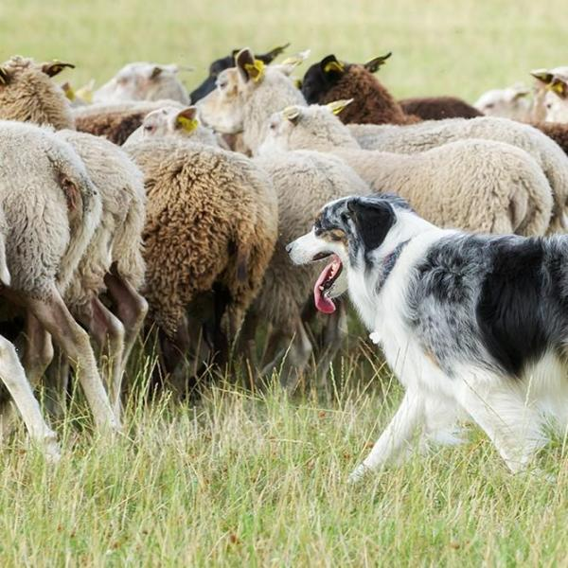
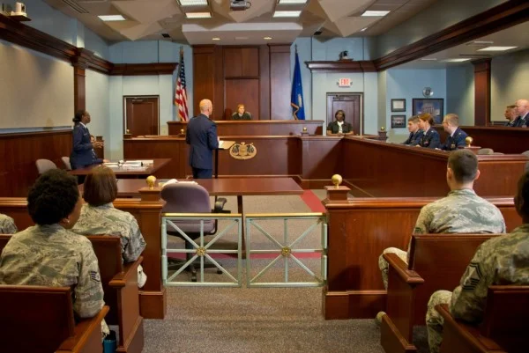
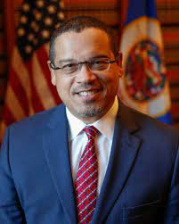
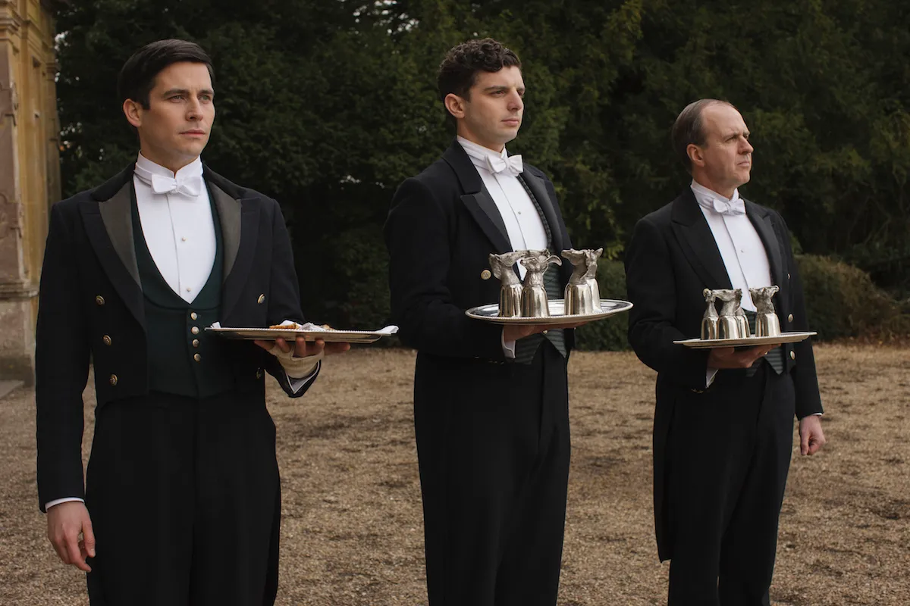
make these words plural
girlfriends
Girlfriend
Sheepdog
Mother-in-law
Court-martial
Attorney general
If the rightmost word of a compound takes an irregular form, nevertheless, the entire compound generally follows suit.
Example :
footman --?
sheepdogs
mothers-in-law
courts-martial
attorneys-general
Rule 8

Slide 13
Compounds
 | Adjective | Noun | Verb
Adjective | bittersweet | poorhouse | whitewash
Noun | headstrong | homework | spoonfeed
Verb | feel-good | pickpocket | sleepwalk
Two or more words may be joined to form a new, compound word.

Slide 14
Rule 9 :
The rightmost word in compound is the HEAD --- the part of a word/phrase that determines its broad meaning and grammatical category---of the compound.
Example:
noun + adjective = adjective (headstrong)
verb + noun = noun (pickpocket)

Slide 15
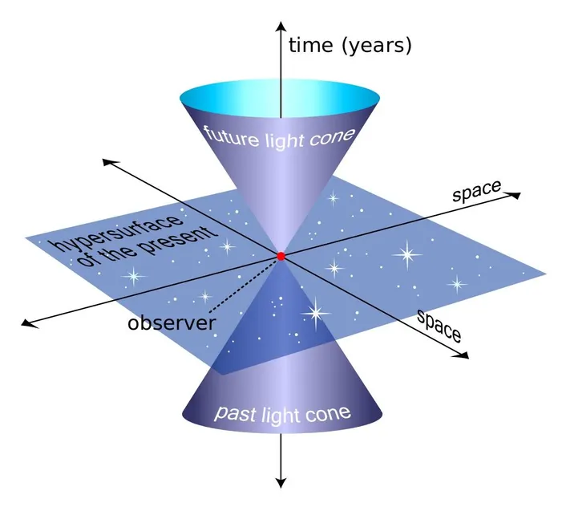
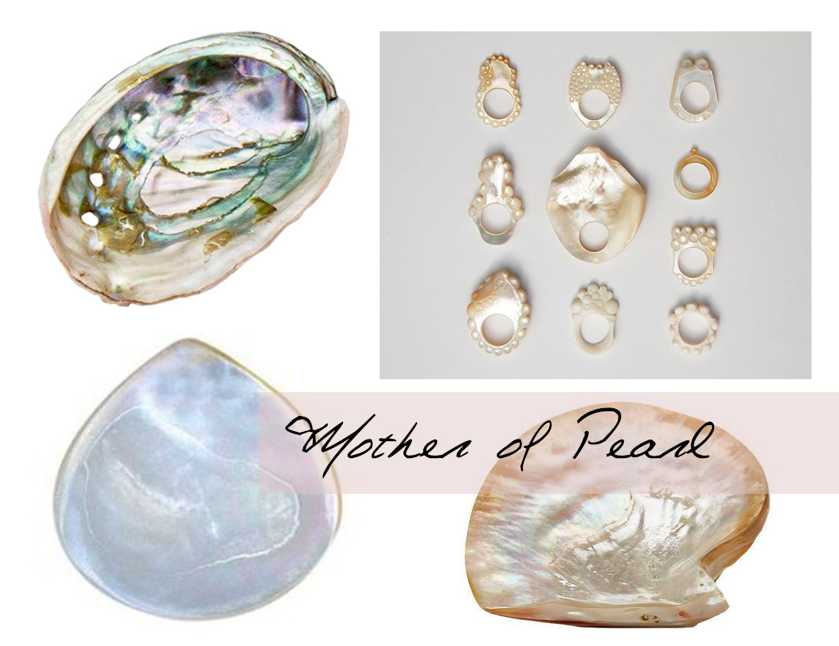
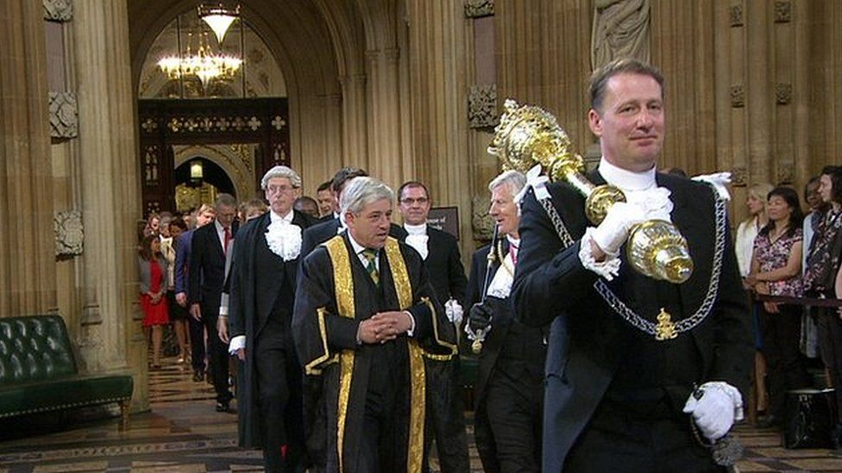
Compound complexity
Three-time looser
Master of ceremony
Father-in-law
Four-dimensional space-time
Mother-of-pearl
Sergeant-at-arms

Slide 16
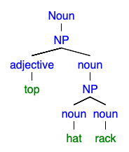
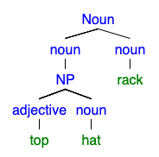
Compounds and ambiguity
Top hat rack
A rack for top hats
The highest hat rack

Slide 17
Meaning of Compounds
The meaning of compounds is not always the sum of the meanings of its parts.
Rule 10
“A blackboard”

Slide 18
Some compound words reveal other meanings from the parts.
What about a cathouse?
A boathouse
Rule 11
A cat house

Slide 19
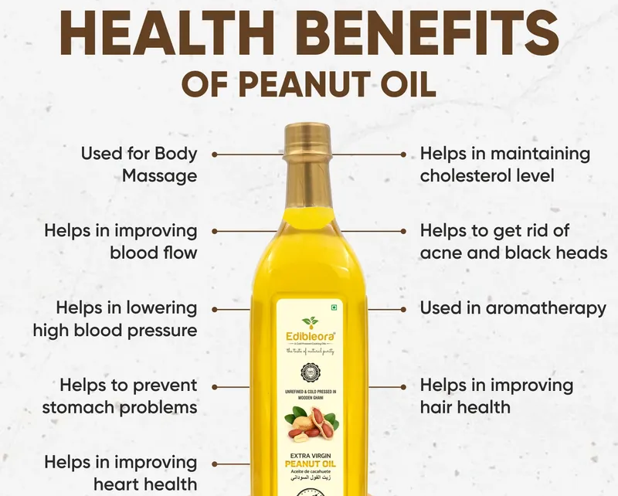
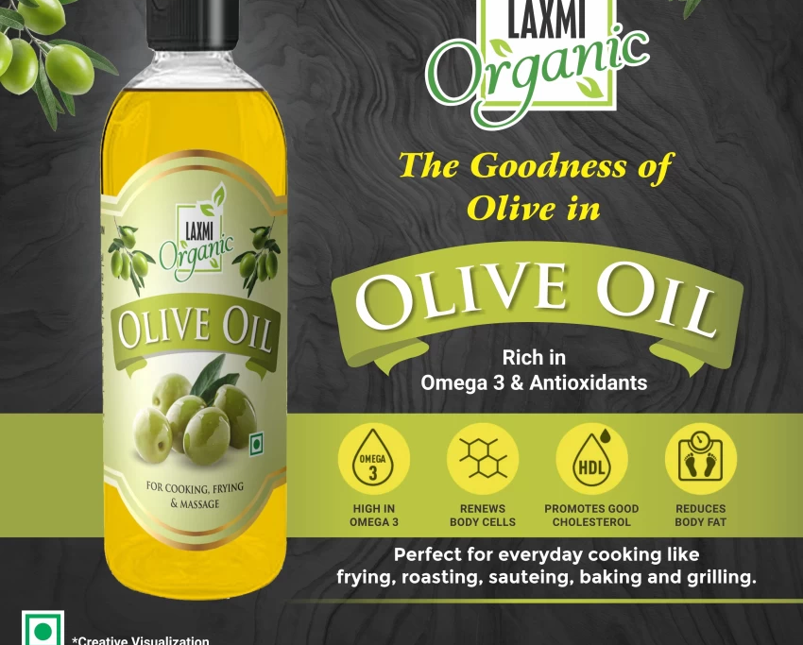
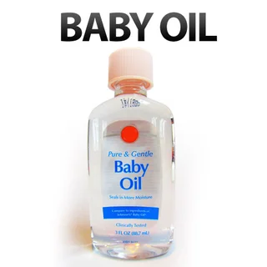
What about these compound words?
“Made from something”

Slide 20
some words may reveal from its parts but other are not. nowadays, many compound words do not seem to relate to the meanings of the individual parts at all.
Rule 12
For example :
a turncoat ?

Slide 21
The compound word pronunciation
Compound words differ from other words which are not compounded.
Compound words: the first word is usually stressed (pronounced somewhat louder and higher in pitch).
Non-compound words: the second word is stressed.
Try it :
A redcoat vs a red coat
Rule 13

Slide 23
Next week will be an evaluation time, be prepared!!

