Slide 1
Syntactic Category
Morphosyntactic class
Meeting 8

Slide 2
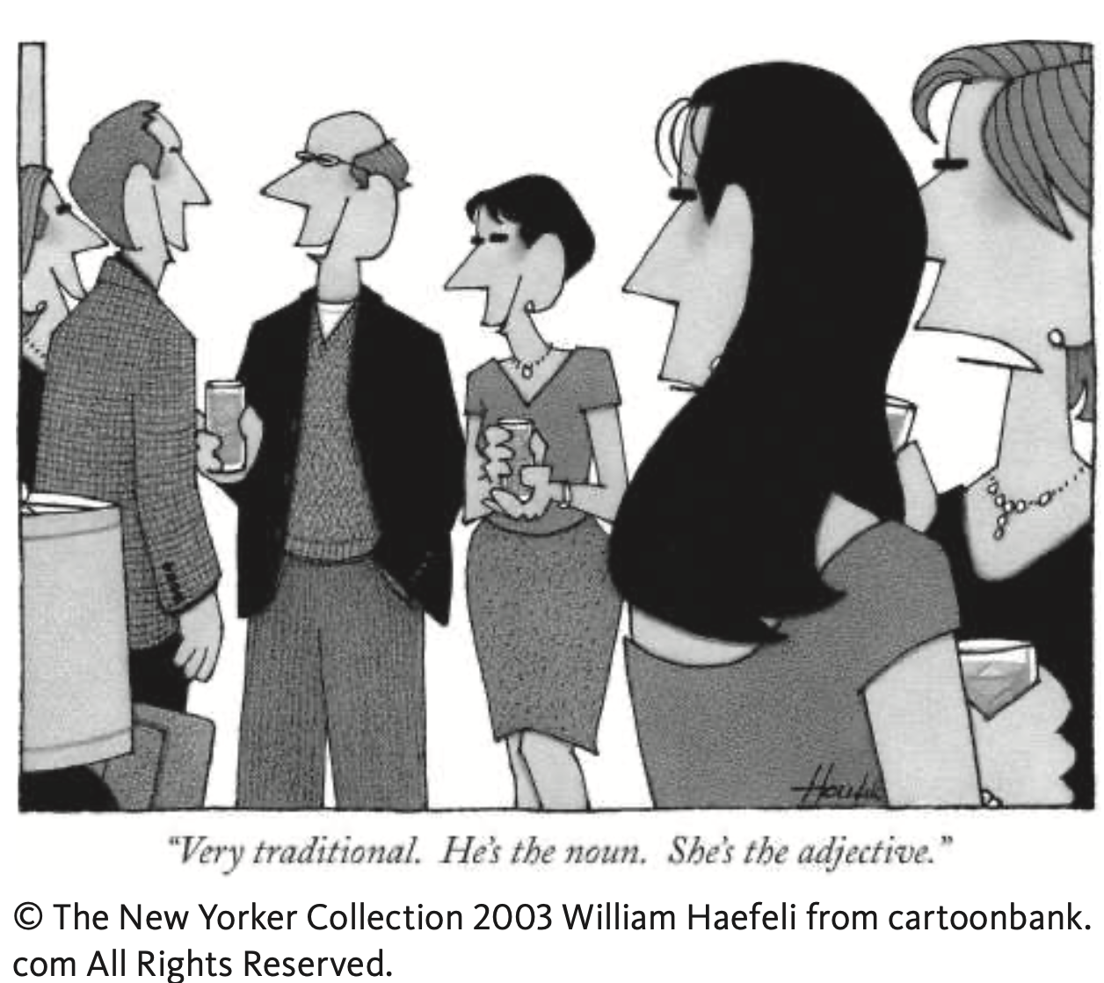
Word class/ part of speech
Syntactic category refers to a family of expression that can substitute for one another without loss of grammaticality .
For example:
The Kids found a new kitty.
My mom found a new kitty.
This white puppy found a new kitty.
Your uncle found a new kitty.
Noun Phrases

Slide 3
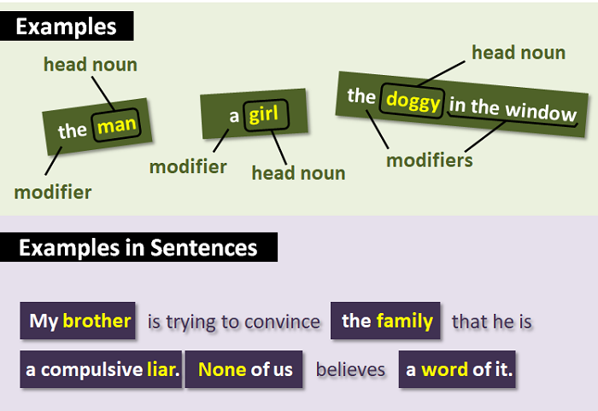
What is a noun phrase (NP) ?
A phrase?
A phrase means a group of words which form a grammatical unit. It does not contain a finite verb – being a verb or predicate – as well as does not have a subject-predicate structure.
A phrase has at least two words and functions as one part of speech.
A noun phrase is a group of two or more words headed by a noun that includes modifiers.

Slide 4
NP consists of a determiner (like a or the) and a noun, as well as a proper name, a pronoun, a noun without determiner, or even a clause or a sentence.
Proper nouns like Tiyas and pronoun such as he, him are single words can be categorized as NP as they can fill a subject or object or other NP slots.
For example:
Your uncle found a new kitty.
He found a new kitty .
The man loves a new kitty.
a new kitty loves him.
NPs can be more complex :
The boy that the girl loved played with a new kitty.

Slide 5
True or false? A noun phrase consists of a noun (a person, place, or thing) and any modifiers.
A. True
B. False

Slide 6
True or false? A noun phrase can function as a subject, an object, or a complement within a sentence.
A. True
B. False

Slide 7
Select the one with a noun phrase between the asterisks:
A. Youth would be *an ideal state* if it came a little later in life.
B. Better to write for yourself *and have* no public, than to write for the public and have no self.

Slide 8
Select the one with a noun phrase between the asterisks:
A. *When I was a boy* I was told that anybody could become President. Now I'm beginning to believe it.
B. The thing that impresses me the most about America is the way parents obey *their children*.

Slide 9
Select the one with a noun phrase between the asterisks:
A. Democracy is the name we give the people *whenever we need them*.
B. One machine can do the work of fifty ordinary men. No machine can do *the work of one extraordinary man*.

Slide 10
Find the head noun in this noun phrase.
one true love of mine

Slide 11
Find the head noun in this noun phrase.
three devils in disguise

Slide 12
Select the one with a noun phrase between the asterisks:
A. *There cannot be* a crisis next week. My schedule is already full.
B. You can tell a lot about a fellow's character by *his way of eating jellybeans*.

Slide 13
Select the one with a noun phrase between the asterisks:
A. I am *just going outside* and may be some time.
B. In America any boy may become President, and I suppose it's just *one of the risks that he takes*.

Slide 14
Find the head noun in this noun phrase.
the heavy one in the middle

Slide 15
Verb Phrase
It always contains a verb (V) , and other categories such as a noun phrase or prepositional phrase (PP) --- a preposition followed by an NP, such as in the park, on the roof, with a balloon.
For example:
The child …
saw a clown
slept
smart
ate the cake
found the cake in the cupboard
realized that Earth was round
⎷
⎷
⎷
⎷
⎷

Slide 16
Prepositional Phrase
Other examples:
It's a present from her.
(Remember that the "noun" can be a pronoun.)
She stole it from the man across the street.
(Here, the noun is a noun phrase.)
It's obvious from what he said.
(Here, the noun is a noun clause.)

Slide 17
Adjective Phrase
Other examples:
She had extremely blue eyes.
She wore very expensive shoes.
I'm a fairly intelligent person, but I don't think my grades reflected that.
I am sad about the result.
I am awfully sad about the result. I am very sad.

Slide 18
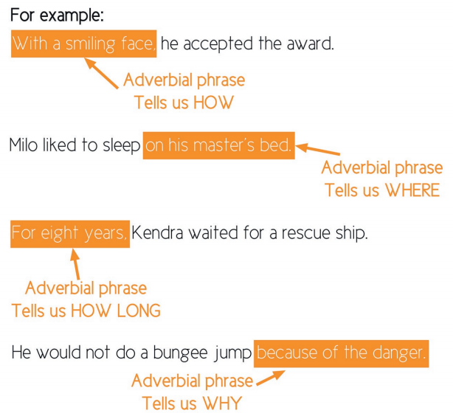
Adverbial phrases
A prepositional phrase is a group of words consisting of a preposition, its object, and any words that modify the object.

Slide 19
Any questions?

