Slide 1
Lexical relations and semantic features
Semantics and pragmatics

Slide 2
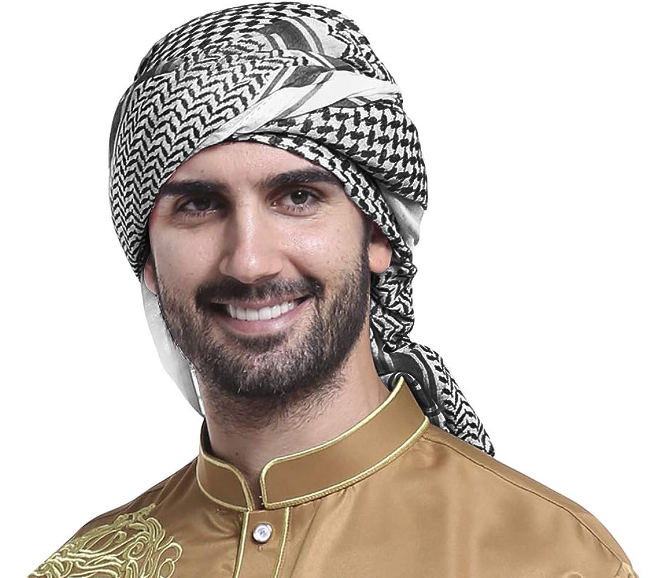
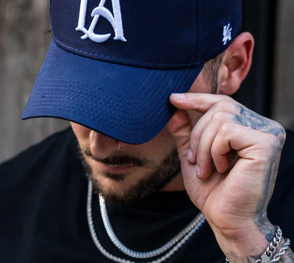
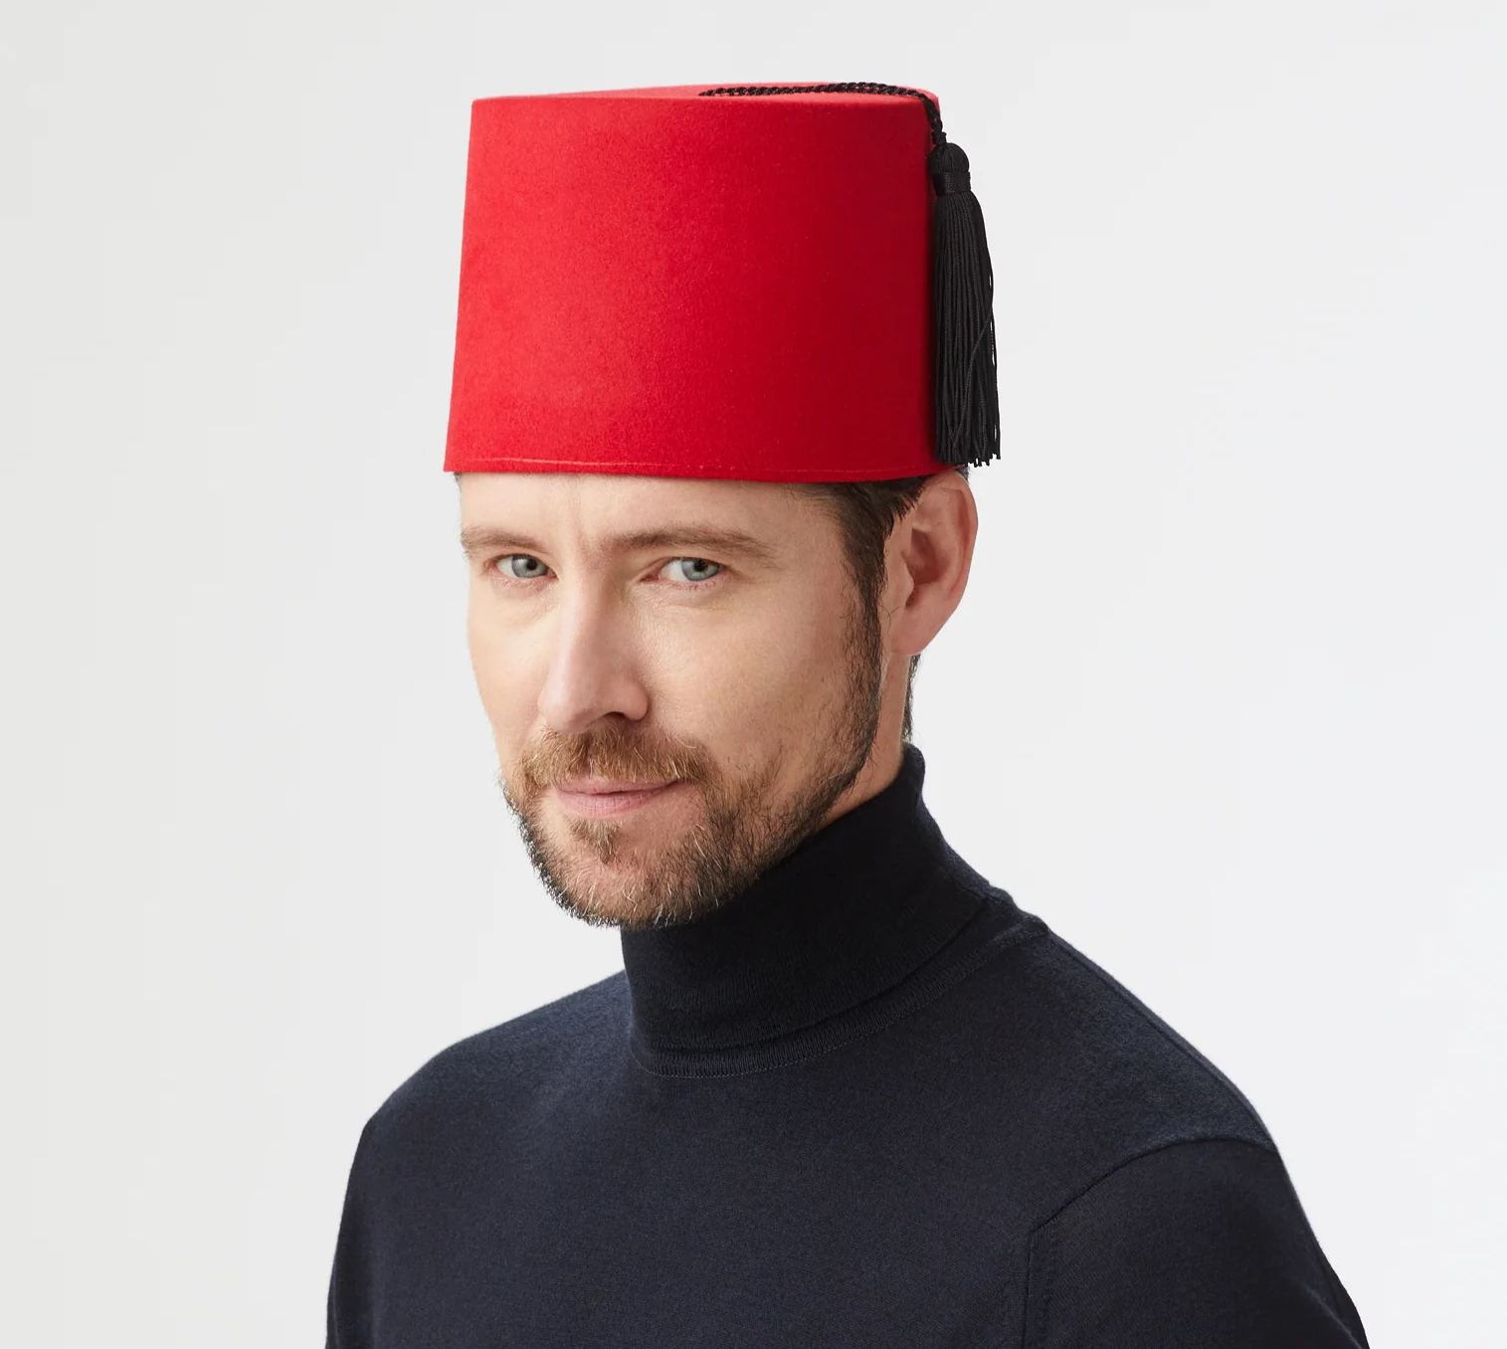
Think about these acts
Does he wear a …
turban
hat
fez

Slide 3
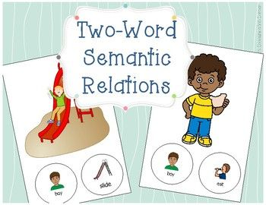
Speakers have considerable knowledge about the meaning relationship among different words in their mental lexicons
what do you know about mental lexicon?

Slide 4
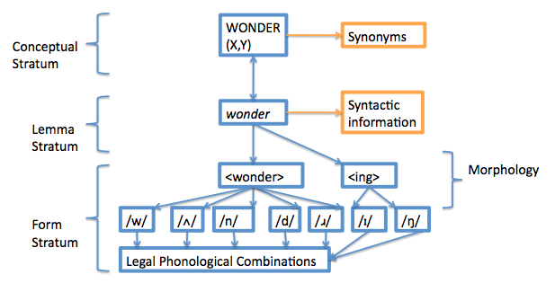

Slide 5
How it happens
Words are semantically related to one another in a variety of ways.
The words that describe these relations often end in the bound morpheme –nym.
The best-known lexical relations are synonymous (known as synonyms --- words or expressions that have the same meaning in some or all contexts--) or opposites (known as antonyms).

Slide 6
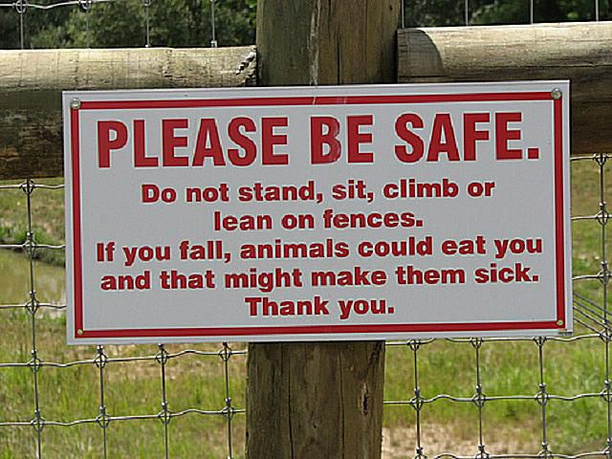
A sign in a zoo
Please do not annoy, torment, pester, plague, molest, worry, badger, harry, harass, heckle, persecute, irk, bullyrag, vex, disquiet, grate, beset, bother, tease, nettle, tantalize, or ruffle the animals.

Slide 7
It has been said that there are no perfect synonyms --- that is, no two words ever have exactly the same meaning.
He’s sitting on the sofa. He’s sitting on the couch.

Slide 8
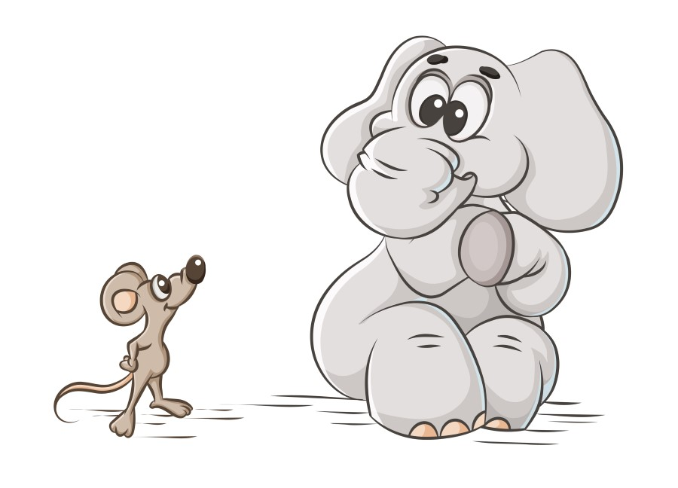
Antonyms
Words that are opposite in meaning are antonyms involving complementary and gradable pairs.
Alive/dead
present/absent
awake/asleep
big/small hot/cold fast/slow happy/sad
Remember!
The meaning of adjectives in gradable pairs is related to the objects they modify.
We know that a small elephant is much bigger
than a large mouse

Slide 9
Another pairs of antonym
Give/ receive
Buy/sell
Teacher/pupil
They are called Relational opposites, and they display symmetry in their meaning.
Examples:
If Herry gives a TV to Bryan, meaning that Bryan receives a TV from Herry.
If Belia is Jenni’s teacher, meaning that Jenni is a student.
If Julia buys some mangos from Melody, meaning that melody sells mangos to Julia.

Slide 10
Another feature of antonym
Prefix un-, non-, and in- addition
For instance:
Likely/unlikely able/unable fortunate/unfortunate
Entity/nonentity conformist/nonconformist
active/inactive adequate/inadequate dependent/independent

Slide 11
Homonyms, polysemy, and hyponyms
Homonyms (homophones) relate to words that have different meanings but are pronounced the same and may or may not be spelled the same.
For example :
Write and right
Night and knight
See and sea
Bear and bare

Slide 12
Polysemy
it refers to a single word that has multiple meanings that are related by extension.

Slide 13
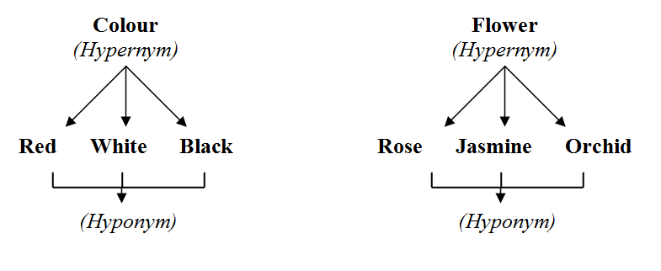
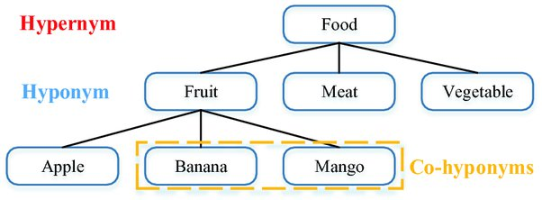
hyponyms
Words that refer to a specific subtype or instance of a more general category, which is termed the "hypernym". In other words, a hyponym is a word whose meaning is a subset of another word's meaning.

Slide 14
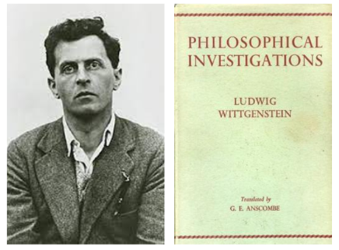
Semantic features
“If it is true that words have meanings, why don’t we throw away words and keep just the meaning?”

Slide 15
What does semantic features mean?
Properties that are part of word meanings that can reflect our knowledge about what words mean.
It is important to decompose the features, as it can clarify how certain words relate to other words.
For example:
The basic property of antonyms is that they share all but one semantic feature in common.
Consider these words : BIG and RED?
What do you think about those words.
Are they classified as antonym? Why are they not so?
about size
They have a common feature which is adjective
about color

Slide 16
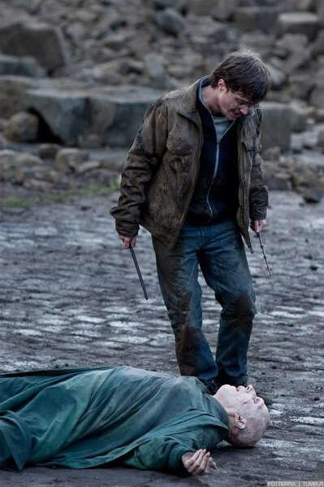
Bravery
determination
Self-sacrifice
Semantic features are among the conceptual elements that are part of the meanings of words and sentences.
For example:
Harry Potter killed Lord Voldemort
What can you say about the semantic features in the sentence above?
A killer
Ruthless,, cold, powerful
Evil incarnate
immortality motivation

Slide 17
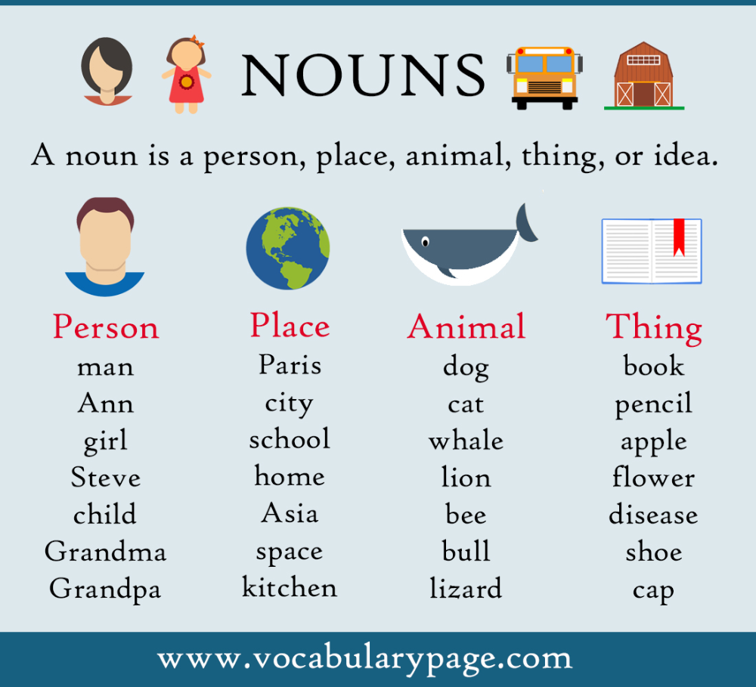
Semantic features of nouns
Indicating “female”
For example:
Aunt maiden widow
Girl woman hen
Indicating count/mass nouns
For example :
student book course
Money water hair

Slide 18
Any questions?

Slide 19
Things to do
Next week is the evaluation time
What you need to do is say something about a topic that we have learnt together including challenges, navigation, any topics that you think it is worth to mention.
250 words would do.
Send your thoughts to my email at dedy.subandowo@ummetro.ac.id by Sunday 15 oct at 11 pm the latest, so that I can read and select which thoughts can be discussed in the next meeting.

