Slide 1
PRAGMATICS
Reflections on Linguistics Mastery
Meeting 7

Slide 2
Outline
What is pragmatics
A brief overview of pragmatics studies
Three fundamental aspects in pragmatics
The role of context in pragmatics
Relevant pragmatics issues :
pronouns and other deictic words
implicature
conversational patterns and structures (e.g. turn-taking)
Pragmatics and language instruction:
the possibility of pragmatics transfer
cross-cultural studies : speech acts
pragmatic proficiency and the value of language instruction

Slide 3
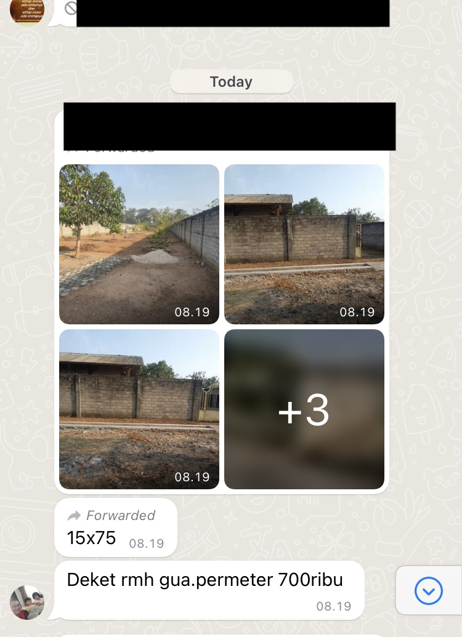
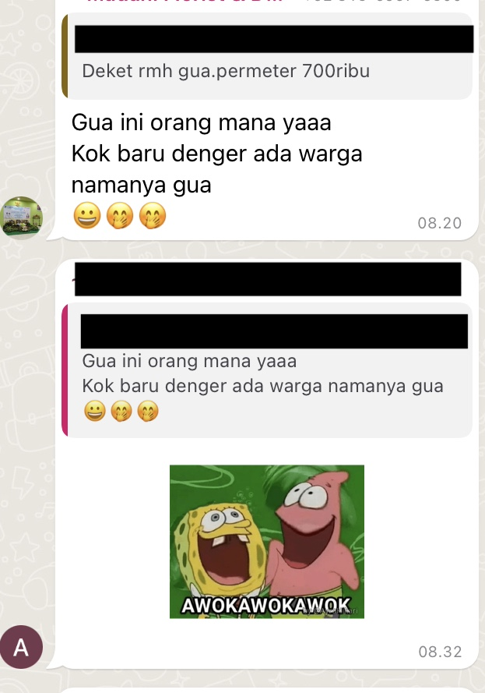
The context:
Budi sent pictures about the land sale to the residential group without providing any contextual information regarding the land.
Agung asked for extra information regarding the shared pictures.

Slide 4
WHAT IS PRAGMATICS
“The study of the use of language in communication, particularly the relationships between sentences and the contexts and situations in which they are used”
(Richards and Schmidt, 2010, p.449).

Slide 5
A BRIEF OVERVIEW OF PRAGMATICS STUDIES
Over the past 30 years, pragmatics has grown into a well-established discipline in institutional terms.
Specialist journal : Journal of Pragmatics, Pragmatics – Science Direct
A professional organization – The International Pragmatics Association
Pragmatics is the science of the relation of signs to their interpreter.
Other words, it studies not with language as a system or product per se, but rather with the interrelation between language form (communicated) message and language users.

Slide 6
Three fundamental aspects in pragmatics
How the interpretation and use of utterances depends on knowledge of the real world
How speakers use and understand speech acts
How the structure of sentences is inﬂuenced by the relationship between the speaker and the hearer

Slide 7
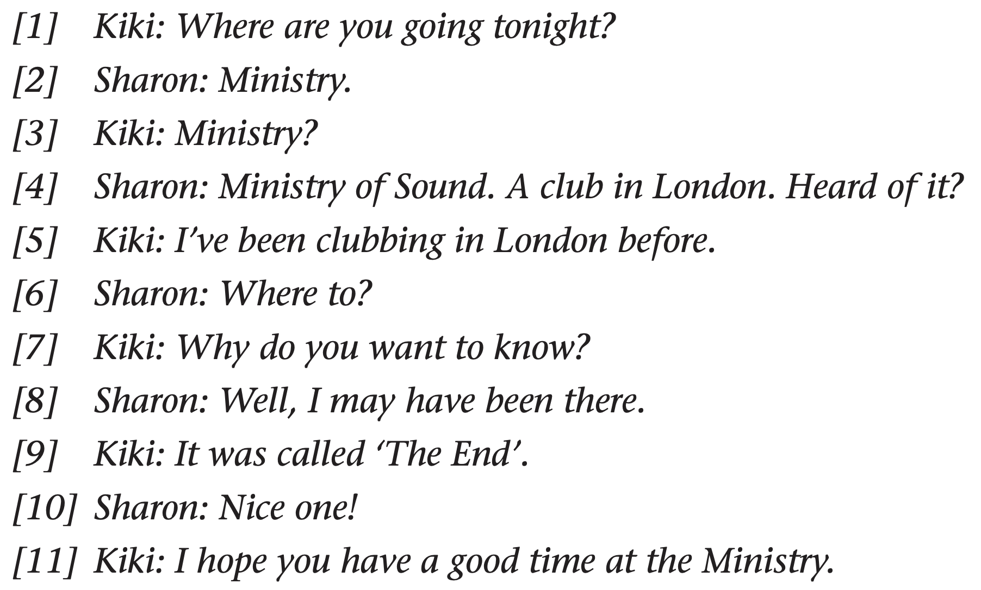
A sample dialogue
Situation: Kiki and Sharon are students at a British University. They have been flatmates for a short time and do not know each other very well. Kiki is Greek and Sharon is English. Sharon is getting ready to go out.

Slide 8
THE ROLE OF CONTEXT IN PRAGMATIC STUDIES
Context in pragmatics means the set of assumptions (that is, mental representations capable of being true or false) that have a bearing on the production and interpretation of special communicative acts.
Features in affecting people’s use of language:
The participants: their roles, the amount of power diﬀerential (if any) between them, the degree of distance–closeness between them, the number of people present.
The message content: how ‘beneﬁcial’ the message is to the hearer and/or speaker, how face-threatening it is, whether it exceeds or stays within the rights and obligations of the relationship.
The communicative activity (such as a job interview, a lecture, or a medical consultation): how the norms of the activity inﬂuence language behaviour such as right to talk or ask questions, discourse structure and level of formality.

Slide 9
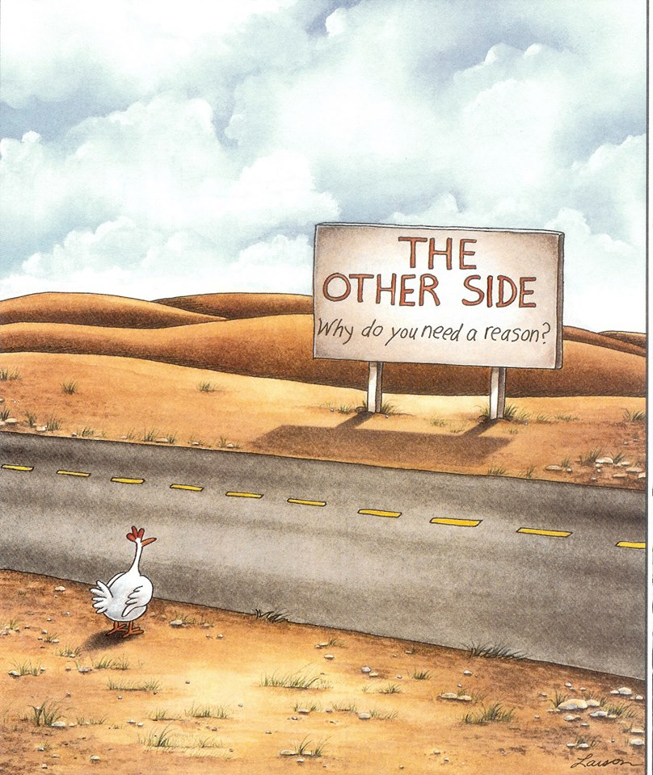
Pronouns and Other Deictic Words
Chicken shouting to friend across the road: Hey!! how do I get to the other side?
Friend : You are on the other side!

Slide 10
Words called DEICTIC as it denotes a word or expression whose meaning is dependent on the context in which it is used (such as here, you, me, that one there, or next Tuesday ).
Deictic words :
pronouns (she, he, it)
demonstratives (this, that)
adverbs (here, there, now, today)
prepositions (behind, before)
complex expressions (those towers over there)

Slide 11
Implicature
--- “What does “yet” mean, after all? “I haven’t seen Reservoir Dogs yet.” What does that mean? It means you’re going to go, doesn’t it?”

Slide 12
Implicature refers to a concept in pragmatics where speakers convey meaning indirectly or through implied suggestions rather than stating something explicitly.
Literal meaning:
The boy mentioned that Toni is such a great guy.
Dad asked Mom whether she thinks the girl is nice and Mom assert that the turkey was moist.
Mom only described “The turkey” not the girl or Tony.
It can be indicated that …..

Slide 13
Conversational Patterns and Structures
The study of conversational patterns is called Conversational analysis.
Conversational analysis deals with the common-sense observation that people take turns in conversation, and that relies on descriptions of naturally occurring data to discover the rules involves in the patterning of conversational exchange.
Patterns: ordered pairs of utterances (e.g., adjacency pairs) such as Question and Answer sections and Turn-Taking

Slide 14
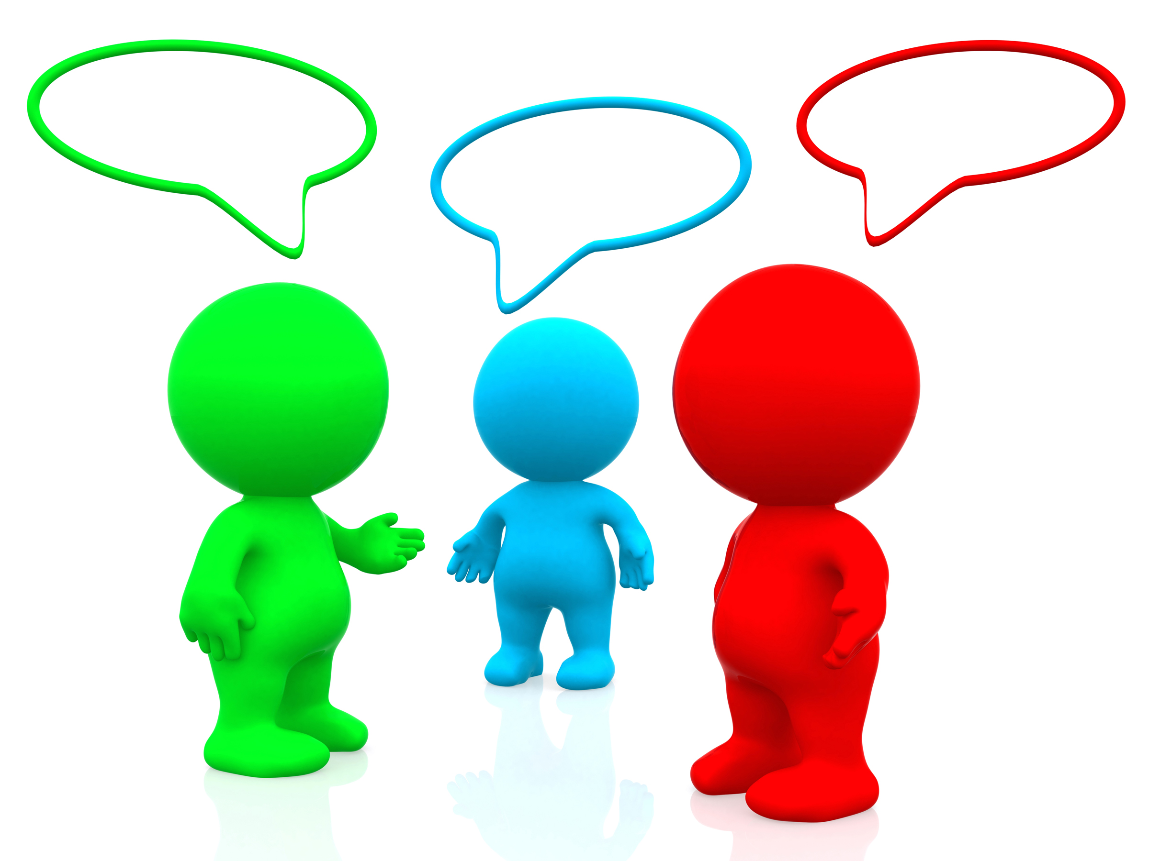
Turn-taking
Basic unit of speech in conversational analysis
Turn means any occasion when a speaker speaks and a turn ends when another speaker takes a turn.
Rules for who speaks when, by nomination from current speakers
Silence leads to self-selection
Features for nomination :
If I may ask a question of the panel’, Can I speak?
Back channel responses ( e.g. Mmm, uhuh, yeah, sure, right)
Interlocutor’s prediction of one another’s turn
Overlap while another speaker is talking

Slide 15
Pragmatics and Language instruction
Pragmatics studies the different aspects of the complex relation between linguistic meaning and contextual interpretation.
The importance of pragmatics in learning and teaching for EFL/ESL or a new language
Learning EFL/ESL to communicate with other people around the globe
Grammaticality vs meaning in a context, which one is more important?

Slide 16
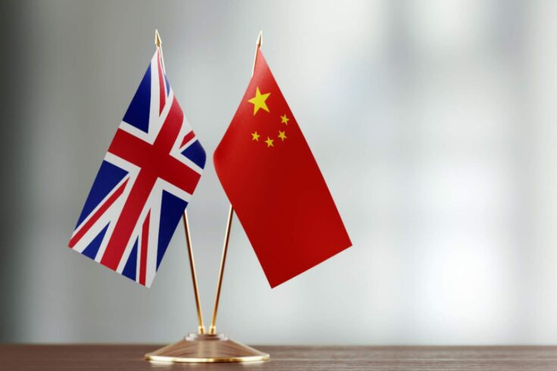
The possibility of pragmatic transfer
Learning a L2 connects to L1
Teachers’ awareness regarding pragmatic transfer is important
Different culture such as “a close friend thank” you in China vs England
Researchers focus on the study “cross-cultural pragmatics” --- a contrastive study through different pragmatic features in a wide range of languages.
Speech acts?
An utterance defined in terms of a speaker's intention and the effect it has on a listener. Essentially, it is the action that the speaker hopes to provoke in his or her audience. Speech acts might be requests, warnings, promises, apologies, greetings, or any number of declarations.
In China if you thank a close friend after they have done you a favour, it
may be perceived as ‘distancing’ behaviour and hence inappropriate; in England, on
the other hand, failure to thank would be inappropriate because it implies taking the
friend for granted.

Slide 17
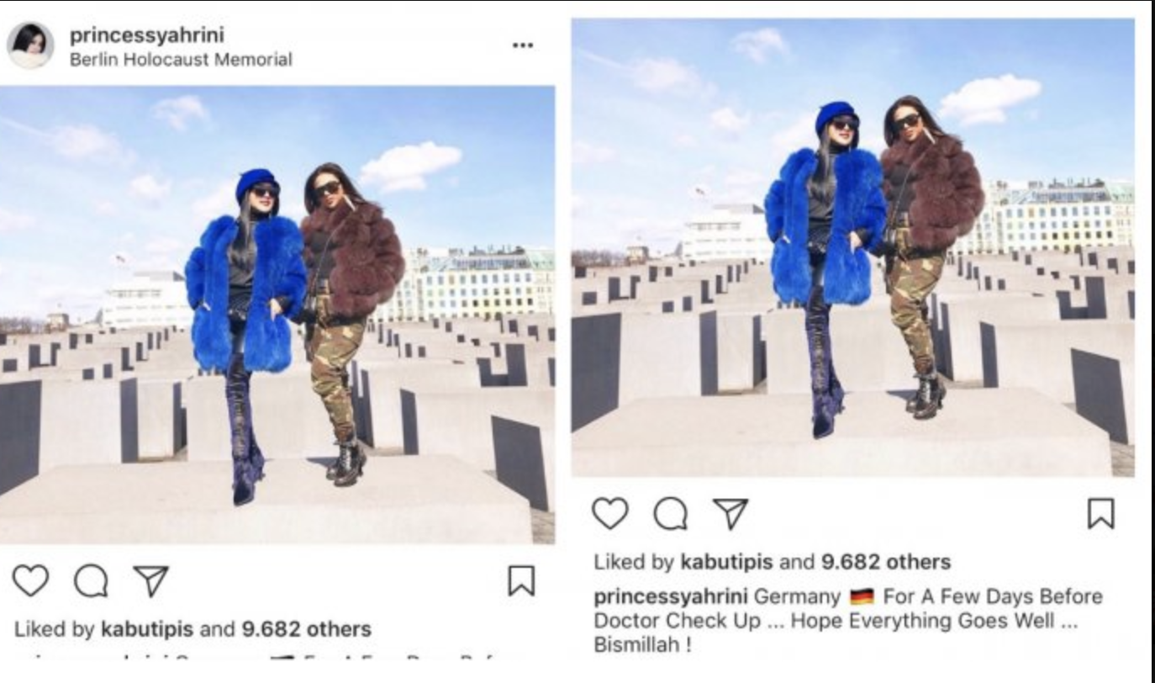
Cross cultural studies : Speech Acts
Question-related issues:
What cultural diﬀerences (if any) are there in the eﬀect of context on the performance of speech acts? (For example, if two strangers slightly bump into each other, do British and Greek people evaluate this similarly in terms of degree of seriousness, and thus have similar conceptions as to whether a verbal apology is required?)
What cultural diﬀerences (if any) are there in the impact of sociopragmatic principles on people’s performance of speech acts? (For example, when responding to a compliment, is it more important to express verbal modesty in Chinese than in English?)
What language diﬀerences (if any) are there in the inﬂuence of pragma- linguistic conventions on the performance of speech acts? (For example, when expressing disagreement, is it common to soften the impact by using an ‘I agree with you but …’ structure, or by asking for further information?)

Slide 18
Pragmatic Proficiency and the Value of Language Instruction
Teachers’ considerations:
1) Is the target pragmatic feature teachable at all? (e.g., Hedging: it seems to me that …)
2) Is instruction in the targeted feature more eﬀective than no instruction? (e.g., request vs apology)
3) Are diﬀerent teaching approaches diﬀerentially eﬀective?

Slide 19
Bye for now
Do you have any questions?

