Slide 1
Psycholinguistics
Discourse and Conversation
Dedy Subandowo
11.18.2020

Slide 2
Outline
The Definition of Discourse
Spoken and Written Discourse
2.1 Informal and Formal Spoken Discourse
Lexical Patterns in Spoken Language
Aproaches to Discourse Analysis
Conclusion

Slide 3
1. The Definition of Discourse
Consider an ordinary day → Discourse day
Morning → greeting, having breakfast, watching news item on TV, going to work or school
Afternoon → discussing plans at meeting, writing an essay in the university library, having lunch with classmates
Evening → having dinner with family, sitting down to review the day, dream about future
Discourse concerns language functioning in one of many contexts that together make up a culture ( Schmitt, 2020).

Slide 4
Discourse is relevant to the diverse demands on language including different features of patterning as well as lingustic strategies.
In the field of applied linguistics, it has come to be known as “discourse analysis”.
Discourse analysts investigate “utterences” (sequences of words written or spoken in a specific context).

Slide 5
2. Spoken and Written Discourse
Focus in linguistics on written language as highly structured and organized
Spoken language seems to be formless and ungrammatical
Discourse analysis investigation
Spontaneous speech is unlike written text, it contains many mistakes, sentences are unsually brief and indeed the whole fabric of verbal expression is riddled with hesitations and silences (Beattie, 1983) .

Slide 6
Halliday’s (1985) myth of formlessness justification shows that “imperfection” is based on the analysis of written transcriptions of conversation.
Spoken language is a highly elaborate organization and grammatically intricate, though it seems to be different from the language that which we read and write.
The scale between spoken and written discourse (McCarthy et. al, 2020)

Slide 7
2.1 Informal and Formal Spoken Discourse (McCarthy et. al, 2020)
Informal Spoken Discourse | Formal Spoken Discourse
Primary purpose is the achievement of interpersonal goals: to establish who we are, how we relate to others and what we think of how the world is | Primary purpose is the achievement of pragmatic goals: to talk to ﬁnd out information, to pass on knowledge, to make appointments, to get jobs and to jointly participate in practical activities
Spontaneity phenomena, such as false starts, hesitations, interruptions and overlap | Turn-taking more ordered
Constantly shifting topics as the goal is not to achieve a particular purpose | Role diﬀerentiation: there is clear role diﬀerentiation between interactants (for example, in doctor–patient interactions), which results in greater topic control
Conversations are open-ended and can continue for hours; it is in the process of talking that we explore our social relationships | Formal conversations are closed; once the task is achieved, interaction ends

Slide 8
3. Lexical Patterns in Spoken Language
Speakers make their lexical choices.
Listeners receive and interprete them.
The meaning is open to negotiation.
The lexical meaning comes out form the context.
E.g., agreed meaning emerges from the repetition or synonym.
SPEAKER 1: And then we went down to San Diego. Santa Barbara.
SPEAKER 2: California. Lovely.
SPEAKER 1: Yeah. Oh.
SPEAKER 2: Yeah.
SPEAKER 1: It was really beautiful.
SPEAKER 2: It’s a beautiful place.

Slide 9
Agreed meaning with synonym
SPEAKER 1: Alice where did you get that skirt? Cos I want one like that.
SPEAKER 2: Isn’t it lovely?
SPEAKER 1: It’s so nice.
SPEAKER 3: In Top shop.
This situation is known as ‘relexicalization’ (McCarthy, 1988).
Complex forms – repetition and relexicalization
SPEAKER 1: Ooh. Look at the sky.
SPEAKER 2: Oh that’s lovely.
SPEAKER 1: Gorgeous. The sky is absolutely beautiful.
SPEAKER 2: Beautiful.
Complex forms – display of the opposites in the same utterance
SPEAKER 1: I can take a bit of the burden oﬀ Jim. Sometimes it’s hard but I sometimes really feel as though I’m bashing my head against a wall though.
SPEAKER 2: Well it is it is hard isn’t it. It’s not easy to go forward.
It seems that meaning connections such as synonym and antonym are relevant to speaker’s mental lexicon and become a strategy in creating meaning. This is a quick process to retrieve particular words in conversation.

Slide 10
4. Approaches to Discourse Analysis
Sociology Approaches
Conversational analysis
Turn-taking
Sociolinguistic approaches
Ethnography
Variation theory
Linguistic approaches
The Birmingham School
Systemic Functional Linguistics
Critical Discourse Analysis
Language Ideology & Power
Genre

Slide 11
4.1 Sociology Approaches
Conversational analysis :
Detailed organization of everyday interaction
Dialogue
Spoken discourse of a fairly informal character
appropriate and accessible resource for sociological inquiry
Fine-grain analyses with key questions for conversation :
How do people take turns in conversation?
How do people open and close conversations?
How do people launch new topics, close old ones, shift topic, etc.?
How is it that conversation generally progresses satisfactorily from one utterance to the next?

Slide 12
Turn-taking
Basic unit of speech in conversational analysis
Turn means any occasion when a speaker speaks and a turn ends when another speaker takes a turn.
Rules for who speaks when, by nomination from current speakers
Silence leads to self-selection
Features for nomination :
If I may ask a question of the panel’, Can I speak?
Back channel responses ( e.g. Mmm, uhuh, yeah, sure, right)
Interlocutor’s prediction of one another’s turn
Overlap while another speaker is talking

Slide 13
Patterns in turn-taking : adjacency pairs
adjacency pair is a pair of turns that mutually aﬀect one another.
E.g greeting–greeting, compliment–thanks, apology–acceptance.
adjacency pair involves first pair-part and second pair-part
First pair-part | Second pair-part
Smooth preferred sequence
Good morning | Hi, good morning
Congratulations on the new job | Oh, thanks
Dispreferred sequence
Hi, how are you? | Drop dead!

Slide 14
Patterns in turn-taking : adjacency pairs
Politeness
Small talk
Opening and closing
Solidarity routines :
A: I have a terrible headache
B:Oh, I’m sorry, can I do anything?
Converging pairs’
A: I just love that green sweater
B:Oh,so do I, isn’t it great!)

Slide 15
4.2 Sociolinguistic Approaches
Ethnography
Deals with the situation and uses, the patterns and functions, of speaking as an activity in its own right (Hymes, 1974).
Investigates speech event involving interaction such as a conversation at party or ordering a meal.
The SPEAKING as the contextual dimension of use of language
Hymes’s SPEAKING grid (Hymes, 1972)

Slide 16
Variation theory
The structure of spoken narrative
Overall structure of personal experience narrative (Labov & Waletsky 1967):
Abstract (summary of story, with its point),
Orientation (in respect of place, time and situation),
Complication (temporal sequence of events, culminating in crisis),
Evaluation (narrator’s attitude towards narrative),
Resolution (protagonist’s approach to crisis),
Coda (point about narrative as a whole).

Slide 17
4.3 Linguistic Approaches
The Birmingham School
Sinclair and Coulthard’s (1975) tape-recorded mother tongue classes
Traditional class – teacher-centered learning
Pupils answer the teachers’ questions
The analysis of classroom discoure
The extract from the recorder:
T = Teacher P = Any pupil who speaks
T: Now then … I’ve got some things here, too. Hands up. What’s that, what is it?
P: Saw.
T: It’s a saw, yes this is a saw. What do we do with a saw?
P: Cut wood.
T: Yes. You’re shouting out though. What do we do with a saw? Marvelette.
P: Cut wood.
T: We cut wood.

Slide 18
Sinclair and Coulthard’s (1975) model involves:
Classroom-lesson phases |  |  | Eliciting exchange (IRF Model)
Transaction | Discourse markers : e.g. Now then, right
Exchange | Question-answer-feedback combination |  | Initiating move
Move | The single action of questioning, answering, feeding back |  | Responding move
Acts | Nominating to speak |  | Follow-up move
Example of IRF Model conversation:
T: How do we use a thermometer? Jennie. (Initiating )
P: Put it in your mouth. (Responding move)
T: You put it in your mouth. (Follow-up move)

Slide 19
Systemic functional linguistics
Socially oriented
Describing the relationship of language, text and social life
Explaining the nature and organization of language according to what it has to do.
E.g, excuse me, do you know the way to the Pazmany campus? → this serves the purpose of asking for directions
Concerning how people use with each other to accomplish everyday social life
Enabling conversation to work and to have power

Slide 20
4.4 Critical discourse analysis
Focuses on relationship between language, ideology and power (Fairclough, 1989).
Genres play important aspects as social actions in particular social and historical contexts.
Analyses the text from textual regularities, classes, genders, and ethnic bias that are incorporate as well as what discursive practices are constructed in the text.
Genre seems to construct social reality and shape the social context.

Slide 21
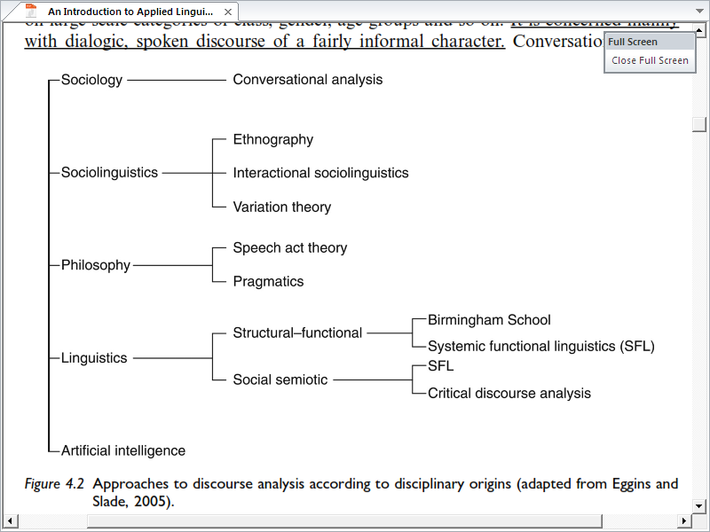
Approaches to discourse analysis according to disciplinary origins (adapted from Eggins and Slade, 2005)

Slide 22
Conclusion
Our lives are built by discourse.
It is not possible to exclude the existance of discourse that plays major contribution to our social relations and communications involving spoken and written language.
The notions of spoken discourse based on the applied linguists’ claims lead to current understanding of how this field works in a wide range of social levels.
The demonstration of spoken and written language is distincly independent and it is open to investigate via proposed approaches that by and large apply succesfully in the field of applied linguistics and education.

Slide 23
Thank you

