Slide 1
REFLECTIONS ON LINGUISTICS MASTERY ---------------------------------------------------------------- Sociolinguistics
By
Llamas, Carmen; Stockwell, Peter. In N. Schmitt (Ed.), An Introduction to Applied Linguistics (pp. 146-63). Arnold.
Meeting 7

Slide 2
Defining sociolinguistics
The study of language and society
The study of the linguistic indicators of culture (e.g.,grammar, vocabulary, discourse analysis, pragmatics, phonology and corpus) and power (ethnicity, gender, ideology and social rank on language events.
Sociolinguistic studies are to account of social aspects of language in a real world.
The study of language variation and language change (diachronic and synchronic).

Slide 3
Three key principles in sociolinguistics
differences in pronunciation, grammar, or word choice within a language due to region, social class, education background
Language Variation
Speech Variety
Variant (Variable)
It may be used for different varieties of one language, e.g. American English, Australian English, Indian English.
linguistic various forms due to differences in the socio-economic background, education, age, or sex of the speakers (e.g., /ng/ variable and /r/ sound )

Slide 4
Three key principles in sociolinguistics
Language variation : differences in pronunciation, grammar, or word choice within a language due to region (dialect, regional variation), social class, and educational background (sociolect).
Variety (speech variety): a term sometimes used instead of language2, dialect, sociolect, pidgin, creole, etc., because it is considered more neutral than such terms. It may also be used for different varieties of one language, e.g. American English, Australian English, Indian English.
Variant (variable) : linguistic various forms due to differences in the socio-economic background, education, age, or sex of the speakers
For instance: /ng/ variable and /r/ sound

Slide 5
Linguistic Variation
Code-switching: moving from one language to another language within a single utterance and sometimes even within a sentence.

Slide 6
Diglossia
When one variety is H (high) and the other is low (L)
For example:
Arabic quran (H)
Vs
General Arabic (L)

Slide 7
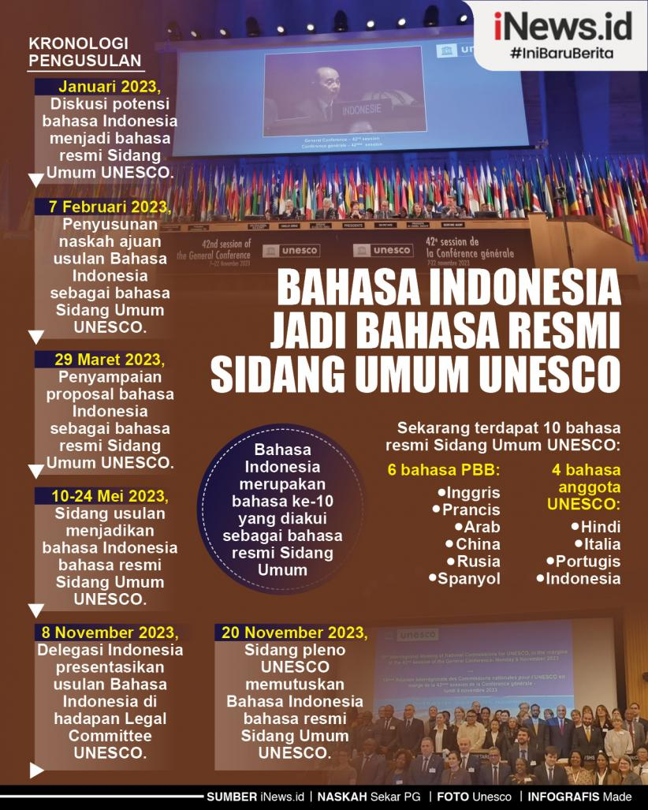
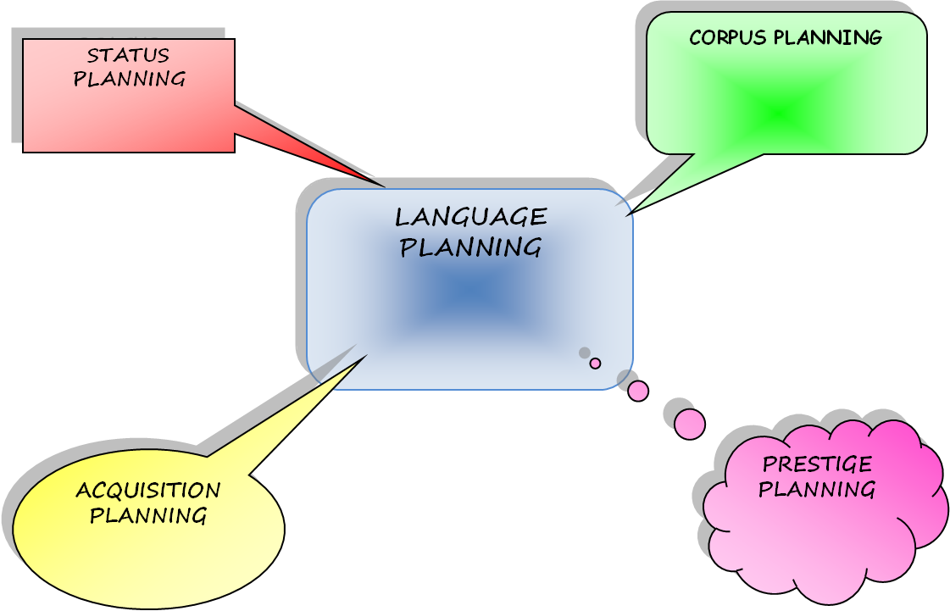
Language Planning
Language planning: the promotion and standardization of one variety of language.

Slide 8
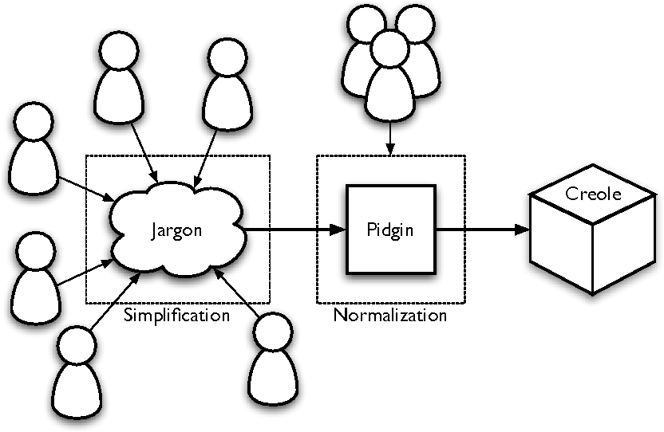
Pidgin and Creole
The birth and death of language. For example, Pidgin vs Creole (L1-pidgin first generation: such as Papua New Guinea)
Tok Pisin :
Gutpela de! - Good day!
Mi likim yu. - I like you. (I love you.)
Tankyu tru. - Thank you very much.
Mi likim wokim dispela. - I like doing this.
Em i gutpela. - It is good.
Mi no save. - I don't know.
Yupela wanem nem? - What is your name? (plural or formal)
Mi likim dispela hap. - I like this place.
Mi likim yu tru. - I really like you.
Mi likim kaikai. - I like food.

Slide 9
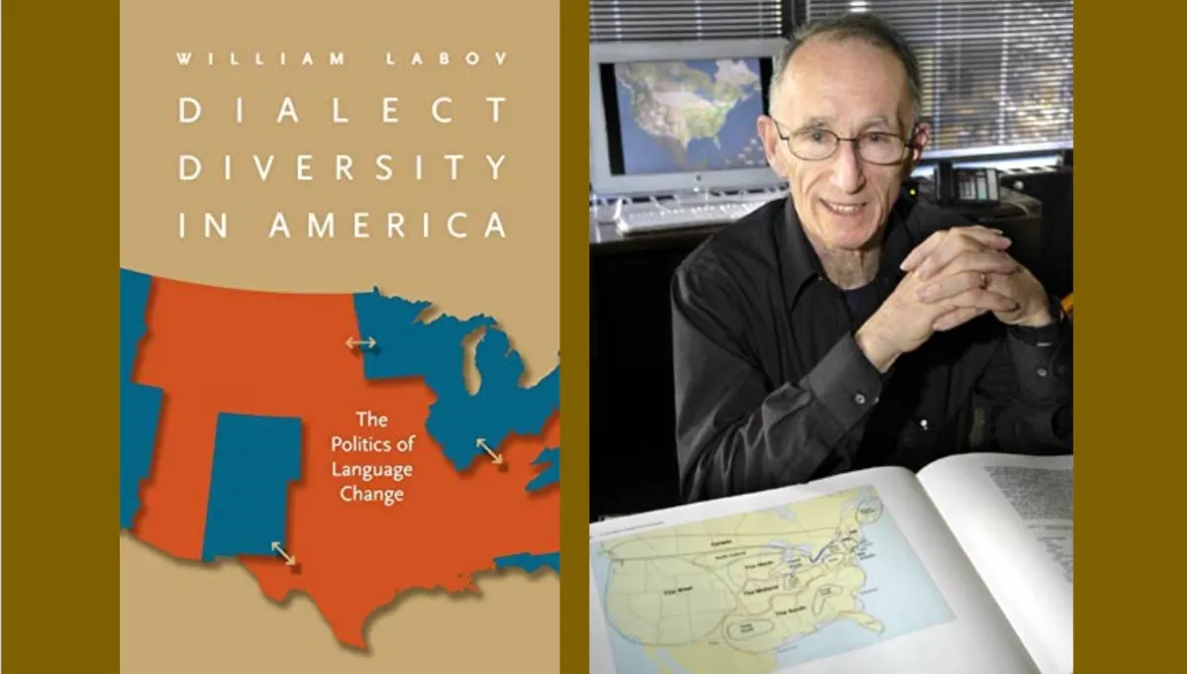
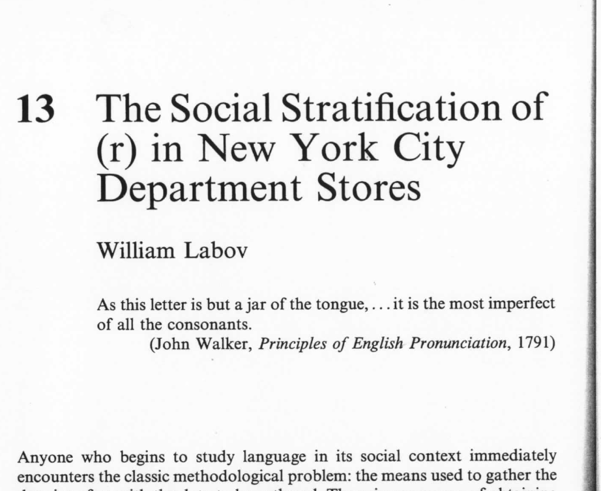
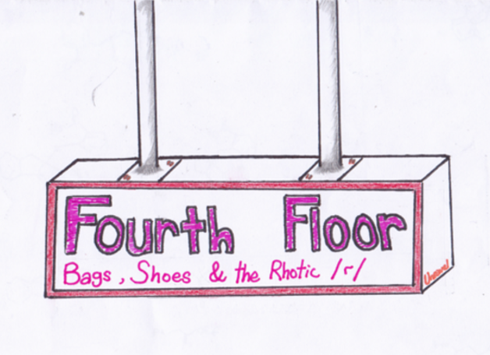
Linguistic variable
He found that the pronunciation of /r/ was influenced by factors such as social class, ethnicity, and neighborhood. In particular, he observed that speakers from higher social classes were more likely to pronounce /r/ in all positions, while speakers from lower social classes tended to exhibit a non-rhotic pronunciation, dropping the /r/ in certain positions.
Labov’s (1972) Social Stratification of (r) in New York City Department Stores : “Excuse me what floor is this?”

Slide 10
Phonological variable :
Non-/r/-pronouncers ‘tap’ against the back of the teeth (almost like a /d/)
Grammatical variation : African-American Vernacular English (AAVE)
Lexical variation : an American resume is a British CV, which is South African biodata
Non-/r/-pronouncers:
"car" pronounced as "cah" (common in parts of England and the southern USA).
"hard" pronounced as "hahd" (common in parts of Massachusetts).
Pronouncing /r/ as a 'tap':
"car" pronounced with a quick tap against the back of the teeth, resembling "cad" (common in the Scottish Highlands or the west of Ireland).
"hard" pronounced with a similar tap, resembling "hadd" (common in the same regions).

Slide 11
Issues in sociolinguistics: Fieldwork-based disciplines of natural environments:
Idiolect -- individual speaks in characteristic ways
Sociolect -- a language variety used by particular social groups.
Standard (standardization by government; classroom and public exam amination)and codification (e.g., grammar books, dictionaries, texts of religious) --- people called prestige
People judge non-standard (poor or incorrect) called stigmatized; attitude leads to the judgement.

Slide 12
Dialect and Accent
Region they come from : Northern vs American accent
What social class they belong
Whether or not the speaker is native speaker of the language
A dialect refers to a particular form of a language that is characteristic of a specific group of speakers. It encompasses variations in vocabulary, grammar, and pronunciation that distinguish it from other forms of the same language.
An accent, on the other hand, specifically refers to the way in which words are pronounced. It is a component of dialect but focuses on the pronunciation aspect.
When people say they have no accent, it means they are speaking in a standardized and prestigious accent.

Slide 13
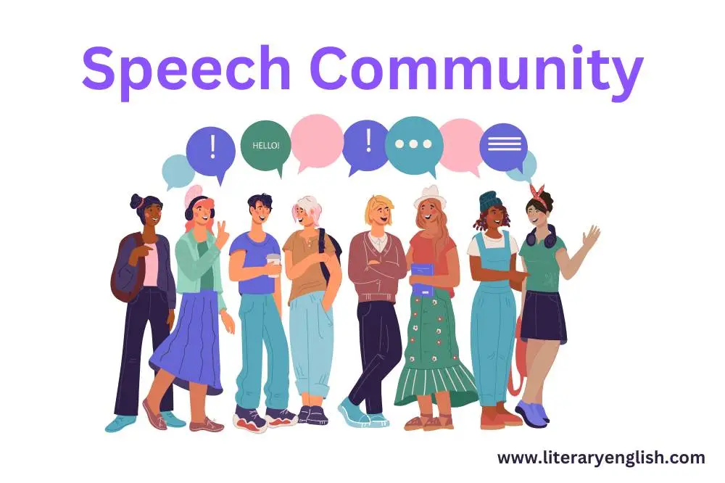
Speech communities
The way people speak often serves to define them as a group.
Speech communities are relevant to the group as defined by other non-linguistic means: nationality, age range, gender, town or city population.

Slide 14
Social factors correlating with language variation
Geographical and social mobility
Gender and power
Age (older vs younger people)
Audience (adjusting accents), that is called “accommodation”
Identity – personal, ethnic, geographical, political, family identities
Social network relations – individuals within a social group

Slide 15
Sociolinguistic research
Collecting and analysing data:
Natural field-work studies
Interviews
Questionnaires (spoken and written)
Thinking aloud protocols
informal to formal conversation awareness elicitation
Interpretating data:
Why variation occurs between speakers from the same speech community?
What function does the variation serve?
How does variation change?

Slide 16
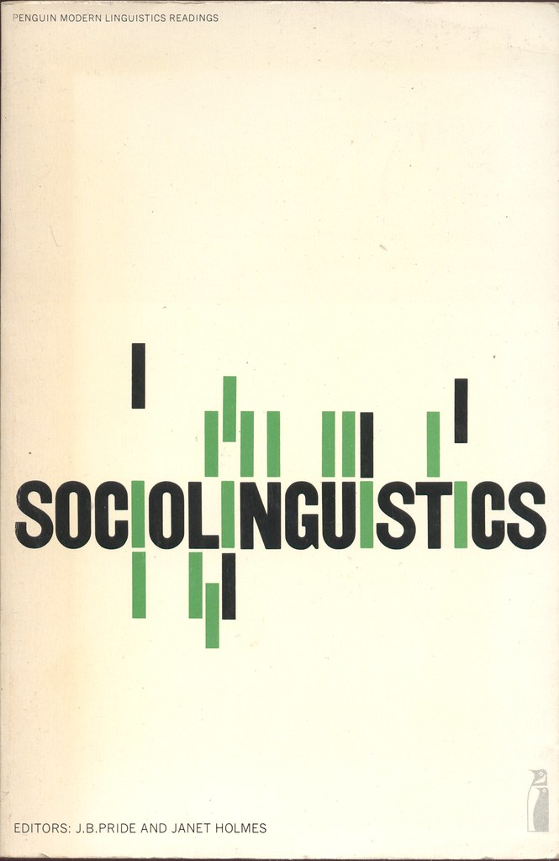
Applications of Sociolinguistics
Language formulation proposal for government policy on education
Language planning
Teachers’ references in the classroom (bad grammar)
Film actors imitating accents
This Photo by Unknown Author is licensed under CC BY-SA-NC

