Slide 1
REFLECTIONS ON LINGUISTICS MASTERY ---------------------------------------------------------------- Speaking and Pronunciation
By
Burns, Anne; Seidlhofer, Barbara. In N. Schmitt (Ed.), An Introduction to Applied Linguistics (pp. 240-57). Arnold.
Meeting 9
Notes:
Cohen = UCLA
Henry = Sweden focusing on L2 learners motivations

Slide 2
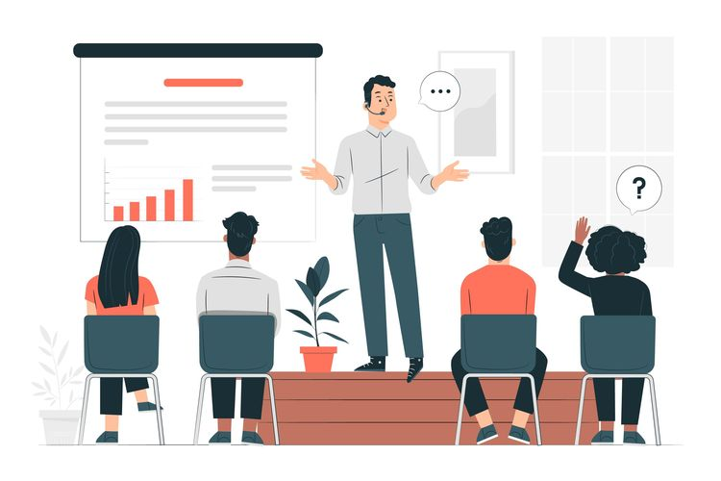
What are speaking and pronunciation?
So much part of daily life
Developing subtle and detailed knowledge about why, how, and when to communicate and complex skills for producing and managing interaction such as asking a question or obtaining a turn.
For social activity purposes
Speaking

Slide 3
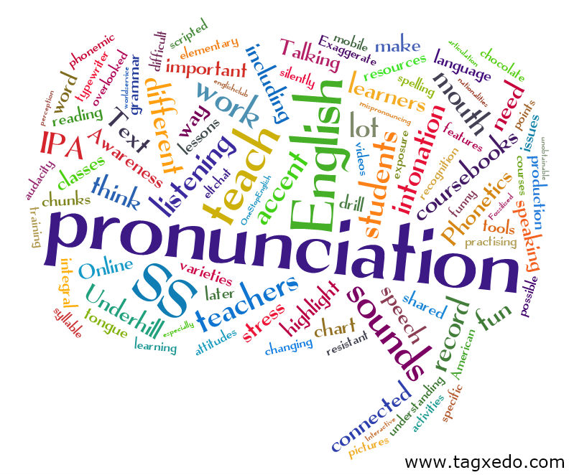
Pronunciation
The correlation with speaking : when saying e.g., “Thank you” in a loud or soft voice
For language teaching every spoken language lesson is a pronunciation lesson as well.
Showing identity, membership or a particular social group
Intelligibility matters

Slide 4
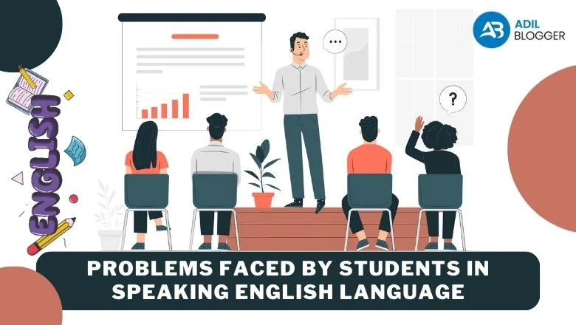
Issues in speaking
Spoken interaction between speakers and listeners (interlocutors) under the time constraints
Speakers need to know the relationship with other speakers,
Adjusting the language
Responding to verbal and non-verbal signal from their listeners
Taking turn : when to start and finish
Clauses are more productive in speaking than writing

Slide 5
Genres of speaking
Genre means to identify the kins of interactions in which the interlocutors are involved, for example speeches, jokes, doctor’s consultations, etc.
Transactional communication : an exchange of goods and service, for example booking a flight at a travel agent or phoning a careers’ center for information.
Motivation for interactional communication : to create and maintain social relationship, for example, casual conversation between friends

Slide 6
Generic structure
It refers to the overall way in which a text unfolds.
Abstract : summarize the main point “Did I ever tell you about …”
Orientation : the who, what, where, when
Complication : the main part of the story leading to a problem or crisis
Evaluation : the speakers’ reactions to the story
Resolution : story’s main players solve the problem
Coda : the story is brought full circle; makes a point about the text

Slide 7
Exchange
A way of showing ‘how speakers can keep taking turns’
Sinclair and Coulthard’s (1975) Initiation (I) – Response (R) – Follow-up (F) Exchange Format
It indicates response, shows our social and emotional reactions to the topic or shared understanding
Turn-taking can be difficult when there is a high competition or disagreement, unless indicating a sign ‘anyway’ or ’so’

Slide 8
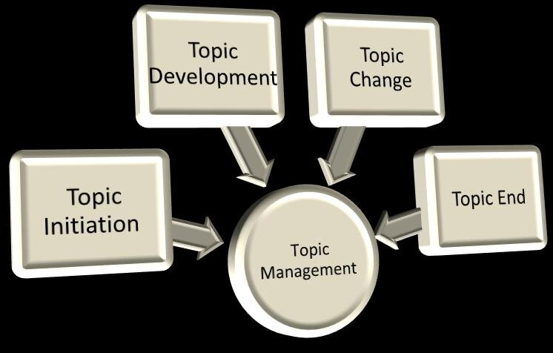
Topic management
Mutual understanding
Appropriate level of expliciteness
Discourse strategies utilization : clarifiying, summarizing or adapting to points make by other speakers

Slide 9
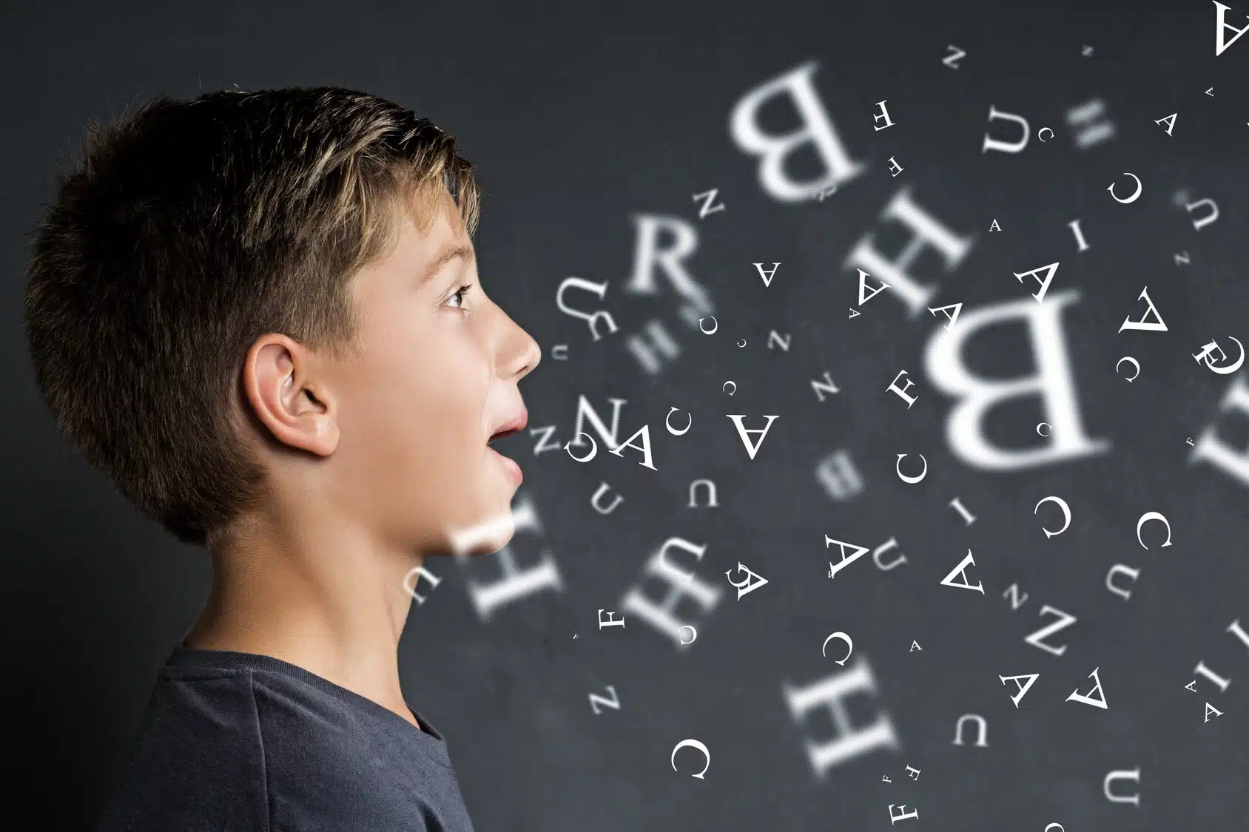
Issues in pronunciation
All aspects of how we employ speech sounds for communicating
How the actual sounds are produced
Elements of pronunciation from a simple word to a longer sentence
Suprasegmental (or prosodic) features

Slide 10
Tone units/chunking
How speakers use their voices to structure what they say by providing signposts for listeners, e.g., saying telephone number
Tone groups are indicated by pitch movement "//” also called tone – the voice going up and down.
Two units
// I lived in Halstat // and I had a really nice neighbour called Mahmud //
Three units
// I lived in Halstat // and I had a really nice neighbour // called Mahmud//

Slide 11
Prominence : Salient stress
Pitch movement on the syllables highlighted by capitals
E.g., NEIGHbour, sTAN

Slide 12
Introducing and ending topics
Pitch levels : low and high
“I don’t know what you mean by saying ...?”
// Sometimes HE used to cut the grass outside OUR place // and sometimes WE’D cut the grass outside HIS place //.

Slide 13
Pedagogical implications
Focusing on formal grammatical knowledge as the basis for communication on the sentence level
Evaluating proficiency in pronunciation, grammar, and vocabulary
Improving communicative competence
Scripted dialogue as a reference
Focusing on discourse-based activities
Conversational moves
Ear training for sound contrast, such as Bed vs Bad

