Slide 1
Speaking III
ENGLISH TO SPEAK OUT

Slide 2
4, 3, 2, TALK
PUT STUDENTS IN GROUPS OF THREE

Slide 3
ROLE
Student 1 speaks
Student 2 notes down the main points in the speech
Student 3 is the critical listener charged with giving feedback on specific features
(e.g. handling of verbs, use of connectives, range of vocab)

Slide 4
TOPICS
Talk to me about :
  Your relatives
  Your family expectation
  Friend of you
  Someone you know
    How long you have known?
    How did you meet him/her?
    What kind of person is she/he?
    Why do you like him/ her?

Slide 5
Jong Perfetti (2011) found that this activity enhanced their students performance. Nation (1989) identified the following improvements in his subjects:
  FLUENCY.
  ACCURACY
  CONTROL OF CONTENT.

Slide 6
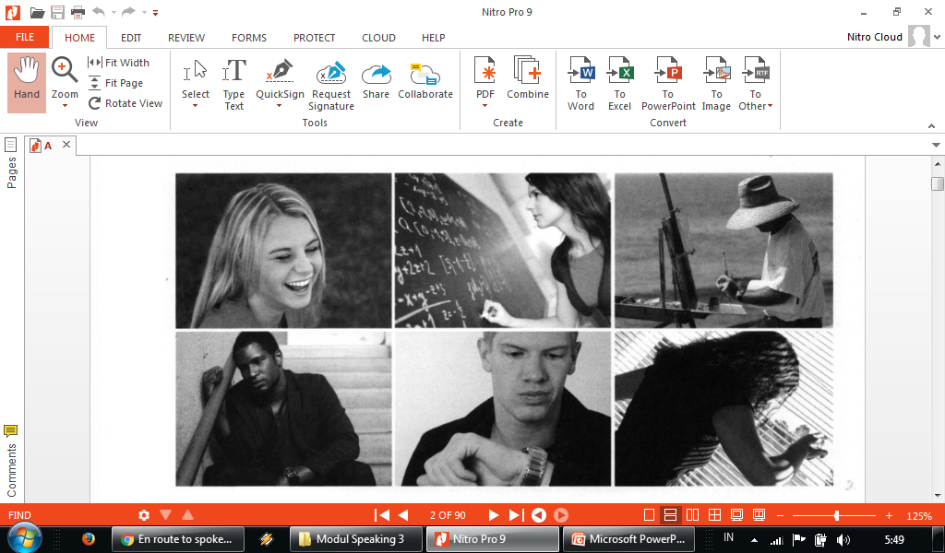

Slide 7
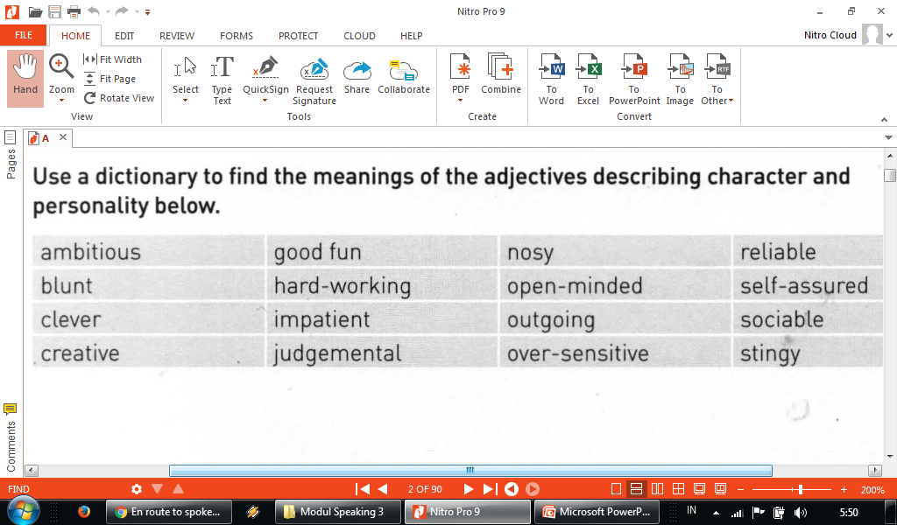

Slide 8
I consider my self to be ........
_{I would say I was .........}

Slide 9
