Slide 1
TALKING ABOUT SPORTS

Slide 2
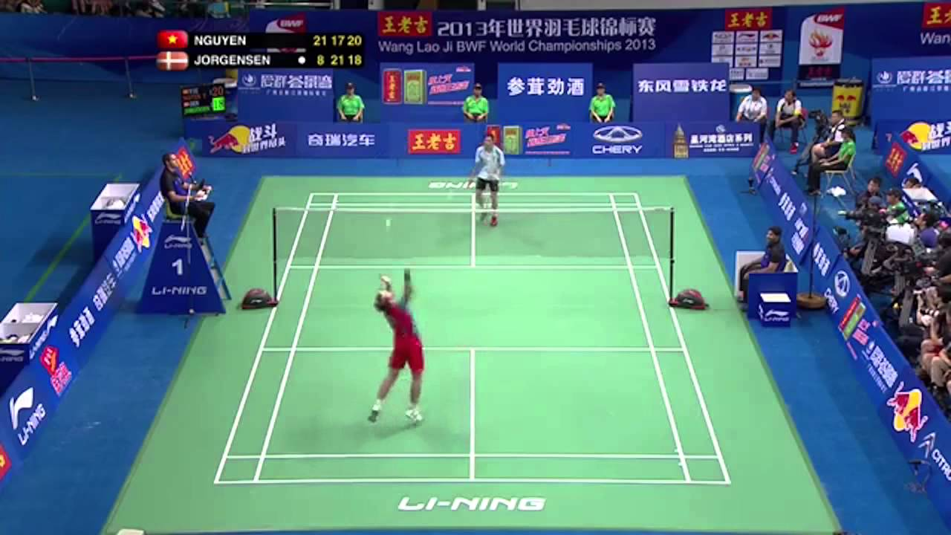

Slide 3
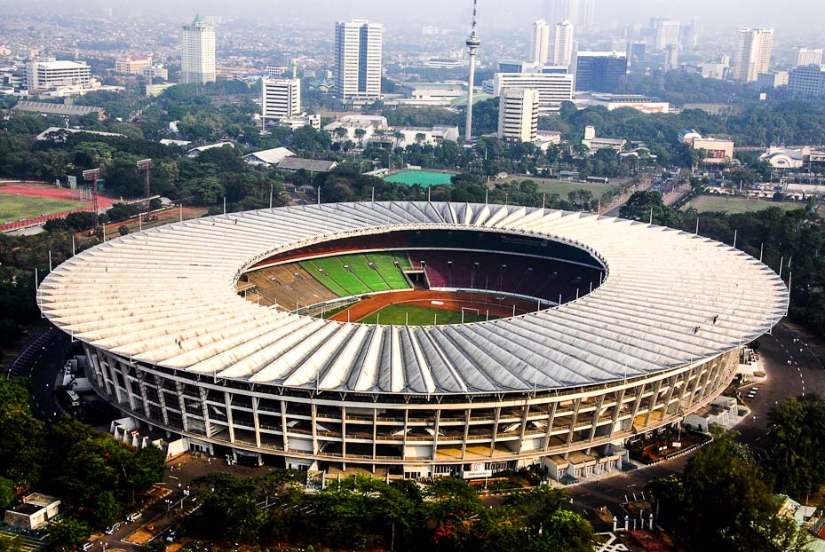
GBK Stadium

Slide 4
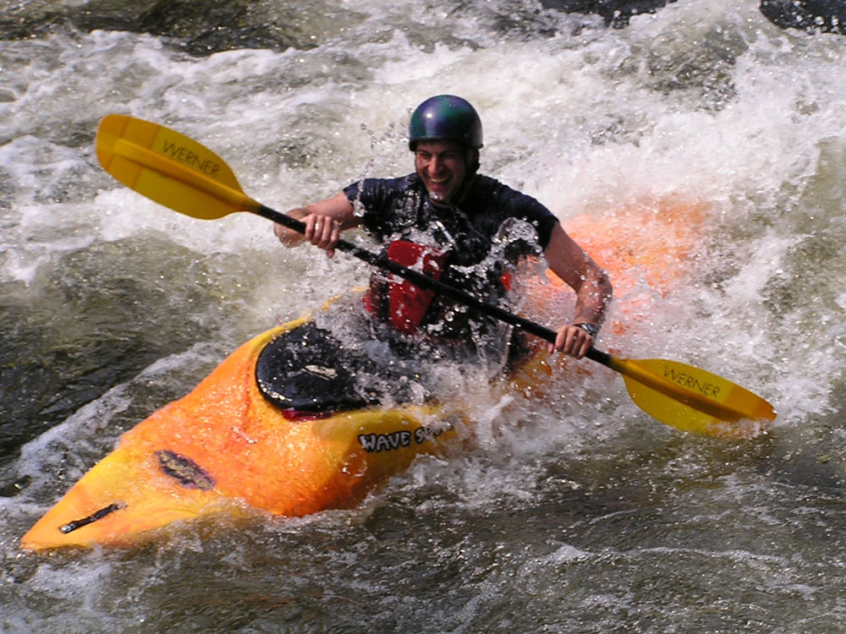
Kayaking

Slide 5
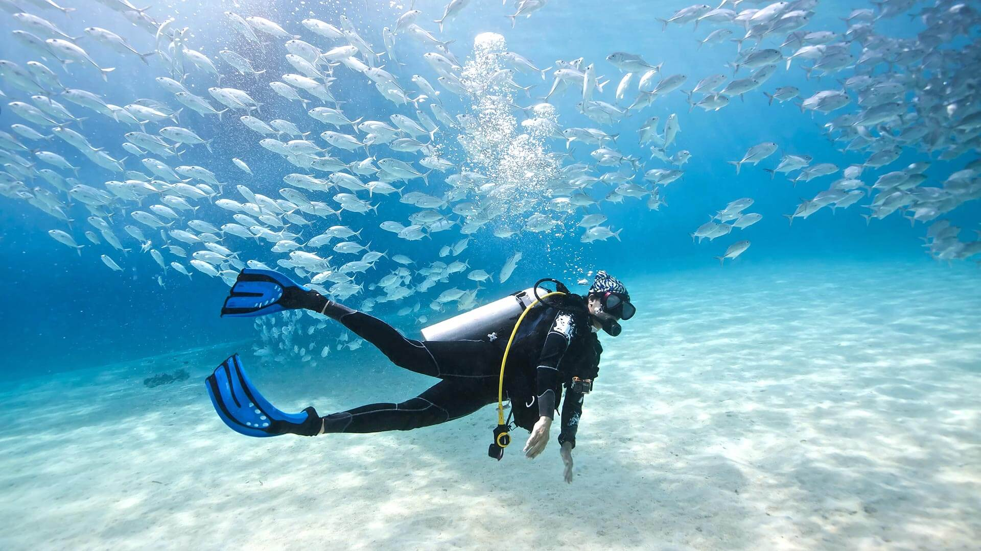
Scuba-diving

Slide 6
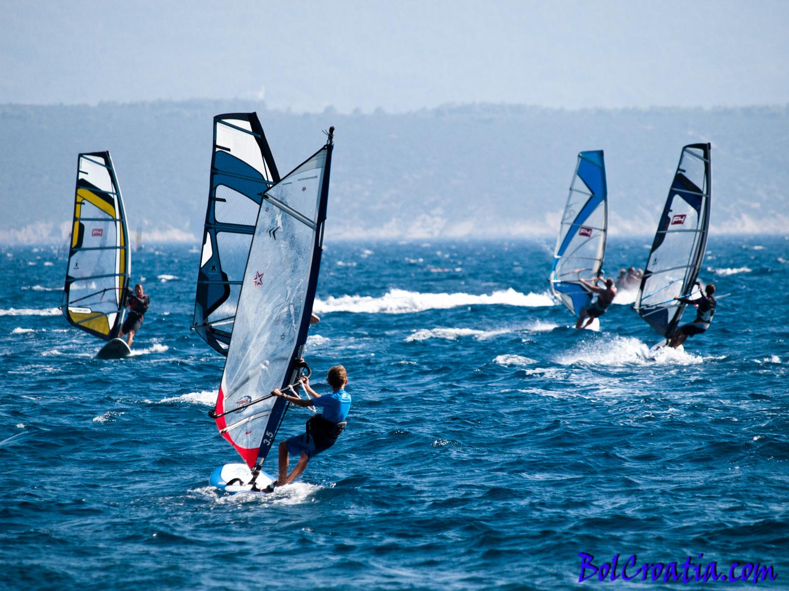
windsurfing

Slide 7
Abseiling

Slide 8
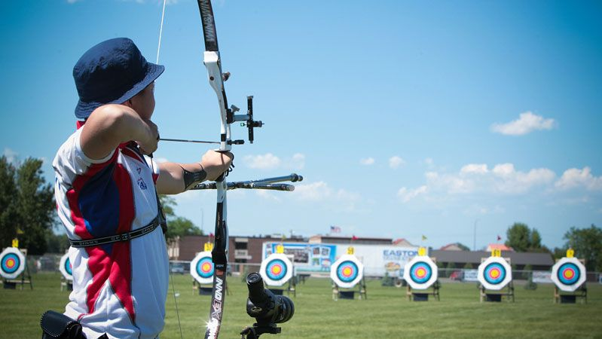
Archery

Slide 9
SPORTS QUESTIONS

Slide 10
Talk about a sport in your country.
you should say:
what sport it is
is it well developed in your country?
what is the most popular sport there?

Slide 11
QUESTION 1
Describe a game or sport you enjoy playing.
You should say :
What kind of game or sports it is
Who you play it with
Where you play it

Slide 12
QUESTION 2
Describe a game or sport you have participated.
You should say :
What was it
When you participated
How many people watched it

